Slide 1
How Should I Revise?
Notes:
Name of the game here is simplification. Obviously lots here is over-simplified but at this point, it’s about getting very basic messages across.

Slide 2
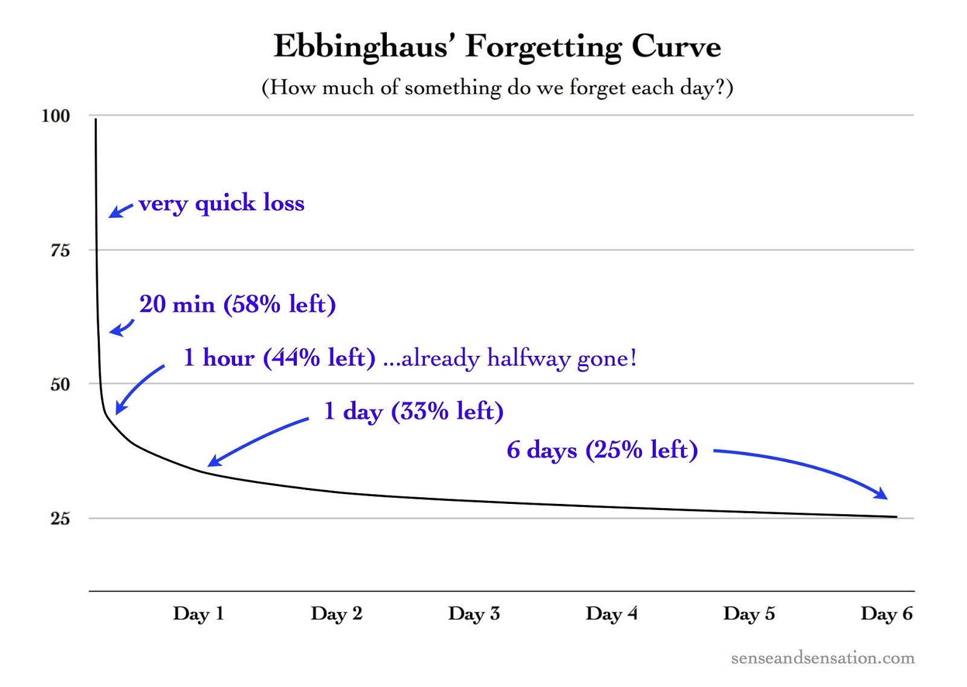
Know your enemy

Slide 3
Understanding vs. remembering
This session is about remembering
If you don’t understand something to start with, there is no point using the techniques we will cover
To understand better:
  Go talk to your teacher
  Get a textbook
  Check your notes
  Get a revision guide

Slide 4
Common study techniques:
Reading textbook/revision guide
Highlighting/summarising key words
Mnemonics
Summarisation
These are all common, but ineffective

Slide 5

Notes:
Point is using those methods will help you, but only a bit. Other methods will help you a lot more

Slide 6
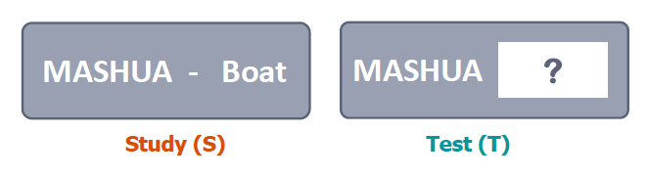
Karpicke and Roediger, 2008
Students learnt 40 words in a combination of study (S) and test (T) approaches
Notes:
Thanks to Efrat Furst here for providing some images which I have stolen ☺

Slide 7
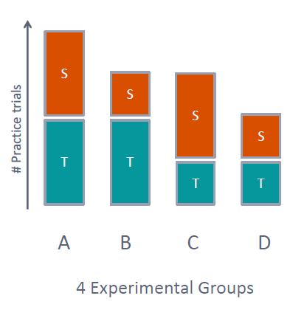

Slide 8
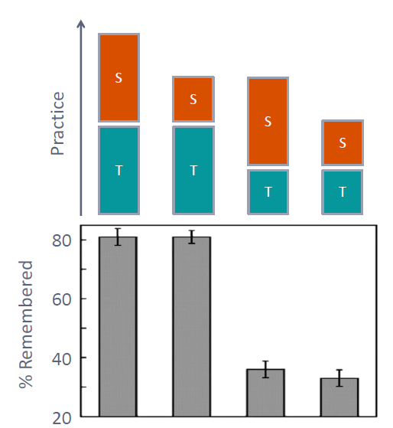

Slide 9
Memory reactivation – your brain is not like a computer
Notes:
If you open a file from your PC, no matter how many times you do so it won’t change unless you change it. This isn’t how memory works, the more times you forcibly “open” a memory the stronger it will become in the long term

Slide 10
Retrieval practice
Flashcard Q&A
  Convert your notes/the syllabus into Q&A
  Make sure you speak out your answer
  Have a friend/sibling/parent help you and hold you to account to get the correct answer
Questions
  Textbooks/worksheets
  Past papers
  Revision guides
  Ask your teacher for more resources
Generation effect
  Write down everything you know from memory. Check your notes, make corrections/additions, do it again

Slide 11
Spacing: making it even better
Notes:
Idea is to do a few topics in smaller chunks rather than one topic in one go. Also spread those out over time and come back to them

Slide 12
How will it help?
Will improve the strength of your memory of what you are trying to remember
Will actually make you less nervous in your exams!

Slide 13
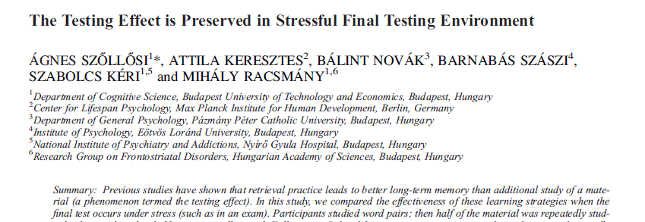

Slide 14

Stressful task
Study word pairs
Restudy word pairs
7 days
Non-stressful task
Group 1
Test on words
Stressful task
Study word pairs
Tested on word pairs
7 days
Non-stressful task
Group 2
Notes:
How to induce stress:
Therefore, participants in the
stress group were exposed to the Trier Social Stress Test
(TSST; Kirschbaum, Pirke, & Hellhammer, 1993), which
was developed to induce moderate psychosocial stress in
humans in laboratory settings. Participants had 5 minutes
to prepare for giving a 5-minute speech in front of two observers
(a male and a female) who had been introduced as
a board of experts in non-verbal behaviour. Following the
5-minute preparatory phase and the 5-minute speech, participants
were given a 5-minute arithmetic task. We told them
that audio and video recordings would also be made for later
analysing their behaviour (no recording was actually made).
Participants in the control group were exposed to a standardized
control version of the TSST (Het, Rohleder, Schoofs,
Kirschbaum, & Wolf, 2009), which was developed to be as
similar as possible to the original stress-inducing procedure
but without any socially stressful components (observers as
well as audio and video recorders).

Slide 15
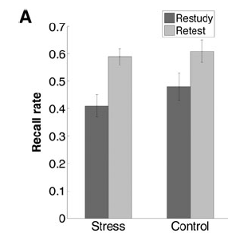

Slide 16
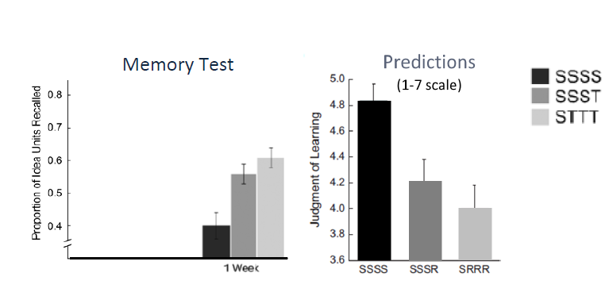
How do people feel about different methods?
Notes:
People who do retrieval practice think it isn’t having an effect

Slide 17
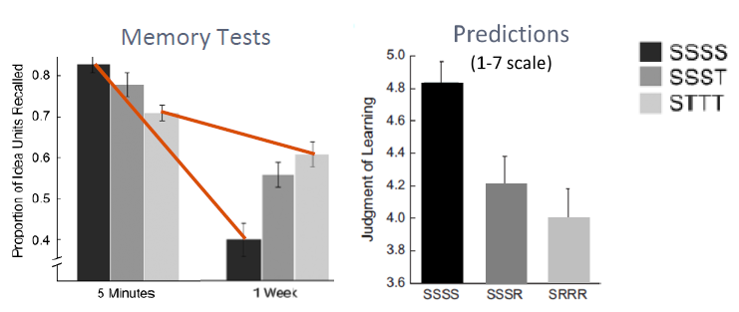

Slide 18
You must trust in the science!
Doing retrieval practice will feel like hard work that isn’t making a difference
You must trust that, in the long term, it will!

