Slide 1
Silly mistakes: why we make them and what we can do about them
Notes:
I introduce and say that during the course of the talk we will be explaining why you make mistakes in exams. NOTE FOR USE: this is a highly simplified presentation which aims to provide as much motivation and support to Y11+ as is possible. It is not a scientific treatise. I’ve tried to elaborate a bit in the notes to the slides.

Slide 2
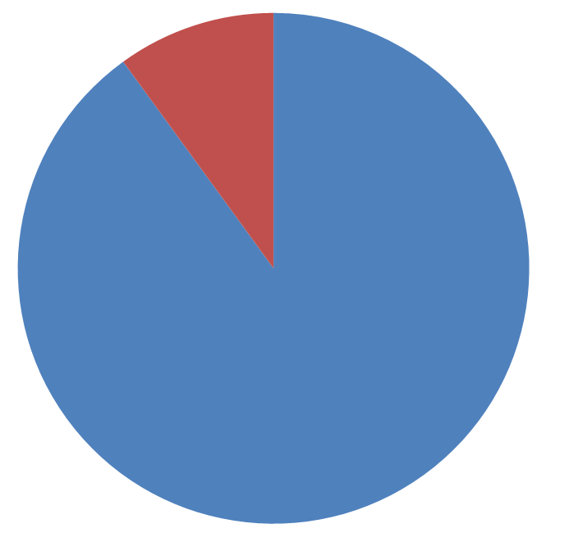
Why do we drop marks in exams?
Dropped marks for some other reason
Dropped marks because you did not know the material well enough

Slide 3
When you say you dropped a mark because of a “silly mistake” or because you didn’t “read the question,” this is your brain trying to get you off the hook and preserve your self esteem.
In reality, 9 times out of 10 you got the question wrong because you did not know the material well enough
Notes:
I made this statistic up. The point is to hammer home that they need to know the material as well as possible.
One could argue that the lack of knowledge even underlies the errors as discussed later but this is simplified for the kids.
Thanks to Rosalind Walker for putting it like this:
“Also I think a lot of "didn't read the question properly" is down to not having practised that type of question before. This is actually a deficit in content knowledge I think but doesn't seem that way to pupils - when they see the answer they think "oh yeah, I didn't realise the q was asking me to do that", they see knowledge as something you get before you can answer a question correctly, but I'd argue that pupils need to gain knowledge of different styles of question as well as declarative. Not that we can or should try to anticipate all possible questions, a range of styles trains you in what to look out for, I think. ”

Slide 4
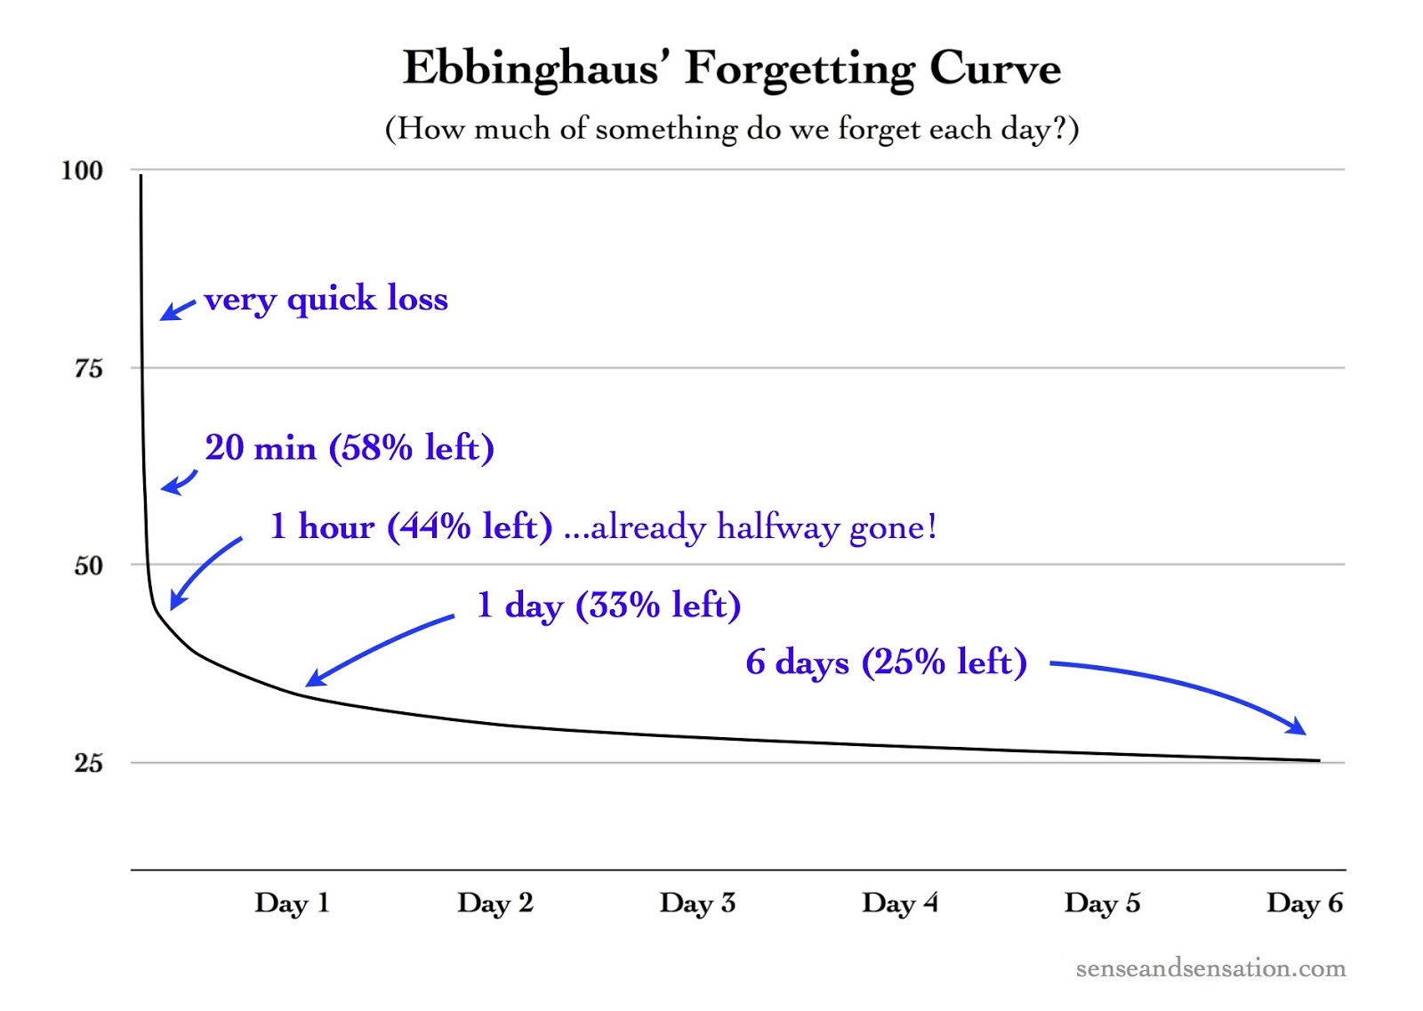

Slide 5
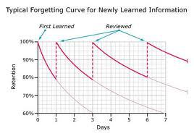
Notes:
From http://www.learningspy.co.uk/featured/deliberately-difficult-focussing-on-learning-rather-than-progress/ see also http://www.learningscientists.org/blog/2016/6/23-1

Slide 6
Take ownership of your mistakes. If you did not know the material well enough that’s your responsibility.
You can know the material better through the effective study strategies Don’t try to get around it with weak excuses.
Notes:
This is the most important message to get through to them.

Slide 7
So for the other cases, why have we made a mistake?
Stress can cause errors
Cognitive load theory

Slide 8
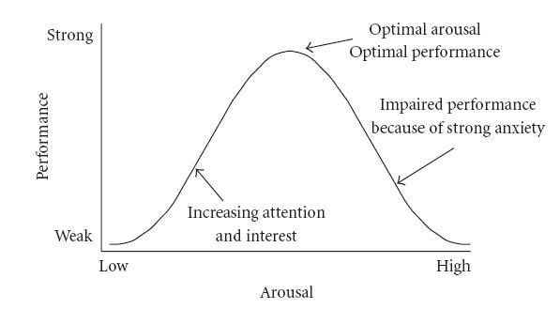
Notes:
This is the Yerkes-Dodson law. Essentially, we have an optimal amount of stress which improves performance. In exams students can sit towards the right of this curve. See here for a good piece about it https://chronotopeblog.com/tag/yerkes-dodson-law/

Slide 9
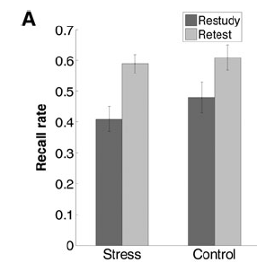

Slide 10
A little bit of stress is a good thing
Effects of stress can be minimised by using effective study strategies
Manage your stress before you enter the exam hall: generally, the more prepared you are the less stressed you will be
Notes:
Obviously there will be exceptions and there will be people who experience exam anxiety whatever the case. Those people should make themselves known to teachers etc.

Slide 11
Cognitive Load Theory

Slide 12
The working memory can hold approximately five items. This is universal.
Environment
Working memory
Long-term memory
This process is what we call learning – it only occurs with practice and thinking
Notes:
LTM is theoretically infinite. WM cannot be expanded – or, there have been no studies which show the ability to expand it through “brain training” and the like
Obviously this is simplified and there is a lot more which is important too, feedback, interspersed practice, engagement, focus etc. There are also different “loops” and subsets. This is based on Willingham’s simple model and suffices to get the point across.

Slide 13
CLT
Summary: human processing power is limited. If too much is demanded of the working memory, individual items will be ignored.

Slide 14
Question: Write the ionic equation for this neutralisation reaction. Include state symbols. (2)
“I made a silly mistake”
  What actually was the mistake?
“I didn’t read the question”
  You mean you stopped reading it in the middle of the sentence??
“I didn’t read the question carefully”
  Ok so what can you do next time?
“Read the question more carefully”
  How do you read something more carefully?
“Read the question more slowly”
  Do you really think that will help?
“Read the question again”
None of these pieces of advice addresses the main problem.
Notes:
The student in question wrote the ionic equation but forgot state symbols. These were the different things he said to me in our conversation about why he got it wrong. At one point I gave him the question again and said read it. Now read it more carefully. I don’t think that generally we can read things more or less carefully. Either we are reading, or we aren’t. I go through this as a dialogue.

Slide 15
Write the ionic equation for this neutralisation reaction. Include state symbols.
By the time you have got to the end of the first sentence your brain is thinking about a large number of different things
Your cognitive load is too high for you to take in the second part
Notes:
There were four ions to write about in this equation, think about their charges, how you work that out, what their symbols are and how that is constructed, what are the reactants, what are the products, what goes on what side, weaker students will even be needing to think about the fact that you draw an → and not an = sign in the reaction. That’s a lot of information.

Slide 16
So what do you do?
Check your answers?
If you do this, all you will do is actually check your answers
That means you will look at spelling, grammar and whether it makes sense – not whether you have actually answered the question
You need to check the question
Notes:
Common advice is to check your answers. I do not think this is good advice as it just leads to students reading through their answers. Much better to check the question. Note that checking your answers can be valid advice for extended calculation questions.

Slide 17
Read the question.
  Cognitive load: high
Answer the question.
  Cognitive load: high
Read your answer again.
  Cognitive load: low (WM is just looking at what is there – you aren’t having to construct your answer again)
Read the question again.
  Cognitive load: low (the question does not demand the WM to start preparing an answer – that has already been achieved)
Have you answered the question?
  Cognitive load: low
Notes:
This is my advice then

Slide 18
Read the question
Answer the question
Read your answer
Check the question

Slide 19
Common advice:
Read the question and check your answers
My advice:
Read your answer and check the question

Slide 20
Mr Boxer’s Top Tips For Exam Success
Make sure you know the material as well as you possibly can by using effective study techniques
Once you have answered a question, check both your answer and the question
Notes:
1 and 2 are obviously related by the fact that LTM supplements WM with knowledge to help “chunk.” See the Willingham links at the end of the slides for more. This is just about giving a clear message.

Slide 21
Further reading:
Willingham, Why don’t students like school?
Didau and Rose, Psychology: What every teacher needs to know
http://coral.ufsm.br/tielletcab/Apostilas/cognitive_load_theory_sweller.pdf
http://edrev.asu.edu/edrev/index.php/ER/article/viewFile/2025/545
https://gregashman.wordpress.com/2017/01/27/cognitive-load-theory-the-single-most-important-theory-for-teachers-to-know/
https://theconversation.com/why-students-make-silly-mistakes-in-class-and-what-can-be-done-48826
http://www.aft.org/sites/default/files/periodicals/WILLINGHAM%282%29.pdf
http://www.learningspy.co.uk/reading/problem-reading-along/
https://chronotopeblog.com/tag/yerkes-dodson-law/
Notes:
Some references here

