Slide 1
Evidence Based Practice in Marking and Feedback
Adam Boxer

Slide 2

Governmental priority
“Ensuring teachers of the future are equipped with an up-to-date understanding of the latest research and a desire to use evidence to inform their teaching practice is key to improving schools.”
Gibb, 2017

Slide 3

Schools have become expert at “faking improvement”
Put in a policy and use flawed evaluative methods to “prove” that it is having an effect
Fraught with methodological problems
This is not a deliberate process
Coe, 2013

Slide 4
Marking through the lens of:
Feedback as promoting student outcomes
Impact on workload
Ofsted’s requirements
Other affective justifications
Recommendations

Slide 5
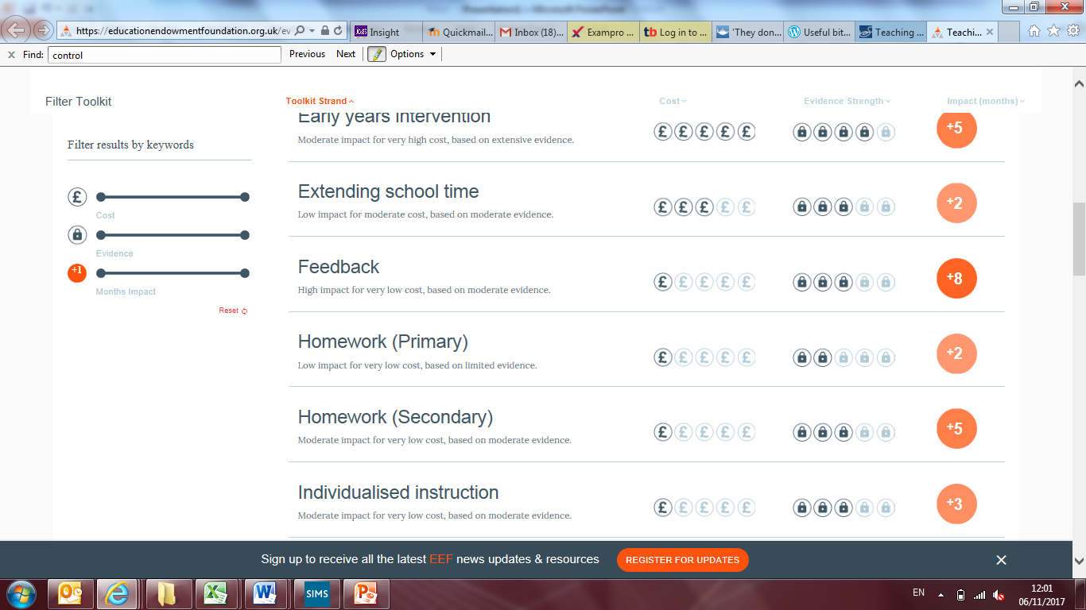
1a: Feedback – EEF Toolkit

Slide 6
Problems with meta-analyses
  Statistical errors
  Mask negative effects
Notes:
Although this is a criticism of Hattie, the EEF are just as vulnerable. In their technical appendix they list meta analyses and take a mean of their effect size. Not great.

Slide 7

Imagine if a school leader said to their colleagues, ‘We’re all going to do a new thing but there’s a one in three chance that we’ll be making things worse’; they would be unlikely to garner much support for their new initiative…
(Mannion, 2017)

Slide 8
The key point
Feedback is incredibly complicated
Policies must take into account the full range of evidence

Slide 9
1b: Marking and feedback
Marking is a sub-set of feedback
Carries the problems as mentioned above
Will only ever account for a small amount of feedback offered by teachers

Slide 10

1b: Marking and feedback

Slide 11
1b: Marking and feedback
The evidence is very clear:
  “The quality of existing evidence focused specifically on written marking is low”
  “This is surprising and concerning bearing in mind the importance of feedback to pupils’ progress and the time in a teacher’s day taken up by marking.” (EEF, 2016)
This means that any marking policy is based on no reliable evidence

Slide 12

1c: The cognitivist argument – what have you proved by your marking?
Predicated on the problem of transfer and the role of cues in memory (Willingham, 2002)
See also Soderstrom and Bjork (2015) on difference between learning and performance

Slide 13
2. Impact on workload
  Absolute workload
  Absolute cost

Slide 14

Absolute impact on workload – government working party

Slide 15
Absolute impact on workload – government working party
Marking…[is] an unhelpful burden for teachers…the time it takes is not repaid in positive impact on pupils’ progress.
teachers have less time to focus on the most important aspect of their job – teaching pupils.
cutting out the unnecessary frequency and depth of marking to create a manageable workload has clear benefits

Slide 16
My calculations…
1 KS3 piece a fortnight
3 KS4 pieces a fortnight
4 KS5 pieces a fortnight (at least)
145 pieces a fortnight
If each took 3 minutes (conservative!):
435 minutes
7.25 hours a fortnight
~138 hours a year
Conservative estimate of 1518 hours for the department
All aside from the time taken discussing marking in meetings, briefings etc.
Notes:
3 minutes is conservative once you take into account the fact that you take longer as you get through the pile. Also note that tests and mocks etc are included in the policy but can take significantly longer.

Slide 17
Investments
When you mark work, that time spent is “one off”
Compare to planning (or even data) where time spent is repaid in future years
It is a poor investment

Slide 18
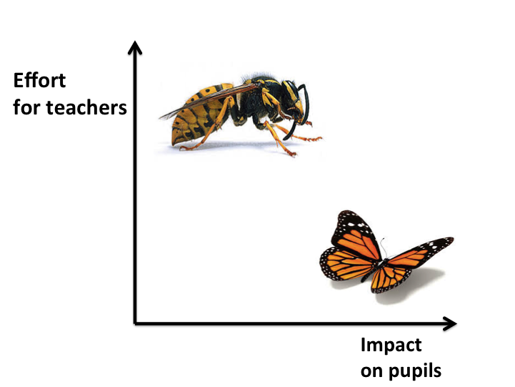
Notes:
The Michaela model. Do the butterflies, avoid the hornets. Based on Sir Tim Brighouse
https://pragmaticreform.wordpress.com/2015/06/06/hornets-and-butterflies-how-to-reduce-workload/

Slide 19
Absolute cost
EEF claims feedback costs are low
Must take into account that you are paying teachers to mark

Slide 20

“It’s time to decide what not to mark this weekend”
Stephen Tierney, 2017

Slide 21

Ofsted and performance management
3a. Ofsted’s use of marking
3b. Use of marking in performance management

Slide 22
“…there is remarkably little high quality, relevant research evidence to suggest that detailed or extensive marking has any significant impact on pupils’ learning.
inspectors should not report on marking practice, or make judgements on it, other than whether it follows the school’s assessment policy.”
(Harford, 2016)

Slide 23
But do they really?
Case study: Michaela Community School

Slide 24
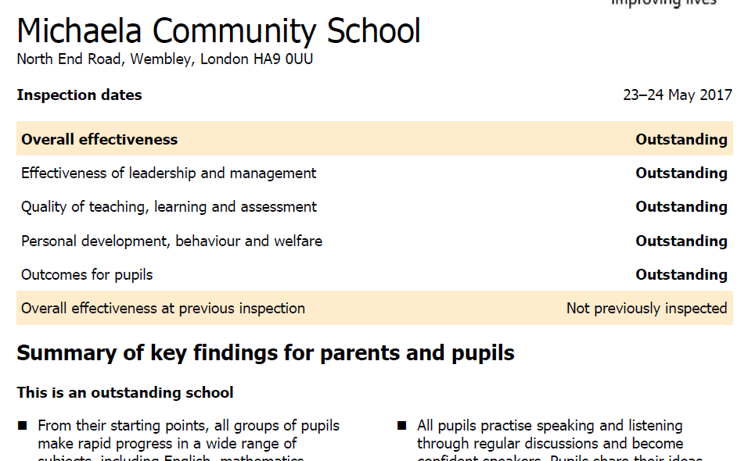

Slide 25
School | Progress 8 | Most recent Ofsted
The Cherwell School | 0.70 | Outstanding (2008)
Outwood Grange Academy | 0.51 | Outstanding (2012)
Bedford Free School | 0.17 | Good (2016)
Tadcaster Grammar | 0.17 | Good (2017)
Meols Cop | 0.06 | Outstanding (2012)
Heathfield Community College | 0.50 | Good (2016)
Aylsham High | 0.25 | Good (2014)
Haybridge High | 0.30 | Outstanding (2008)
Hackney New School | N/A | Good (2015)
Huntington Research School | 0.28 | Outstanding (2017)

Slide 26

Ofsted on workload
“Ofsted will also focus on ensuring that senior leaders consider the workload implications of policies before introducing them”
(Spielman, 2017)

Slide 27
JCoSS’s previous inspection
“…ensuring that all pupils’ work is thoroughly marked in line with the school’s policy to help them improve”
All changes mentioned above by Sean Harford are “regardless of any area for improvement identified at the previous inspection

Slide 28
3b – Use of marking in performance management
Ofsted:
“Inspectors will also not seek to attribute the degree of progress that pupils have made to marking that they might consider to be either effective or ineffective.
Finally, inspectors will not make recommendations for improvement that involve marking…” (Harford, 2016)

Slide 29
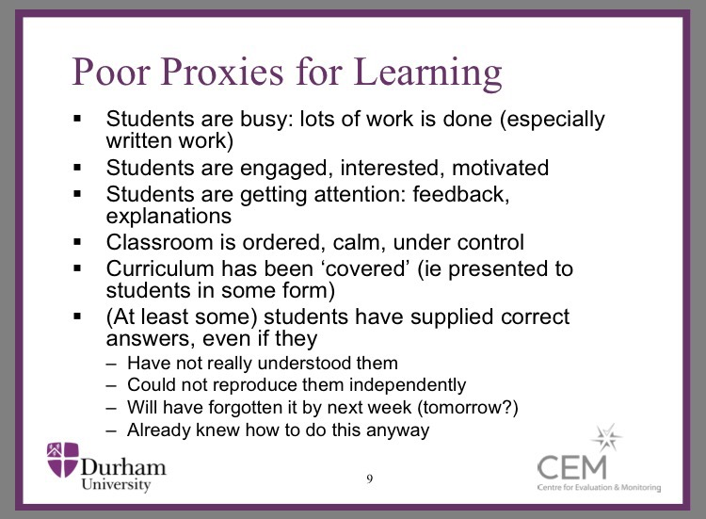
Proxies and Teacher Performance

Slide 30
Government workload review:
“providing written feedback on pupils’ work – has become disproportionately valued by schools”
“[marking] is serving a different purpose such as demonstrating teacher performance or to satisfy the requirements of other, mainly adult, audiences.
Too often, it is the marking itself which is being monitored and commented on by leaders rather than pupil outcomes and progress as a result of quality feedback.”

Slide 31
Campbell’s Law
“The more any quantitative social indicator is used for social decision-making, the more subject it will be to corruption pressures and the more apt it will be to distort and corrupt the social processes it is intended to monitor”
(Campbell, 1976)

Slide 32
Goodheart’s Law
When a measure becomes a target, it ceases to be a good measure
(Strathern, 1997)

Slide 33
Affective justifications
It shows students you care
Parents want it

Slide 34
My personal, anecdotal experience

Slide 35
Recommendations
Radically de-emphasise (eliminate?) the role of marking in assessing teacher and faculty performance
Any policy must be:
  Evidence based
  Subject specific
  Workload proportional to impact

Slide 36

“Ultimately, the DfE can do very little to reduce workload – it is up to school leaders to set a culture where staff are cared for, well-trained and valued and policies are based on common sense and the principle that we shouldn’t be doing things unless they clearly help improve student outcomes.” (Tomsett, 2017)

