Slide 1
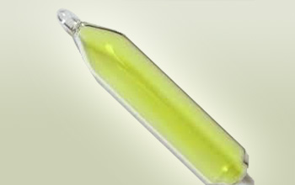
Covalent bonds
Notes:
Can start the lesson off through a discussion of bonding in fluorine. Students will try and draw some kind of ionic thing but it doesn’t work. This is where covalent bonding comes in. I like to then go through the bonding diagram for fluorine together on the board before doing the step by step.

Slide 2
When metals react with non-metals electrons are transferred to make an ionic bond.
When non-metals react with non-metals electrons are shared to make a covalent bond.

Slide 3
Example: Chlorine gas
Step 1: Write down the chemical formula:
Cl₂
Step 2: Write down what atoms you need and how many of them:
2 Chlorine atoms
Notes:
This is my step by step. Steps are on the left, specific example on the right. If they follow these steps it should carry them through any example and I like to get them to write them down.

Slide 4
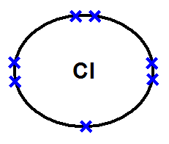
.
Step 3: Draw those atoms
We know that Chlorine is in group 7, so we can draw two chlorine atoms with just their outer shell

Slide 5
.
Step 4: Work out the number of electrons which would need to be shared (same as the number of electrons which are missing)
Notes:
In this case – one from each so they can go from 7 to 8.

Slide 6
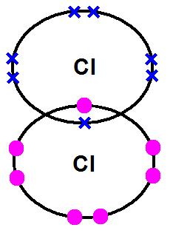
.
Step 5: Share the electrons!
Single covalent bond

Slide 7
.
Step 6: Count to make sure you got it right
Single covalent bond
Notes:
This is crucial – you need to make sure you haven’t magicked up any electrons. Each atom still has seven atoms and fourteen between them. Often students will kind of just make it up and then get stuck because they’ve thrown in a random electron. You may want to show a wrong example.

Slide 8
Step 1: Write down the chemical formula:
Step 2: Write down what atoms you need and how many of them:
Step 3: Draw those atoms (just outer shell)
Step 4: Work out the number of electrons which would need to be shared (same as the number of electrons which are missing)
Step 5: Share the electrons!
Step 6: Count to make sure you got it right

Slide 9
Example: Oxygen gas
Step 1: Write down the chemical formula:
O₂
Step 2: Write down what atoms you need and how many of them:
2 oxygen atoms

Slide 10
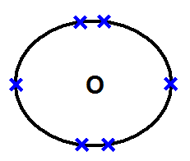
.
Step 3: Draw those atoms
We know that oxygen is in group 6, so we can draw two oxygen atoms with just their outer shell

Slide 11
.
Step 4: Work out the number of electrons which would need to be shared (same as the number of electrons which are missing)
2 electrons to be shared
Notes:
In these case two from each

Slide 12
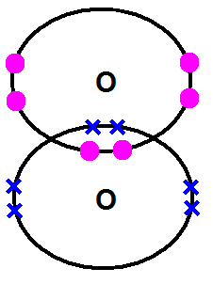
.
Step 5: Share the electrons!
DOUBLE covalent bond

Slide 13
.
Step 6: count the electrons
DOUBLE covalent bond

Slide 14
Questions 1-9

Slide 15
Covalent Substances

Slide 16
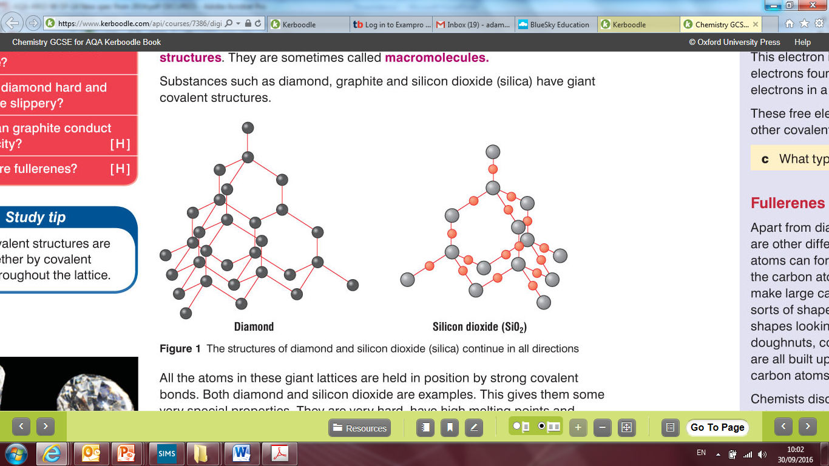

Slide 17
A 1 carat diamond ring weighing 0.2g has approximately 60000000000000000000000 atoms

Slide 18
Solid
Gas

Slide 19
Read page 2 and answer Q10-20

Slide 20
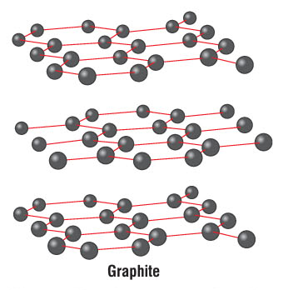
Graphite is an exception
Layers of carbon atoms. Each atom is covalently bonded to three others
Electrons are free to travel between the layers – they are delocalised. This is why graphite conducts electricity.
The layers themselves are strong but are free to slide over each other like a pack of cards. This means graphite is soft and slippery.

Slide 21
Q21-25

Slide 22
Simple Molecules

Slide 23
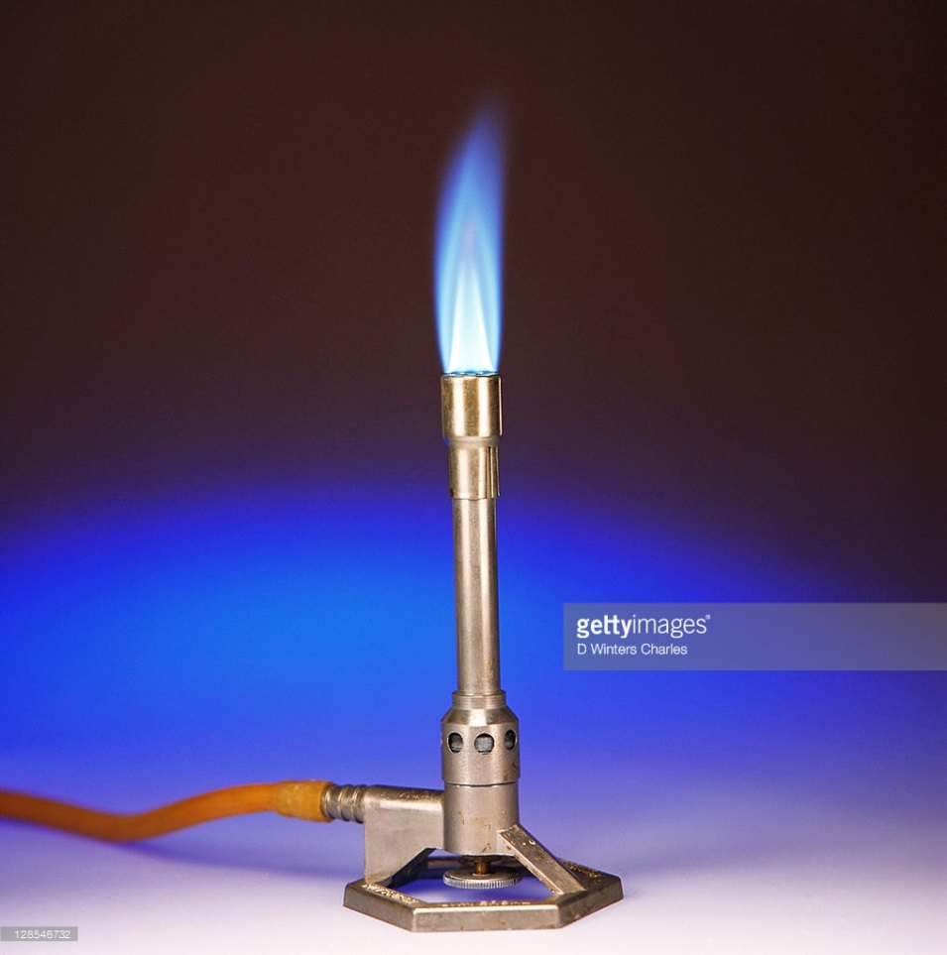
Methane
Notes:
Draw out methane. Ask why it is a gas at room temperature when other covalent substances are not

Slide 24
H
H
H
C
H
H
C
H
H
H
H
Strong covalent bonds within the molecule
H
C
H
Weak forces between the molecules so easy to pull away from each other
H
H
H
C
H
H
H
H
C
H
H

Slide 25
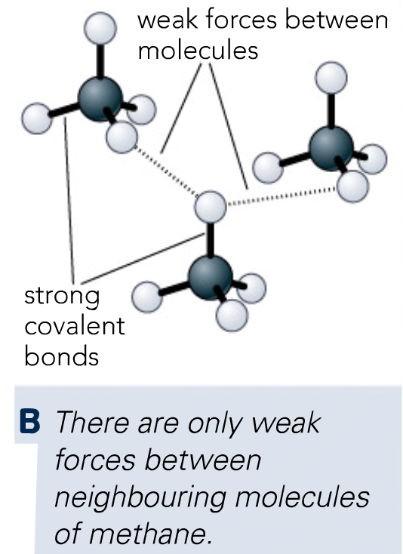
VS.
Notes:
Principle is the same for methane, water, carbon dioxide, any simple molecular substance going really.

Slide 26
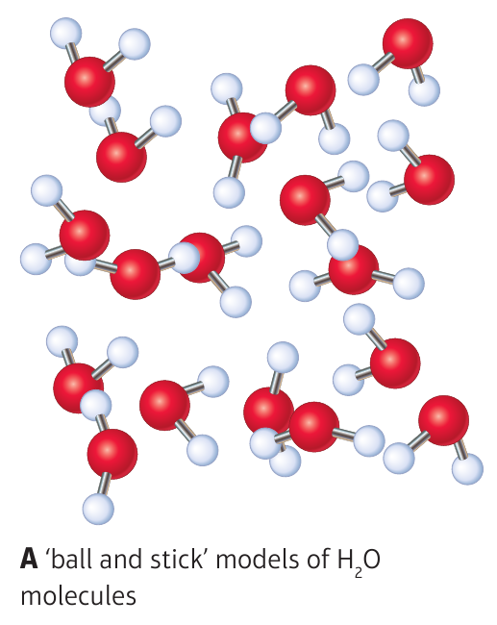
Notes:
Principle is the same for methane, water, carbon dioxide, any simple molecular substance going really.

Slide 27
 | Diamond | Methane
Similarities
Bonding | Covalent | Covalent
Atoms | Involves carbon | Involves carbon
Conduct electricity | Does not conduct | Does not conduct
Differences
Bonding | Strong bonds throughout the substance between billions of atoms | Strong bonds within individual molecules of only five atoms. Weak forces between these molecules
Melting and boiling points | High | Low

Slide 28
Q26-29
Notes:
There is a cool video about water on the Active Teach. However, it goes into quite a bit more detail than is necessary half way through but for a triple set you will definitely want to get into why ice floats on water etc.

Slide 29
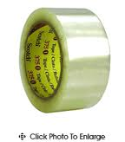
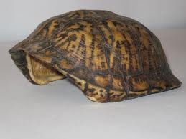
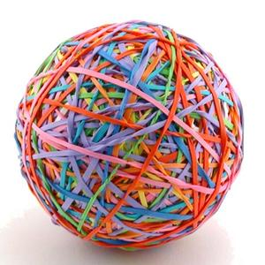
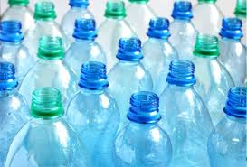
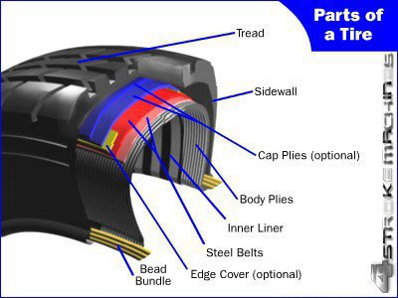
Polymers

Slide 30
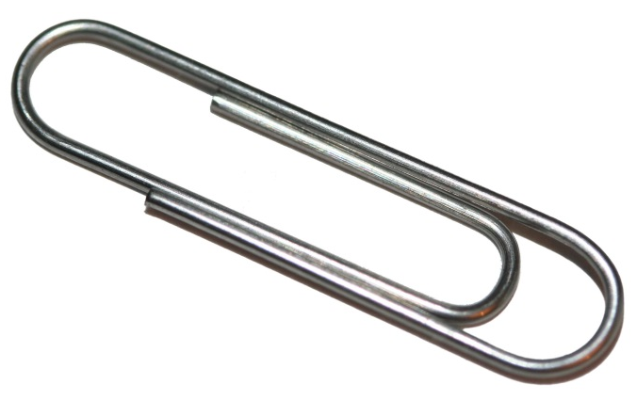
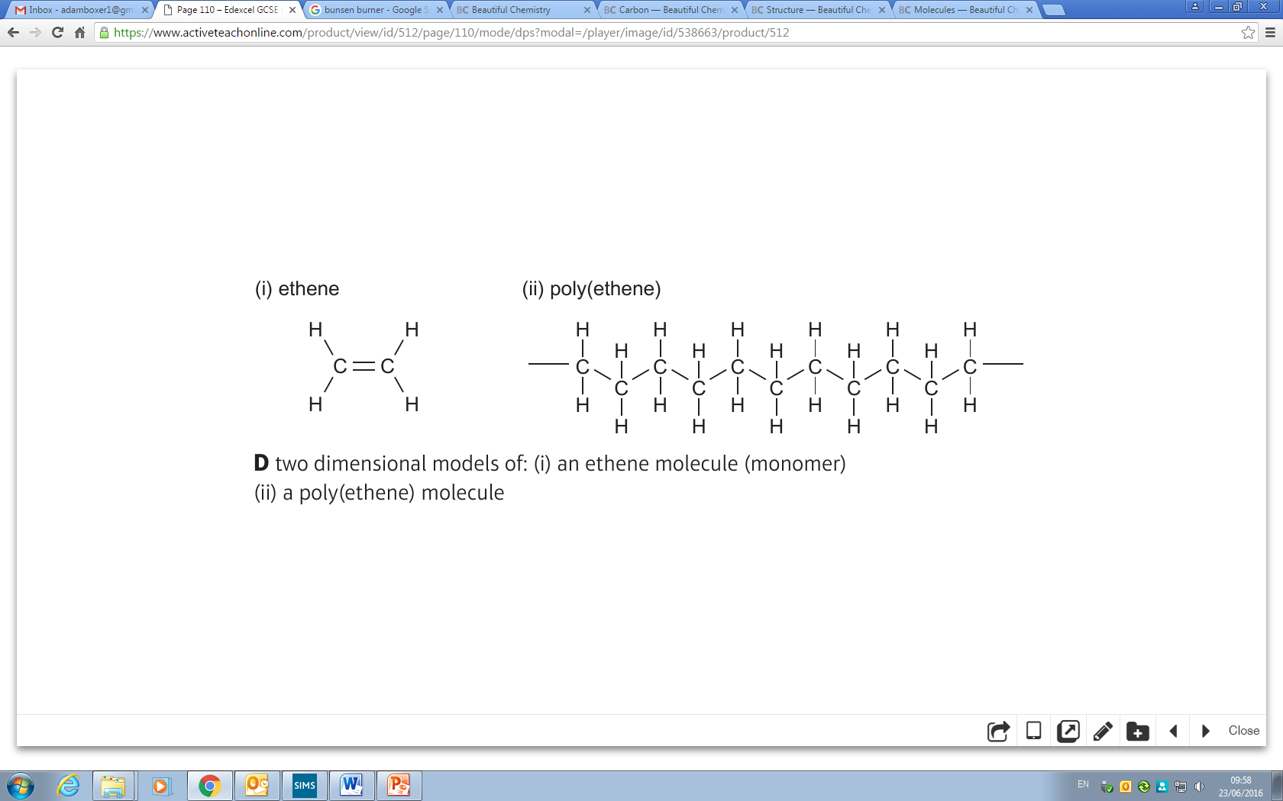
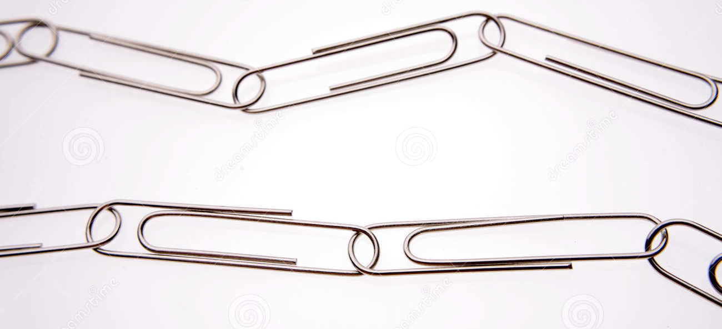

Slide 31
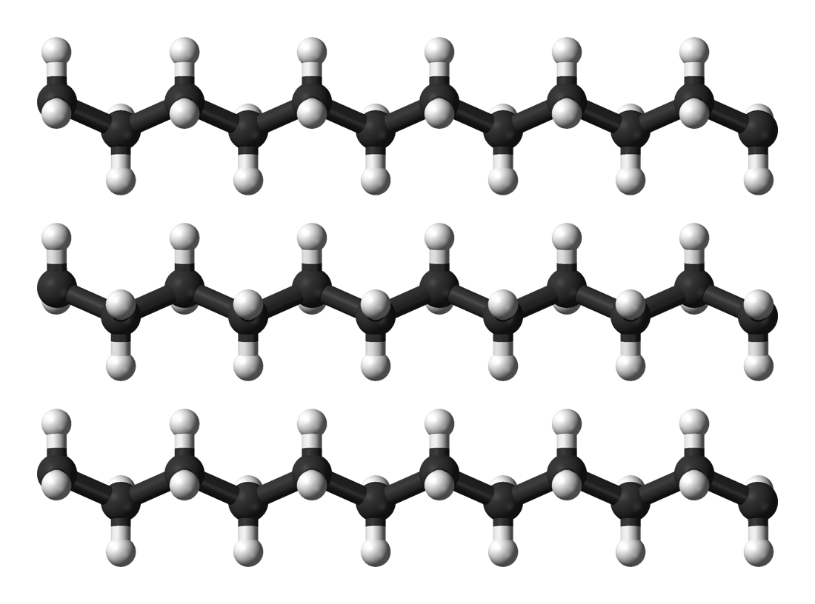
Strong covalent bonds between atoms in the chain
Weak forces between the chains

Slide 32
Q30-35

Slide 33
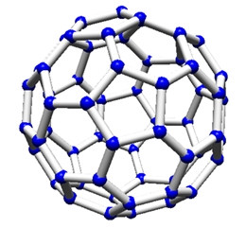
Graphene, fullerenes and nanotubes
Notes:
Graphene is new spec only

Slide 34
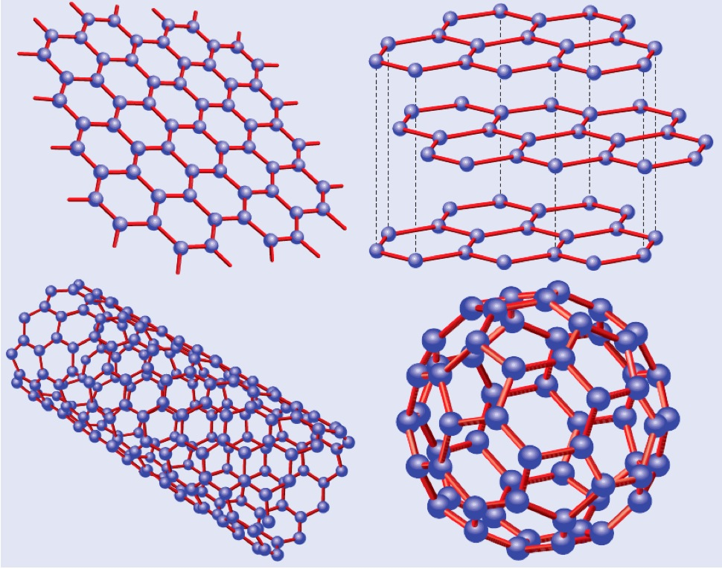

Slide 35
Political and scientific background
https://www.youtube.com/watch?v=wHW_2CUF4zM
http://www.bbc.co.uk/news/science-environment-32100071
Scishow: https://www.youtube.com/watch?v=Mcg9_ML2mXY
Notes:
Graphene is now in the syllabus. I’m sure it has nothing to do with massive uk funding into it… you could look at the videos/political background if you want or just launch straight into it. First video is Osborne waffling on about the Northern Powerhouse and graphene’s place in it. Second article is about the graphene light bulb (which you can later direct interested students to). Third link is a scishow video about it.

Slide 36
Summary questions

