Slide 1
The Atom

Slide 2
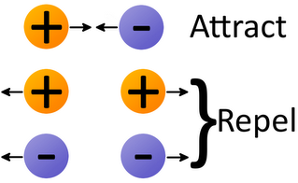
All particles have charge

Slide 3
Neutral charges are neither attracted nor repelled

Slide 4
The concept of charge has allowed us to make lots of discoveries about the atom

Slide 5
Different models of the atom
+
-
-
-
-
-
-
+
+
-
-
-
-
-
-

Slide 6
Complete questions 1-5 on page 1

Slide 7
+
-
-
-
+
-
+
-
-
-
-
+
+
-
-
-
-
+
+
-
-
-
-

Slide 8
-
-
+
+
-
-
-
-
+
+
-
-
-
+
-
+
-
-
-
-
+
-
-

Slide 9
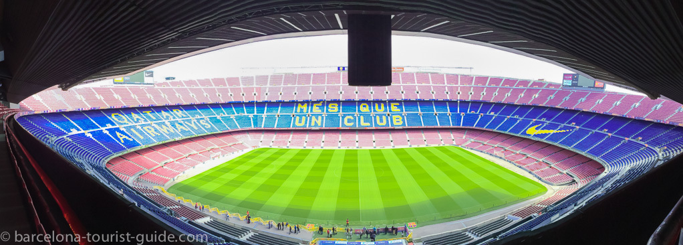
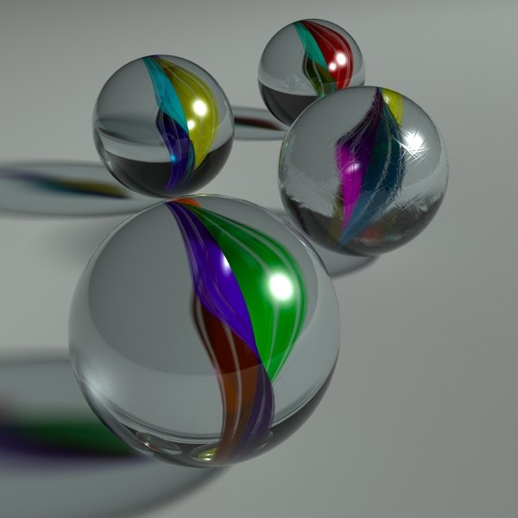
If you blew up an atom to the size of a football stadium……
……the nucleus would be the size of a marble
Notes:
The nucleus of an atom is staggeringly tiny compared to the overall size of the atom. Interestingly, this means that actually most of everything is nothing. Mind blown. I like to compare this to a kitchen sieve. If we hold it close to our eyes or if we were really tiny we would see that most of it is empty space. However, if we hold it at arm’s length you can’t really see the holes any more and it looks like a continuous surface. Now imagine if you took the material from a sieve, flattened it out and then replicated it in layers on top of itself – you definitely wouldn’t be able to see through it and it would appear as a solid object. This also of course means that the majority of the mass of an atom is concentrated in the nucleus which leads on to the next video.

Slide 10
Read page 2 silently and answer the questions

Slide 11
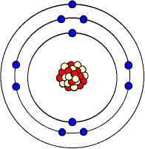
Label the diagram on the sheet. Answer questions 10-17
This is an electron. It travels around the nucleus
Protons and neutrons can be found in the nucleus
This is the nucleus – the centre of the atom
There is only empty space in between the nucleus and the shells
This is a shell. It shows the path the electrons take as they go around the nucleus
Notes:
This is on their worksheet so they can start labelling.

Slide 12
Relative masses of protons, neutrons and electrons
Mass:
70kg
35kg
140kg
10kg
Relative mass:
1
1/2
2
1/7
Notes:
This can be difficult to explain. I normally use it by imagining four different people as above. I then say that if there were only four types of people in the world I would ignore their actual masses, call one of them “1” and fit the rest relative to 1. To explain the fact that electrons have negligible mass I give an example of when I went to a doctor to be weighed, and then afterwards I told her that the measurement was invalid as I had cut my toenails last night. Nobody cares – their mass is negligible compared to the rest of me. But if my toe nails were 100m long, then it would count.

Slide 13
 | Proton (kg) | Neutron (kg) | Electron (kg)
Mass | 1.67 × 10⁻²⁷ | 1.67 × 10⁻²⁷ | 9.11 × 10⁻³¹
Relative mass | 1 | 1 | 0
Notes:
To explain the fact that electrons have negligible mass I give an example of when I went to a doctor to be weighed, and then afterwards I told her that the measurement was invalid as I had cut my toenails last night. Nobody cares – their mass is negligible compared to the rest of me. But if my toe nails were 100m long, then it would count.

Slide 14
Answer questions 18-24

Slide 15
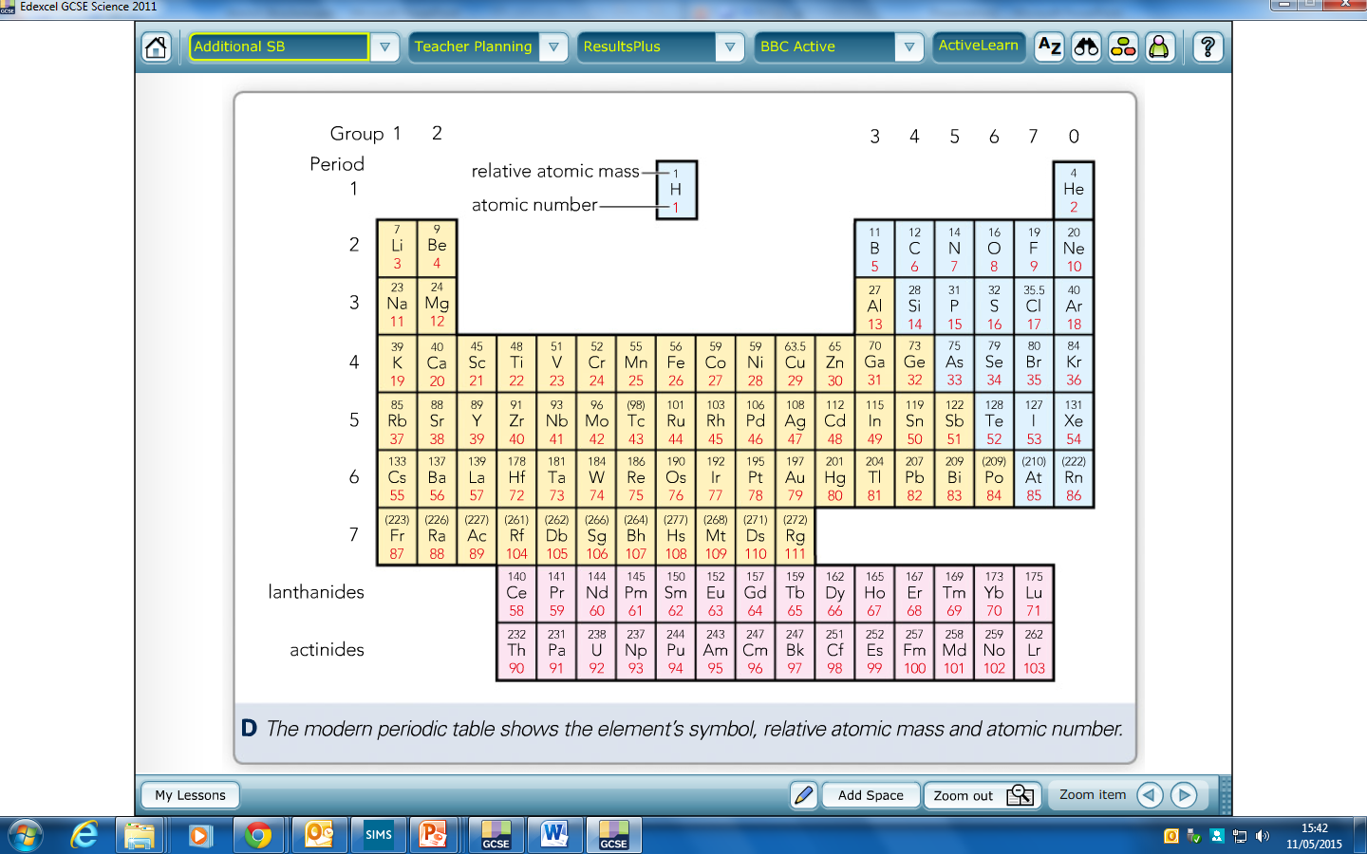
Notes:
Group numbers, period numbers, atomic numbers, mass numbers, metals vs. non-metals – all of these things are relevant.

Slide 16
Atomic number – the small number
Total number of protons in an atom
Mass number – the big number
Total number of protons +neutrons in an atom
To work out number of neutrons:
mass number – atomic number
Notes:
It doesn’t matter which way up the numbers are. Some periodic tables have big ones on the bottom and small ones on the top and others vice versa. Doesn’t really matter – one is small and one is big.

Slide 17
Eg 1: Helium
Eg 2: Lithium
Eg 3: Chromium (Cr)
Read page 4 and answer questions 25-27
Notes:
Go through each of these using the big number and the small number to show how many protons, neutrons and electrons are involved.

Slide 18
Isotopes

Slide 19
Chlorine
Atomic number: 17
Mass number: 35.5
Difference: 18.5
Notes:
Most students will answer that there are 18.5 neutrons. Discuss the fact that this doesn’t make sense as you can’t have half a neutron

Slide 20
Cl-35
p = 17
n = 18
Cl-35
p = 17
n = 18
They are called isotopes – atoms of the same element (so same number of protons) but with different numbers of neutrons
Cl-37
p = 17
n = 20
They have to have the same number of protons otherwise they would be different elements
Cl-35
p = 17
n = 18
They can have different numbers of neutrons – neutrons are like the glue that holds the nucleus together
If three have a mass of 37 and 1 has a mass of 35, what is the mean mass?
Notes:
I like to explain how this works step by step as per the animations. Start with one atom, then move to another one and discuss the similarities and differences. Then throw another two in and show that the mean mass is 35.5

Slide 21
Read the worked examples and do questions 28-32

Slide 22
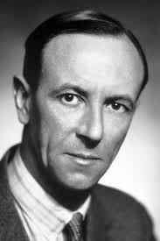
Chadwick!

Slide 23
Chadwick used an experiment to discover the neutron
This allowed scientists to explain the existence of isotopes
As isotopes have same number of protons but different number of neutrons

Slide 24
Electronic Structure – electrons determine how an atom reacts.
There are the same number of electrons as protons in an atom
This means the charges balance

Slide 25
Electronic Structure
-
-
-
-
+
+
-
-
-
-

Slide 26
Examples:
Lithium
Neon
Potassium

