Slide 1
Ions

Slide 2
Atoms and overall charge
Oxygen
Q1-6
Start reading the next section

Slide 3
Lithium
No overall charge
Loss of electron
Gain of electron
Q7-24

Slide 4
Full outer shells
Sodium, oxygen and fluorine
Q25
Start reading ahead

Slide 5
Question 5
Element name and symbol | Group | Number of electrons in outer shell | Will it lose or gain electrons? How many? | Charge on ion
Lithium, Li | 1 | 1 | Will lose one | Li⁺
Beryllium, Be |  |  |  | Be²⁺
Oxygen, ____ | 6 | 6 | Gain two | O²⁻
_________, N
Boron, B
Fluorine, _______
 |  |  |  | P³⁻
 |  |  |  | Rb⁺
Extension: start reading ahead

Slide 6
Element name and symbol | Group | Number of electrons in outer shell | Will it lose or gain electrons? How many? | Charge on ion
Lithium, Li | 1 | 1 | Will lose one | Li⁺
Beryllium, Be | 2 | 2 | Will lose two | Be²⁺
Oxygen, O | 6 | 6 | Will gain two | O²⁻
Nitrogen, N | 5 | 5 | Will gain three | N³⁻
Boron, B | 3 | 3 | Will lose three | B³⁺
Fluorine, F | 7 | 7 | Will gain one | F⁻
Phosphorous, P | 5 | 5 | Will gain three | P³⁻
Rubidium | 1 | 1 | Will lose one | Rb⁺

Slide 7
Drawing ions
Sodium
Oxygen
Q26-28
Start reading ahead

Slide 8
Ionic bonding
Magnesium oxide
Magnesium fluoride
Q29-33

Slide 9
Ionic Structure and Properties

Slide 10
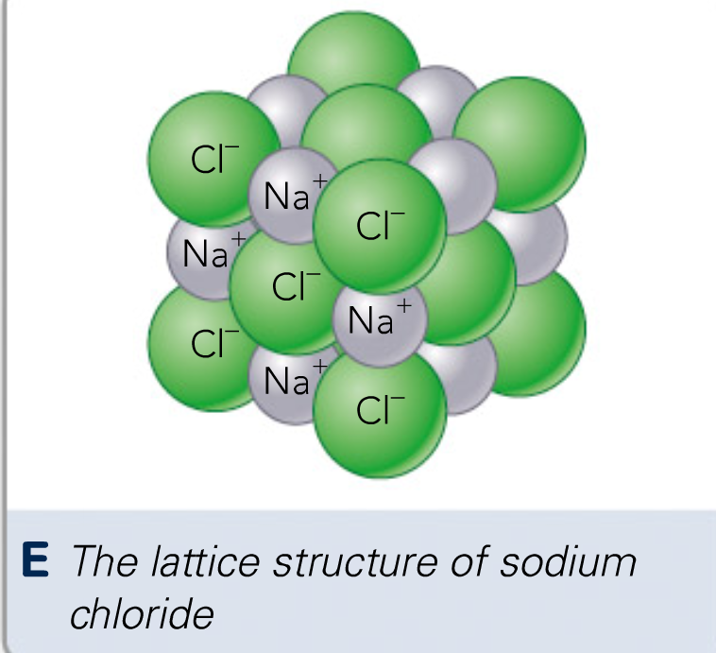

Slide 11
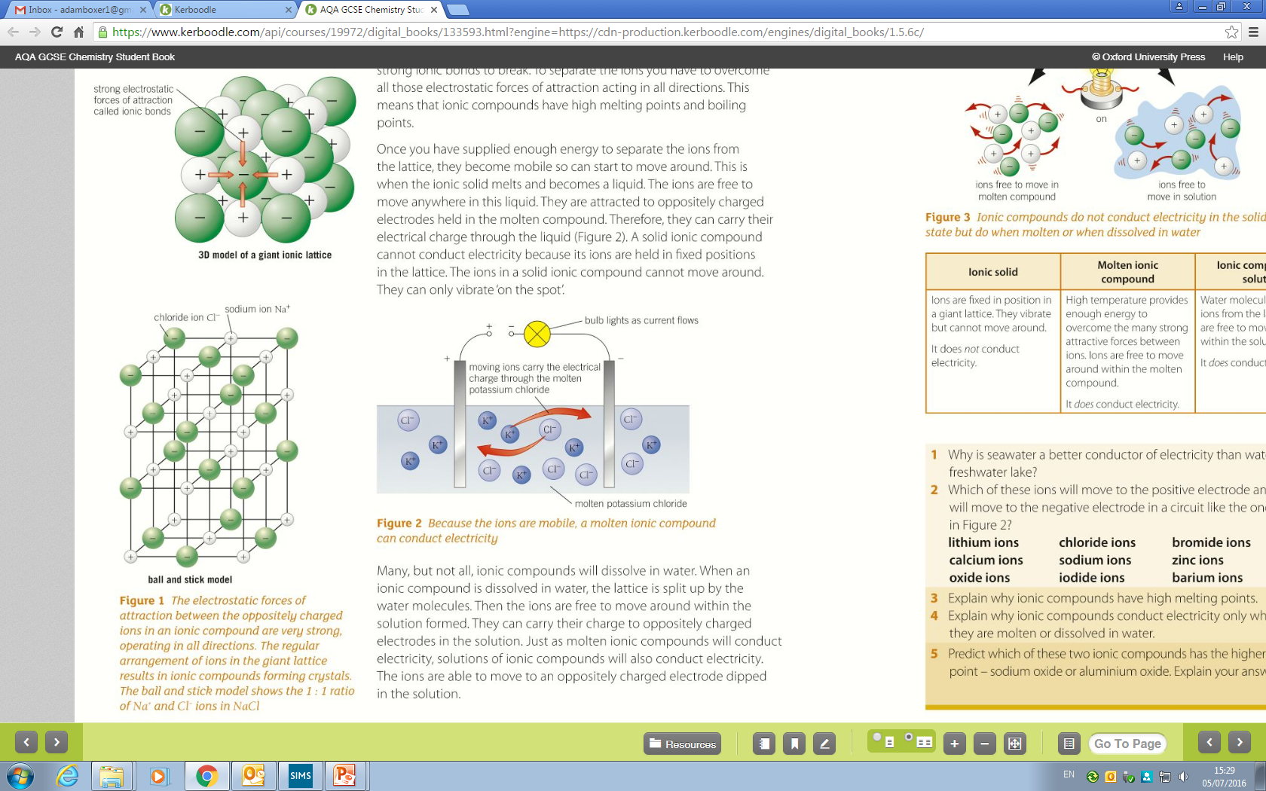

Slide 12
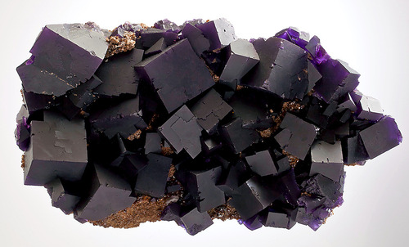
Notes:
This is a piece of fluorite. Note the straight edges. Ask students how they think those edges form. Many will say that they are man made, but in reality that is because in the world that they interact with, straight lines don’t really exist naturally. In reality though all minerals and crystal structures have beautiful straight lines in them because they are lattice formation. This is because the electrostatic force of attraction is non directional – a Na+ ion can attract a Cl- ion in front, behind, above below or left and right of itself. This means that a lattice builds up. I like to work through these steps through a diagram of the board.

Slide 13
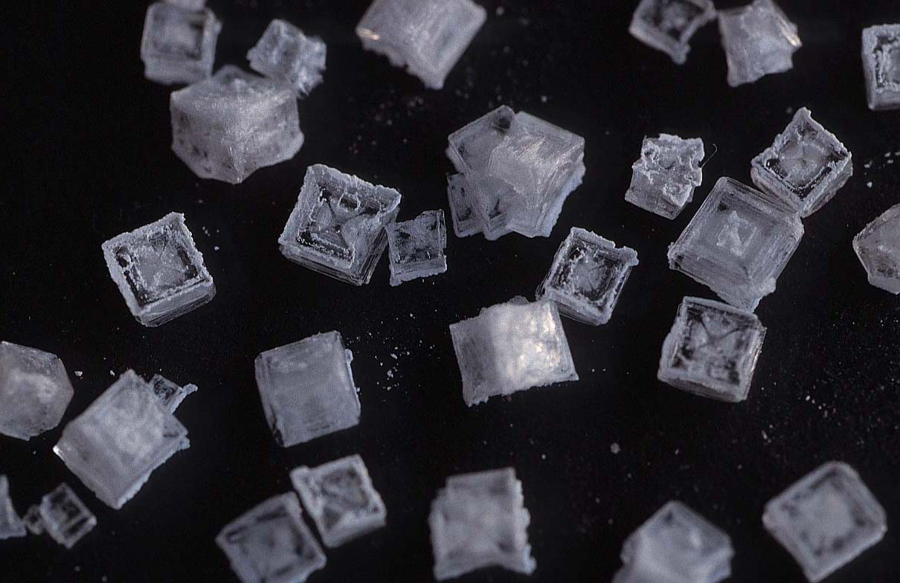
Notes:
This is table salt under a microscope. Note the perfect – and 100% natural – straight edges. Same broadly applies to all ionic substances (and other crystalline structures like snow flakes).

Slide 14
Q34-37
Start reading ahead

Slide 15
Properties of ionic compounds

Slide 16
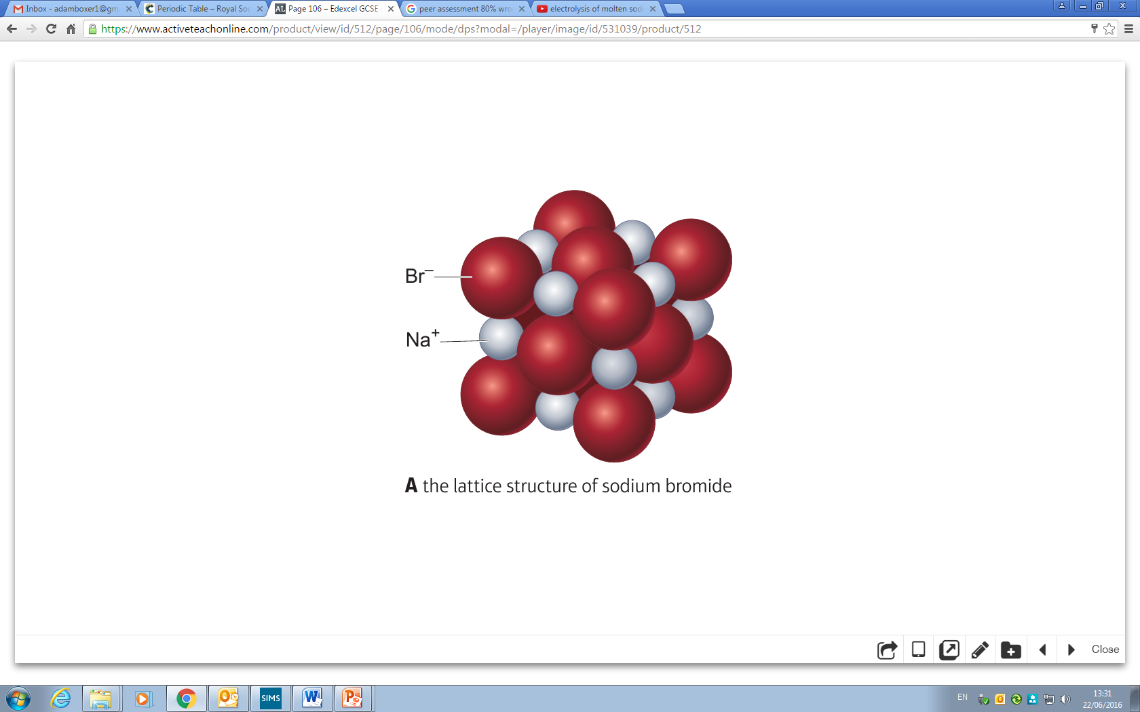
What would this look like if you heated it beyond its melting point?
Notes:
All the ions (note NOT atoms) will have to separate away from each other. Ask students if they think this would be hard or easy. It depends on the strength of the electrostatic force (much like separating magnets depends on the strength of the magnets).

Slide 17
Heat
Solid structure – ions are fixed in the lattice
Gas – ions are free to move. Same is true for liquids but easier to visualise a gas
Notes:
All the ions (note NOT atoms) will have to separate away from each other. Ask students if they think this would be hard or easy. It depends on the strength of the electrostatic force (much like separating magnets depends on the strength of the magnets).

Slide 18
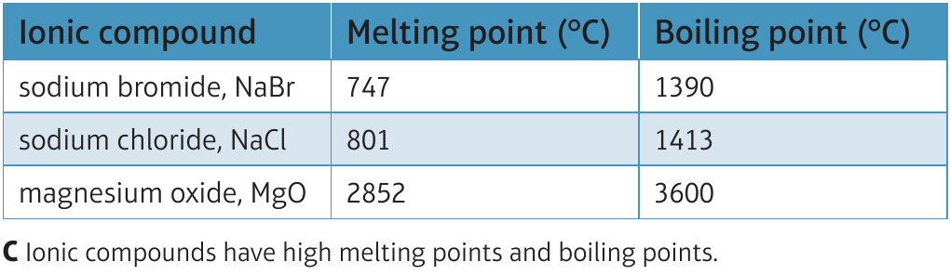

Slide 19

Electrical conductivity
Demonstration
Notes:
Order:
“Distilled water
2 electrodes
NaCl
Distilled water
Light bulb
For demo”
Discuss with students the fact that they all know to not use electricity near water. This comes up all through Hollywood (my personal favourite is in Watchmen – a bit Zak Snyder-ish but a good film). In fact, water does not conduct electricity. You can prove this by setting up a circuit as above but running through distilled water. If the water is close to pure it will not conduct. However, if you add quite a bit of the salt to it and dissolve it, the resulting solution will conduct electricity. This is because the ions have been freed from each other. This movement of charged particles is a current. Also make sure you show that the salt by itself does not conduct. So the salt doesn’t conduct, the water doesn’t conduct, but together they do.

Slide 20

Sodium chloride and water
Water
Particles are free to move but not charged so pure water does not conduct electricity
Chloride ions: Cl⁻
Sodium ions: Na⁺
Particles are charged ions but not free to move as held in a lattice. NaCl(s) does not conduct electricity

Slide 21
Charged particles are now free to move so NaCl(aq) can conduct electricity

Slide 22
Question 38-41
Summary questions to finish the unit

