Slide 1
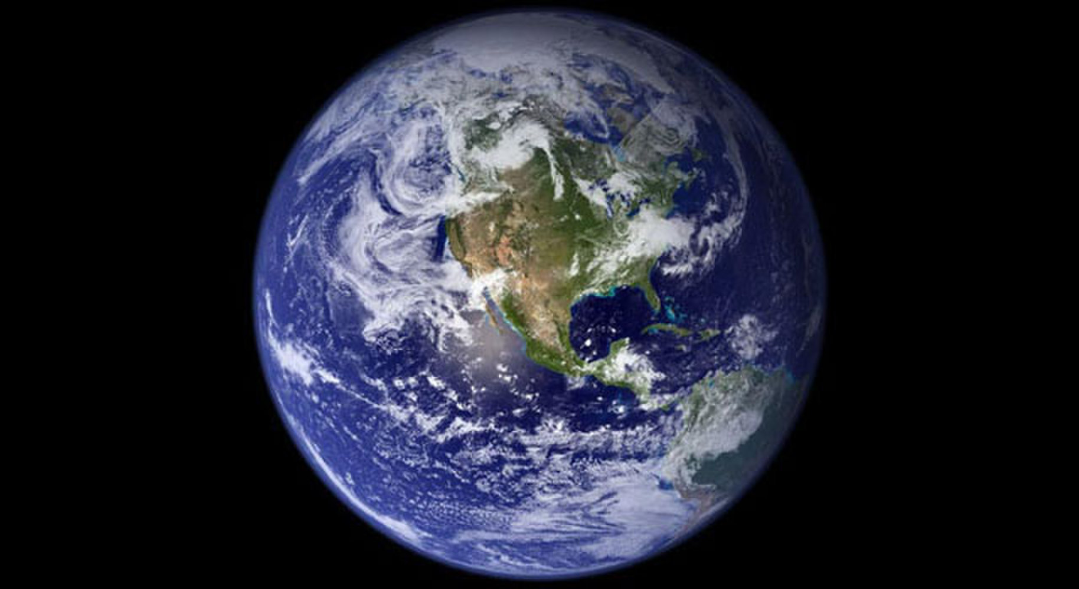
The Earth’s Resources

Slide 2
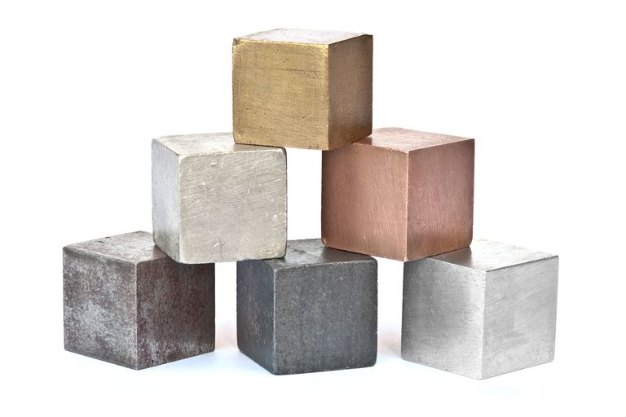
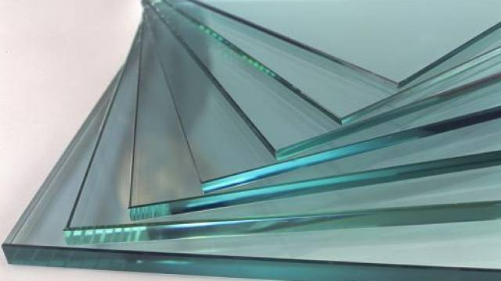

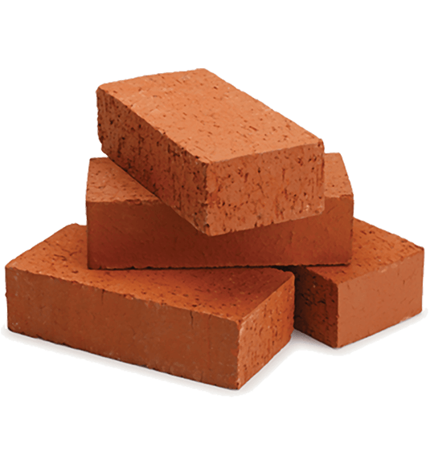
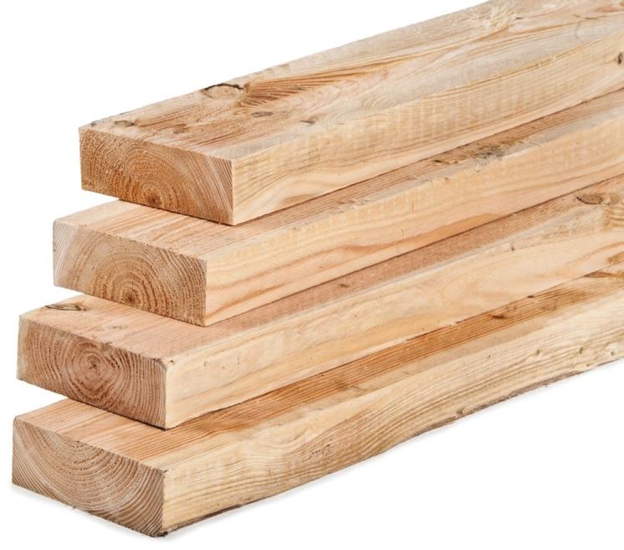
Notes:
We use the Earth’s resources for warmth, shelter, food, transport

Slide 3
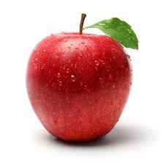
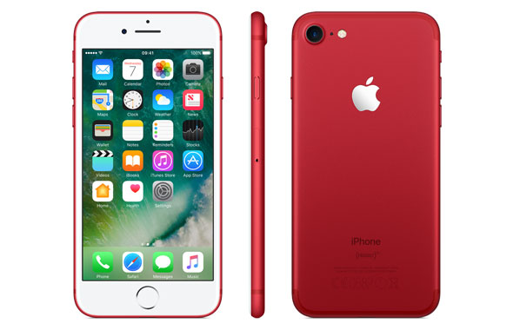
Natural and synthetic items
Notes:
Natural and synthetic resources. A natural apple and a synthetic apple. Ho ho ho.

Slide 4
Synthetic replacements
Common examples:
  Wool for use in clothing is now being replaced by acrylic fibre
  Cotton for use in clothing is now being replaced by polyester
  Wood for use in construction is now being replaced by PVC (a plastic) and MDF composites

Slide 5
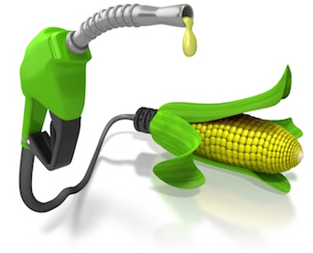
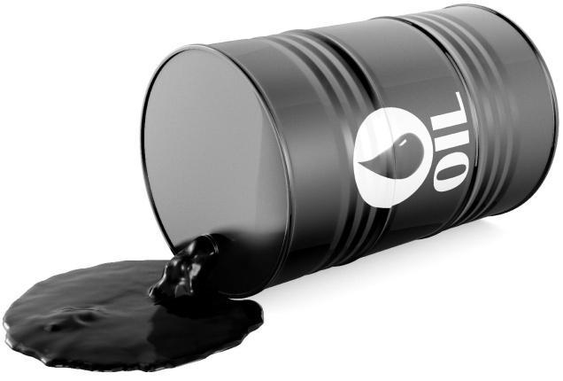
Notes:
Finite vs. renewable

Slide 6
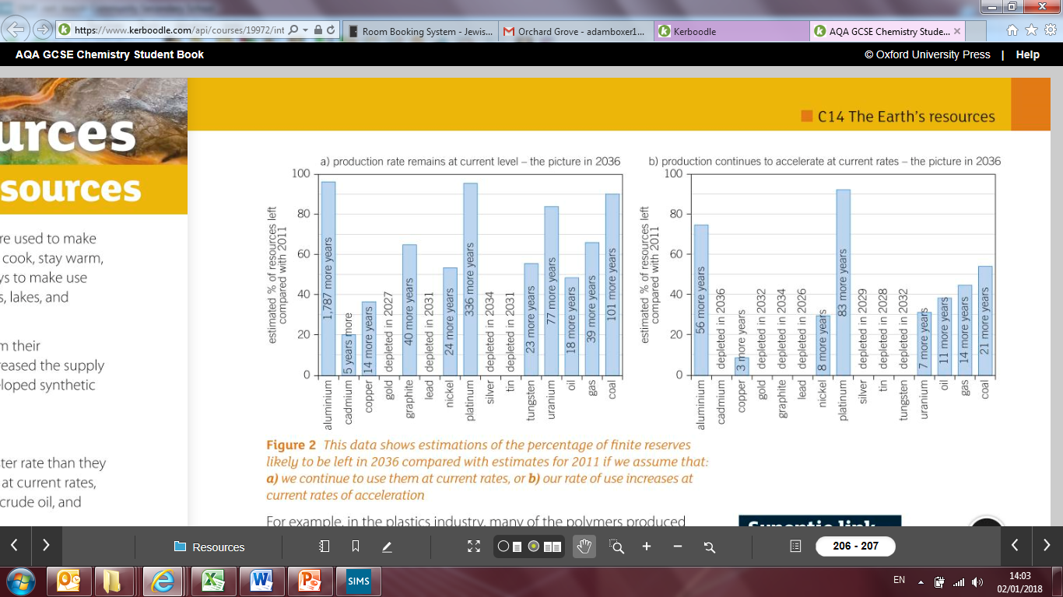

Slide 7
Resulting need for sustainable development

Slide 8
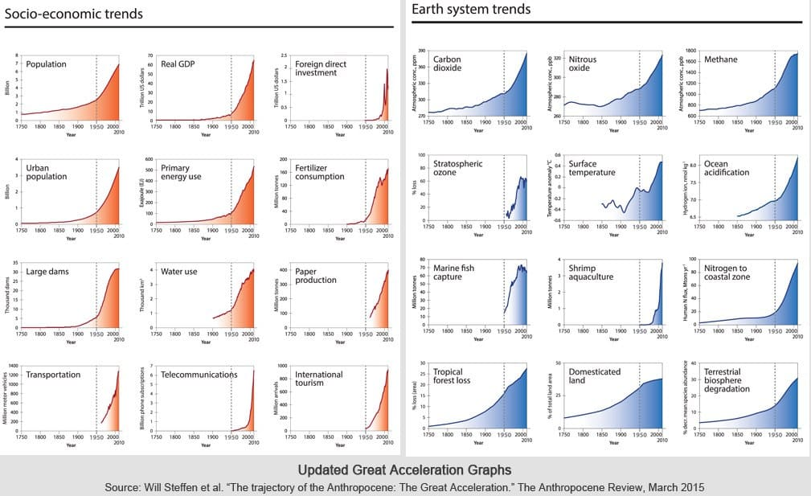

Slide 9
Q1-8

Slide 10
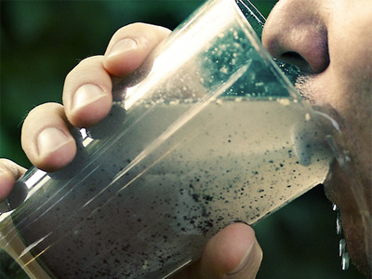
Water safe to drink

Slide 11

Notes:
All of our water originally comes from rain

Slide 12
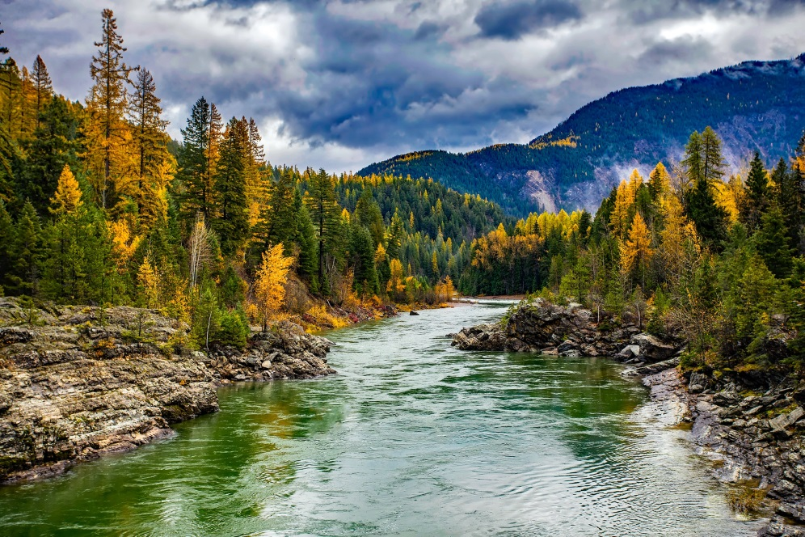
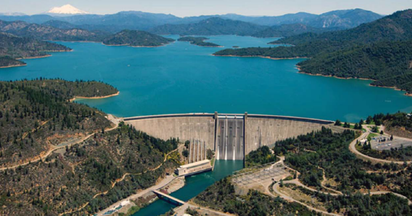
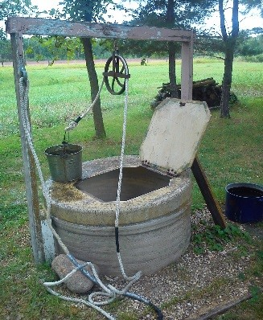

Notes:
Where “natural” water can collect

Slide 13

Water is not always safe to drink:
High concentrations of salts
Microbes
Notes:
Andy Holmes – Steve Redgrave’s rowing partner – died of Weil’s disease which is from drinking contaminated water

Slide 14
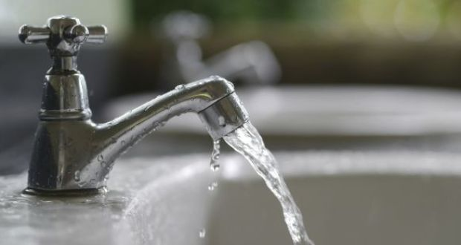
Potable water
Notes:
NOT the same as pure water! It still has dissolved stuff in it, just at safe (and even healthy) levels

Slide 15
To obtain potable water
Choose a source of water
Filter to remove large objects
Sterilise (kill microbes)
  Chlorine
  Ozone
  UV light

Slide 16
9-16

Slide 17
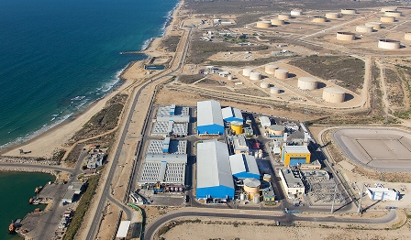
Desalination
Notes:
The Ashkelon desalination plant

Slide 18
Can be carried out by:
  Distillation
  Reverse osmosis using membranes
Requires a lot of energy

Slide 19
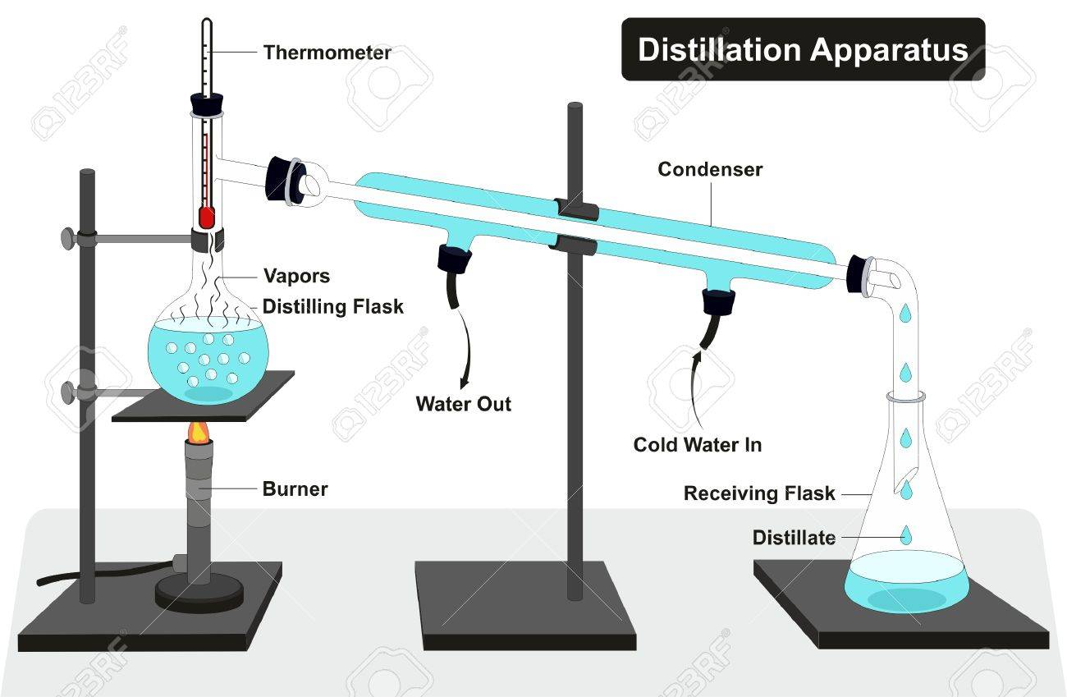

Slide 20
17-24

Slide 21
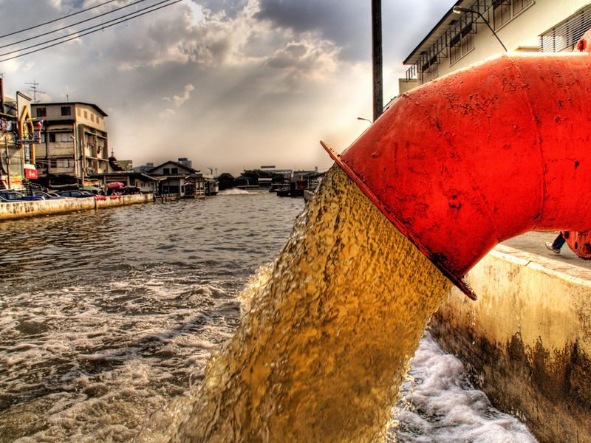
Treating Waste Water

Slide 22
Sewage
Agricultural waste water
Industrial waste water

Slide 23
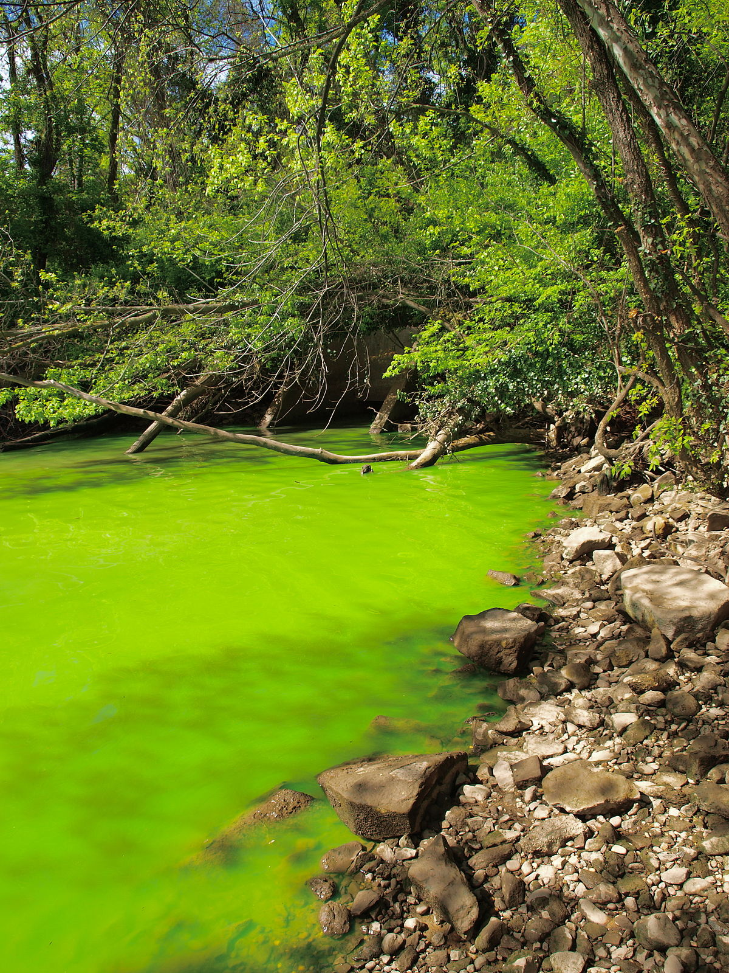
Notes:
Eutrophication – agricultural waste water

Slide 24
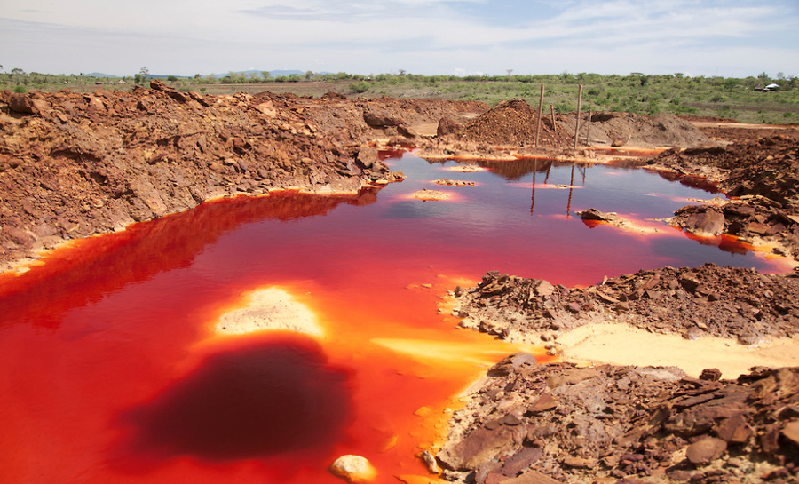
Notes:
Water drained from a mine in South Africa

Slide 25
Sewage and agricultural waste water can have
  Organic matter
  Harmful microbes
Industrial waste can have
  Organic matter
  Harmful chemicals

Slide 26
https://www.youtube.com/watch?v=xyU34Fhi0FY
Notes:
Scishow on waste treatment

Slide 27
Biogas
Sewage sludge
Anaerobic treatment
Remaining sludge used as fuel
Screening and grit removal
Sedimentation
Effluent
Aerobic treatment
Discharged back to rivers

Slide 28
Steps:
  Screening and grit removal
  Sedimentation to produce sewage sludge and effluent
  Anaerobic digestion of sewage sludge
    Biogas produced
    Remaining sludge can be used as fuel
  Aerobic biological treatment of effluent
    Effluent can now be discharged back into rivers

Slide 29
25-34

Slide 30

Life Cycle Assessment and Recycling

Slide 31
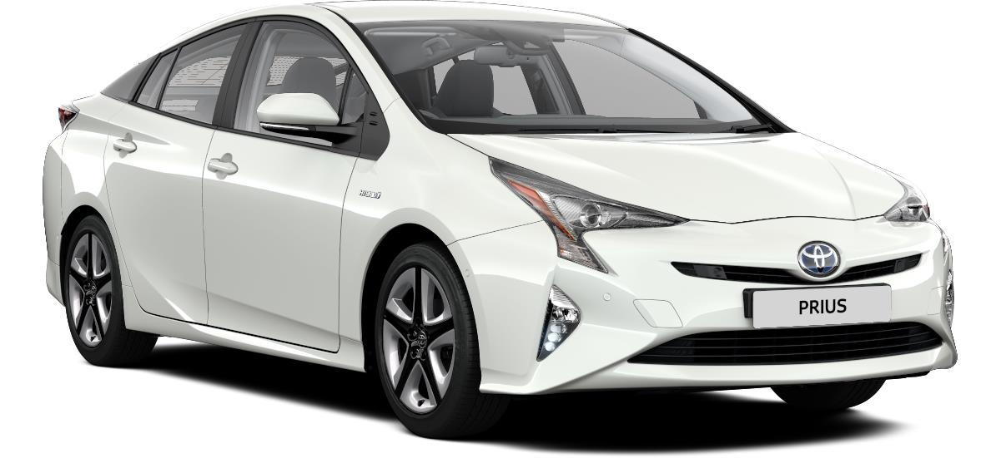
Importance of LCA
https://www.youtube.com/watch?v=xqY8FUDcATE
Notes:
Yes, yes JC is not exactly savoury but hey

Slide 32
Stages of LCA
Extracting and processing raw materials
Manufacturing and packaging
Use and operation during its lifetime
Disposal at the end of lifetime (including transport and distribution)

Slide 33
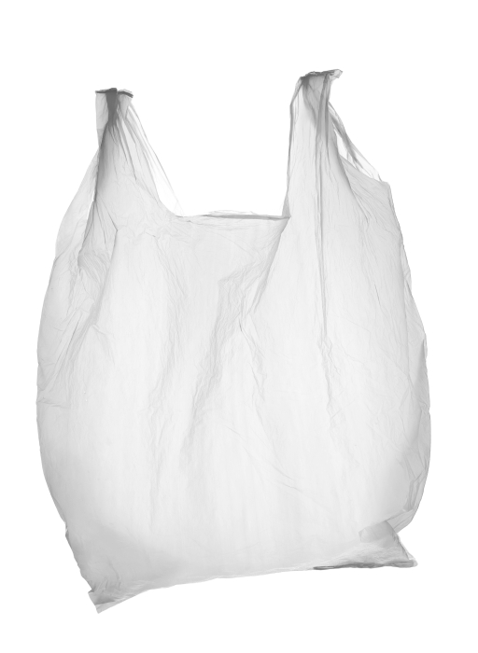

Plastic or paper bags?

Slide 34
Q35

Slide 35
Reduce, Reuse, Recycle

Slide 36
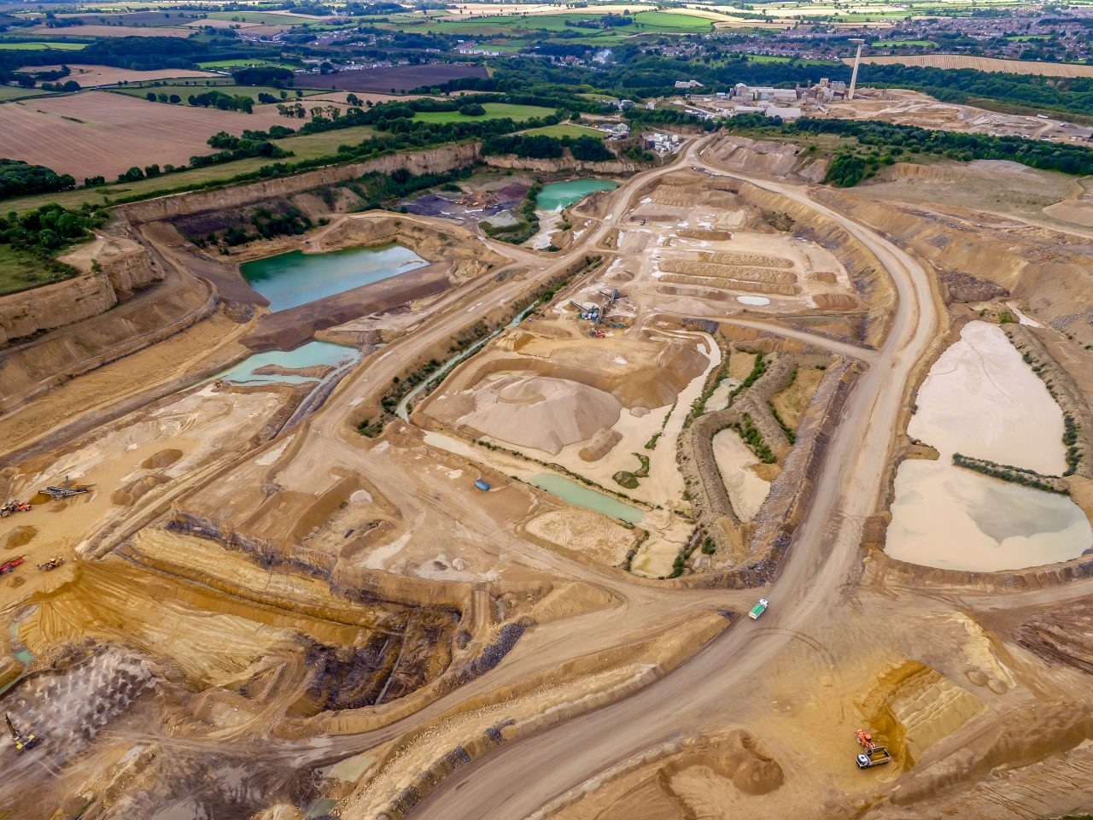
The problem

Slide 37
Reduce, Reuse, Recycle

Slide 38
Resources are limited (non-renewable)
Environmental impacts of quarrying
  Habitat loss
  Generation of CO₂
  Noise pollution
  Generation of hazardous waste

Slide 39
Reduce: To simply use less
Reuse: to use again
Recycle: to use manufacturing processes to make new products
Case study: plastic bags in the UK

Slide 40
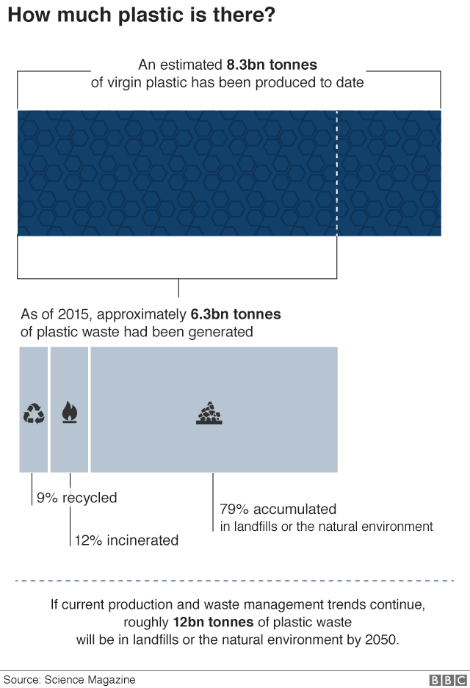
Notes:
All from http://www.bbc.co.uk/news/science-environment-42264788

Slide 41
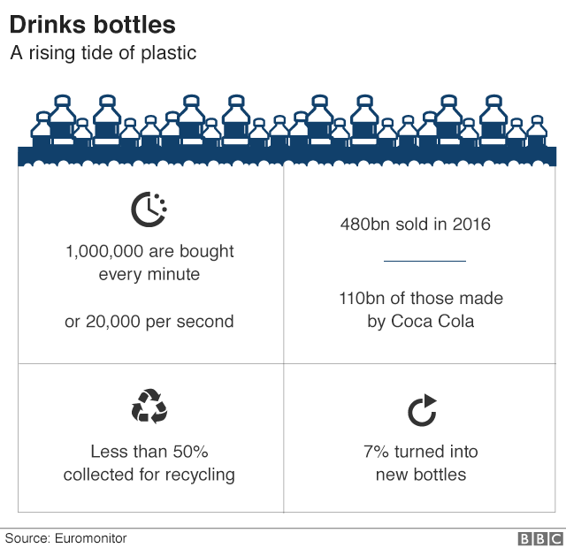

Slide 42
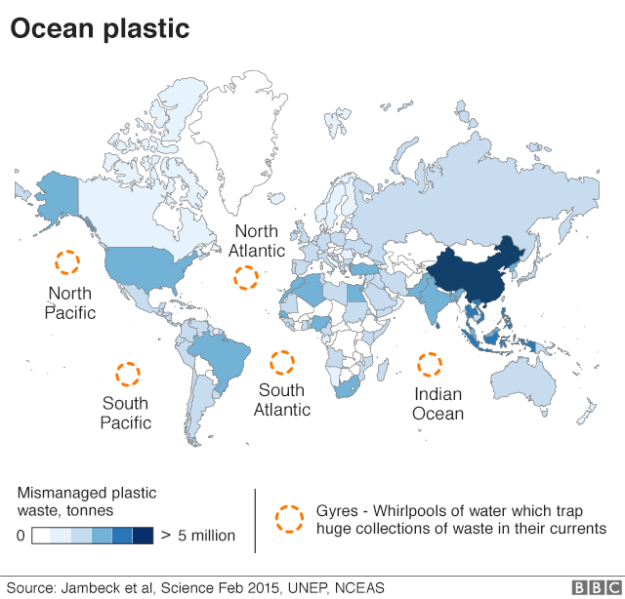

Slide 43
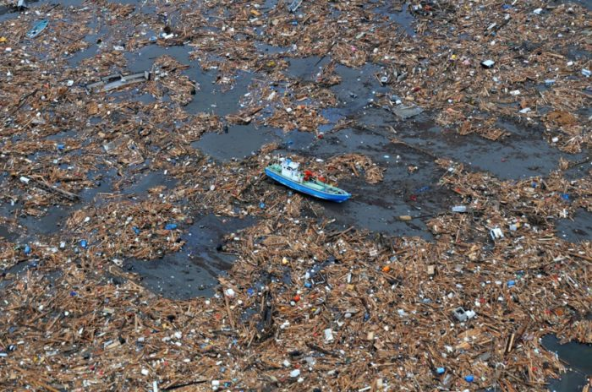

Slide 44
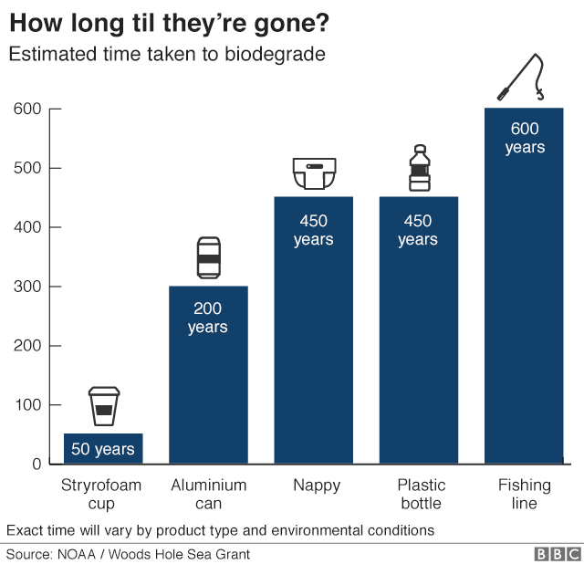

Slide 45
What happens to the plastic you throw away?
https://www.youtube.com/watch?v=_6xlNyWPpB8

Slide 46
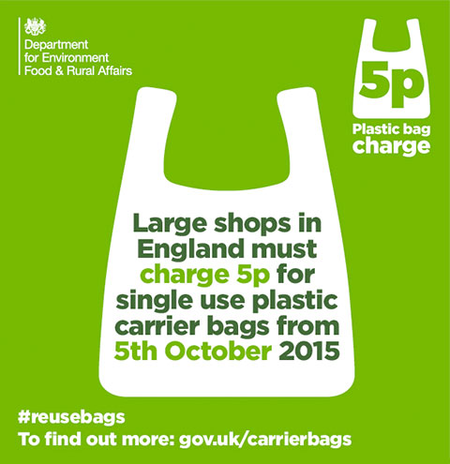
Plastic bag charge
Plastic bag use dropped by 85%

Slide 47
Glass bottles
Can be reused
Can be crushed and recycled to make new glass products

Slide 48
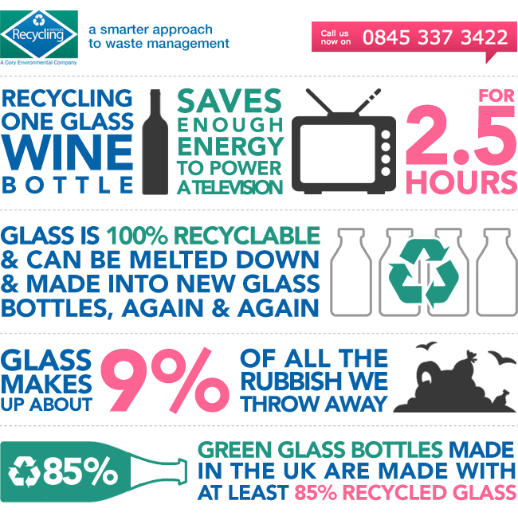

Slide 49
Recycling: https://www.youtube.com/watch?v=b7GMpjx2jDQ

Slide 50
36-46

Slide 51
Metals
Can be recycled by melting and recasting
Need to be separated first which can cause cost

Slide 52
Alternative methods of extracting metals

Slide 53
The problem:
  The Earth’s resources of metal are finite
  Digging, moving and disposing of the large amounts of rock for traditional mining is problematic
    Habitat loss
    Greenhouse gas emissions

Slide 54
Phytomining (copper)
Grow plants near/on metal compounds
Harvest plants
Burn plants
Ash contains the metal compound
(carbon neutral?)

Slide 55
Bioleaching (copper)
Grow bacteria near/on metal compound
Bacteria produce leachate solutions that have metal compound

Slide 56
Both methods require purification
Electrolysis
Displacement with scrap metal

Slide 57
End of unit
Q47-54

Slide 58
Using Materials (Triple only)

Slide 59
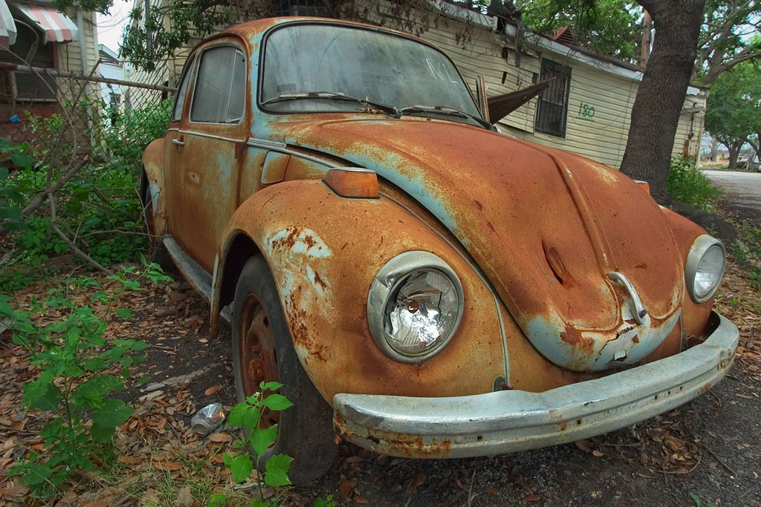
Corrosion

Slide 60
Iron + water + oxygen → hydrated iron oxide

Slide 61
How to protect metals from corrosion
Coatings
  Grease
  Paint
  Electroplate
“Natural” coatings (aluminium oxide)
Sacrificial protections

Slide 62
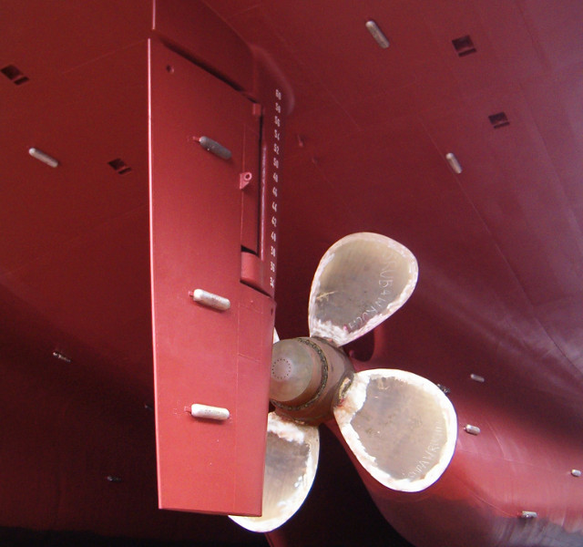

Slide 63
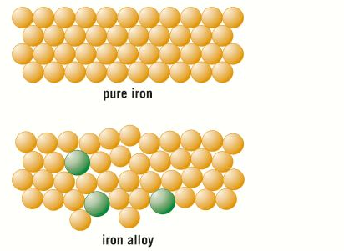
Alloys

Slide 64
Alloy | Composition | Properties | Use
Bronze | Copper and tin | Resistant to corrosion | Statues, decorative items, ship propellers (Was first alloy invented – c.f. bronze age)
Brass | Copper and zinc | Very hard but workable | Door fittings, taps, musical instruments
Jewellery gold | Mostly gold with copper, silver and zinc added | Lustrous, corrosion resistant, hardness depends on carat | Jeweller. Note 24-carat is ~100% gold, 18- carat is 75% etc (divide carat by 24).
High carbon steel | Iron with 1-2% carbon | Strong but brittle | Cutting tools, metal presses
Low carbon steel | Iron with less than 1% carbon | Soft, easy to shape | Extensive use in manufacture: cars, machinery, ships, containers, structural steel
Stainless steel | Iron with chromium and nickel | Resistant to corrosion, hard | Cutlery, plumbing
Aluminium alloys | Over 300 alloys available | Low density, properties depend on composition | Aircraft, military uses
Notes:
Table in mastery booklet

Slide 65
Students should be able to:
recall a use of each of the alloys specified
interpret and evaluate the composition and uses of alloys other than those specified given appropriate information.

Slide 66
Q17-30

Slide 67
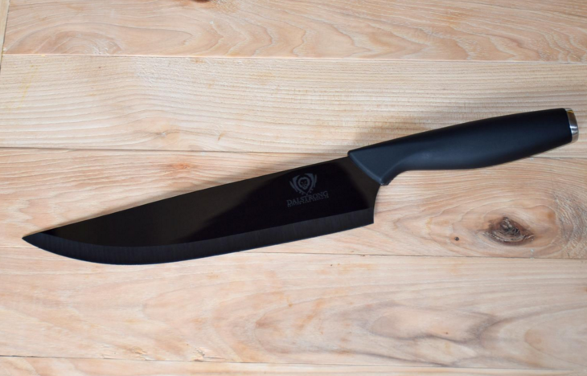
Ceramics

Slide 68
Ceramic | Manufacture | Properties | Uses
Soda-lime glass | Heat a mixture of sand, sodium carbonate, limestone | Transparent, brittle | Everyday glass objects
Borosilicate glass | Heat sand and boron trioxide | Higher melting point than soda-lime glass | Oven glassware, test tubes
Clay ceramics (pottery + bricks) | Shape wet clay then heat in a furnace | Hard, brittle, easy to shape before manufacture, resistant to corrosion | Crockery, construction, plumbing fixtures

Slide 69
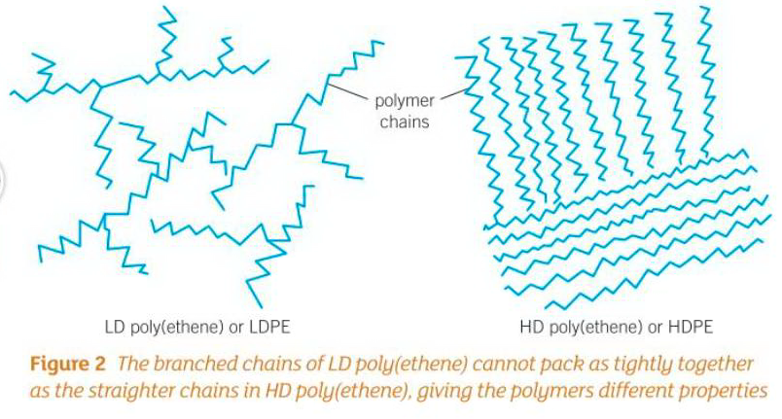
Polyethene: HD/LD

Slide 70
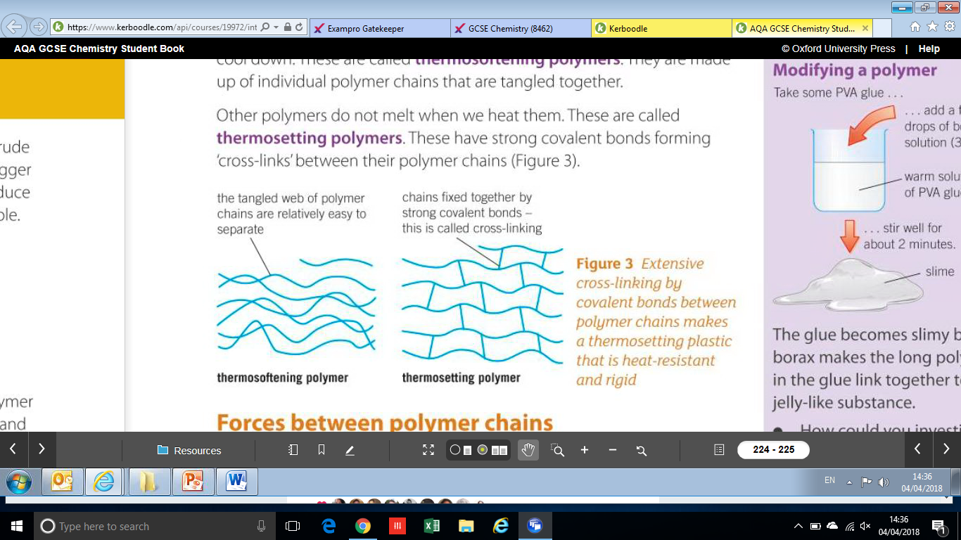
Thermosoftening and thermosetting

Slide 71
31-41

Slide 72

Composites

Slide 73
Composites are mixtures of materials for specific uses
  The main material is called the matrix or binder
  The second material is usually added as threads or fragments
Examples:
  Concrete (cement, sand and gravel)
  Reinforced concrete (concrete + steel rods)
  Plywood (thin sheets of wood and glue)
  MDF (whoodchips or shavings in a polymer resin)
  Pykrete (ice and sawdust)

Slide 74
44-46

Slide 75
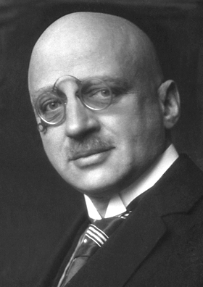
The Haber Process
Notes:
Nasty piece of work Haber was

Slide 76
N₂(g) from the air
Unreacted N₂ and H₂ recycled
Reaction vessel: 450°C, 200atm, iron catalyst
Mixture cooled. NH₃ liquefies.
NH₃ extracted
H₂(g) from natural gas

Slide 77
N₂(g) + 3H₂(g) ⇌ 2NH₃(g)
Effects on yield and rate
  Temperature (forward reaction is exothermic)
  Pressure
“compromise” conditions

Slide 78
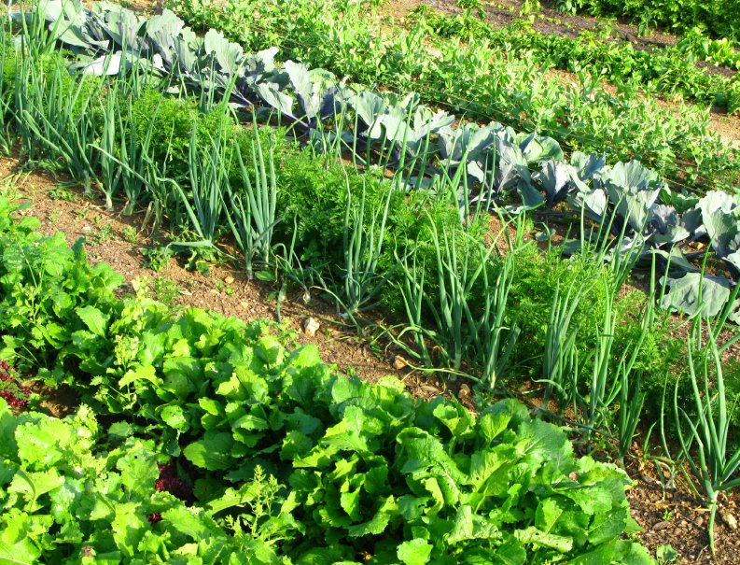
NPK Fertilisers

Slide 79
NPK Fertilisers
Nitrogen
  From ammonia
  Used to manufacture ammonium salts and nitric acid
Phosphorous
  Comes from mined phosphate rock [Ca₃(PO₄)₂]
  Treat the rock with nitric or sulphuric acid
Potassium
  Potassium chloride and potassium sulphate common sources
  Obtained by mining

