Slide 1
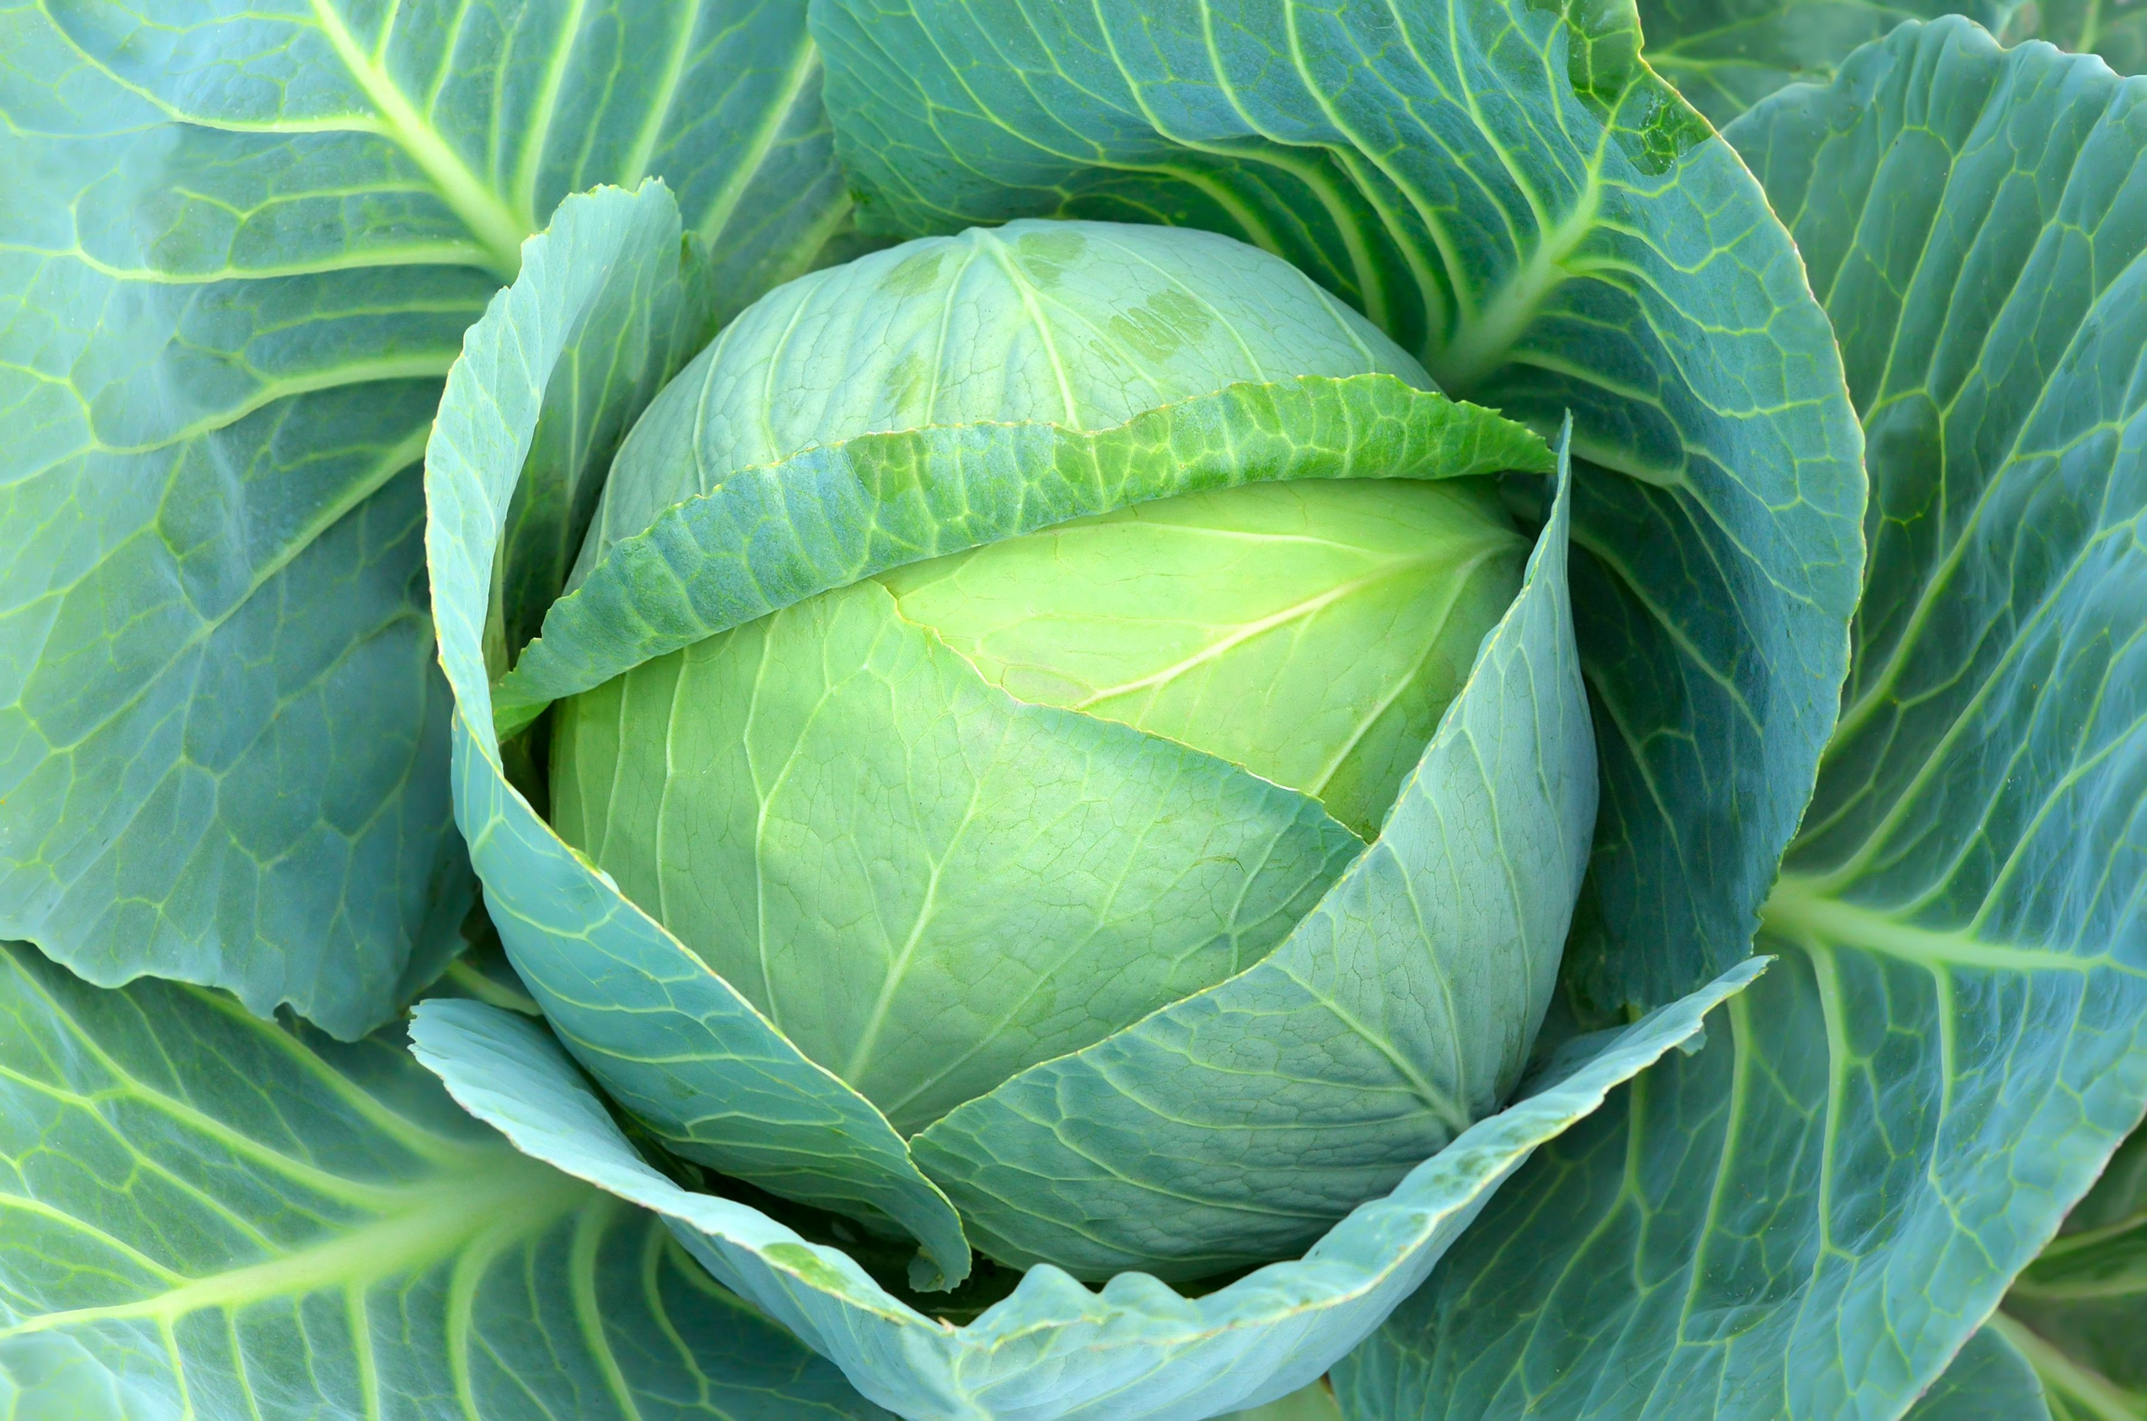
Notes:
Lettuce

Slide 2
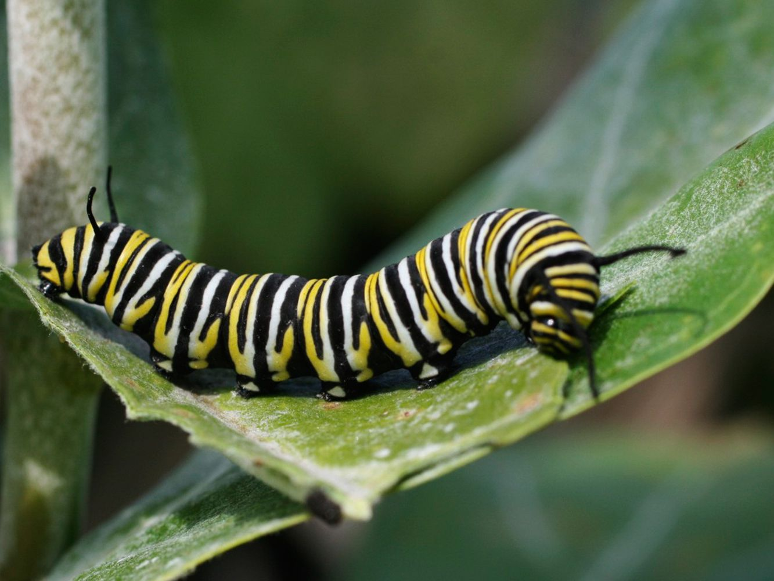
Notes:
Caterpillar

Slide 3
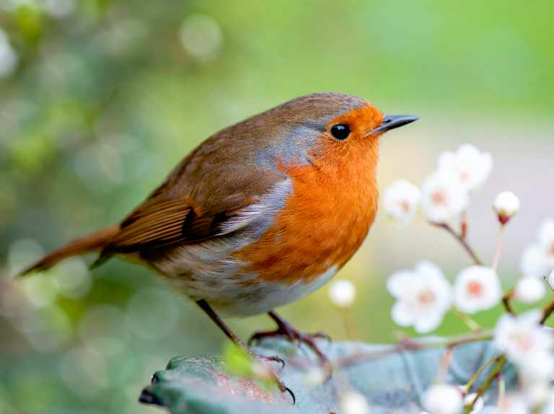
Notes:
Robin

Slide 4
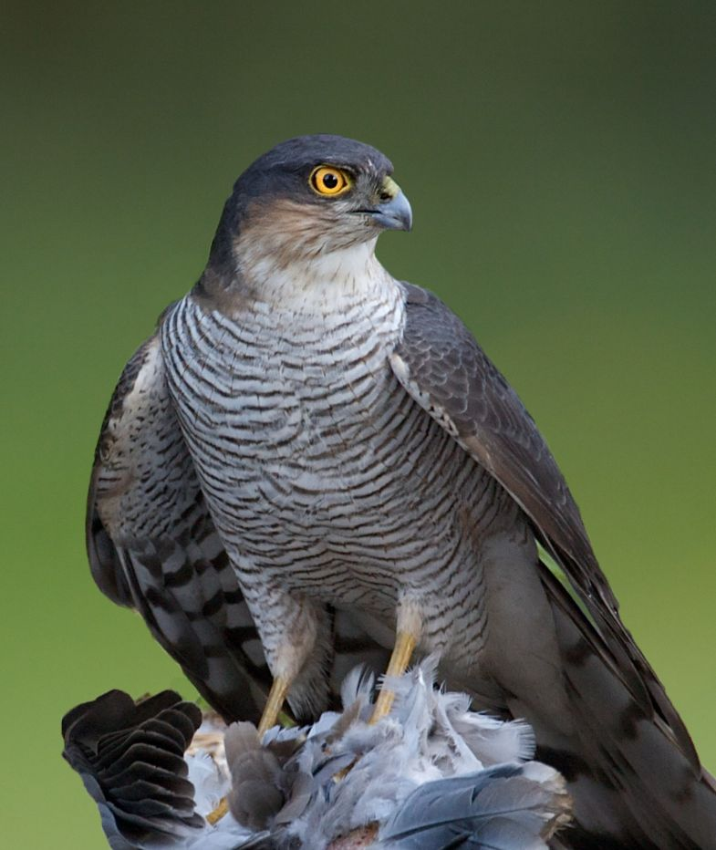
Notes:
Sparrowhawk

Slide 5
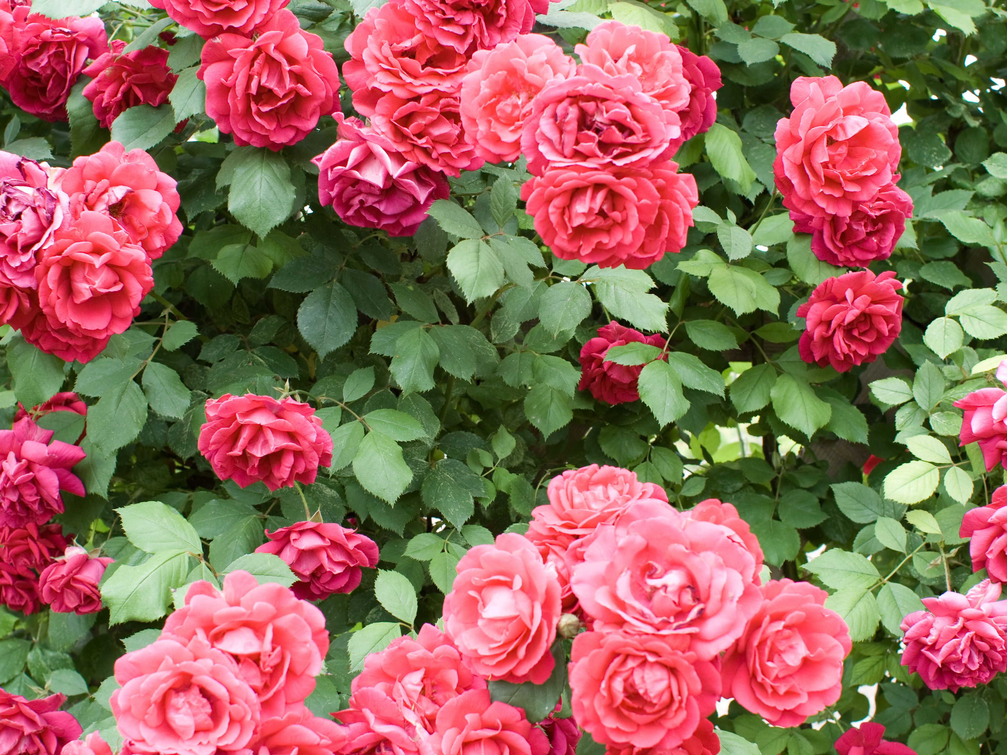
Notes:
Rosebush

Slide 6
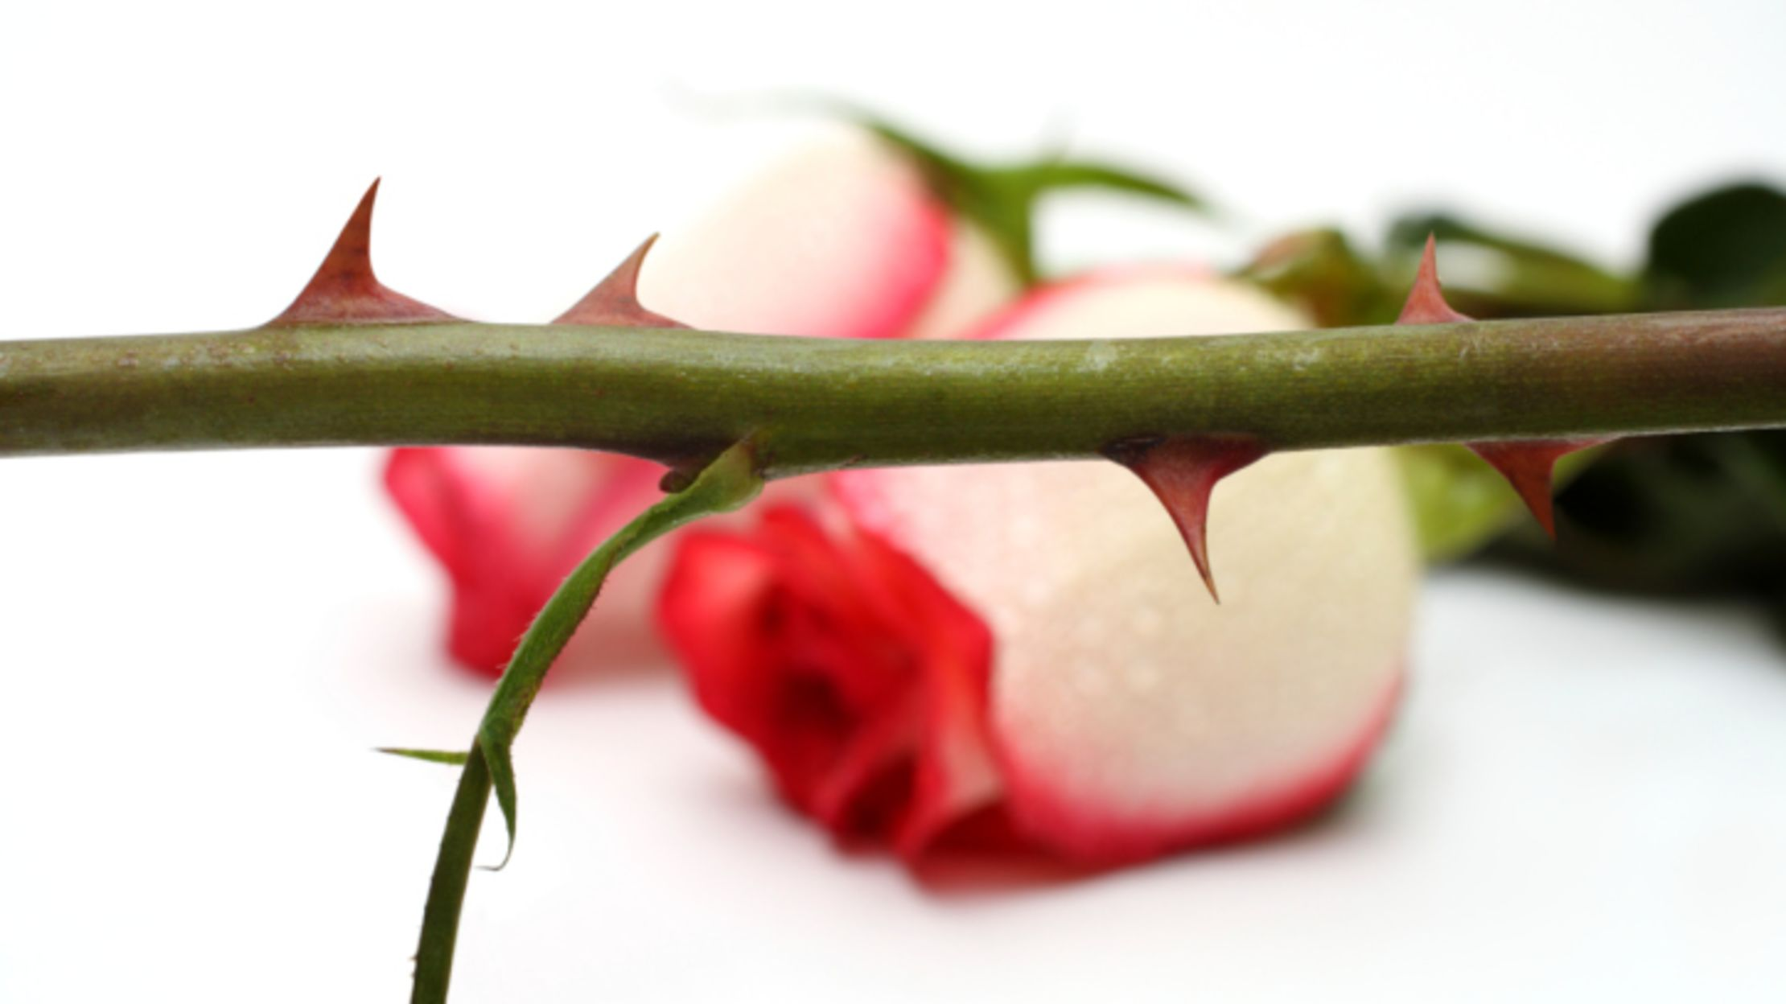
Notes:
Rose thorns

Slide 7
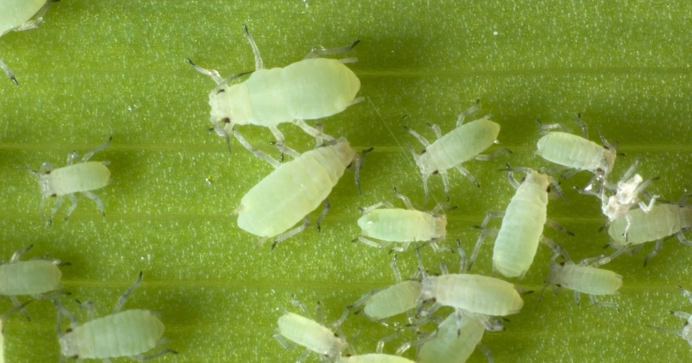
Notes:
Aphid

Slide 8
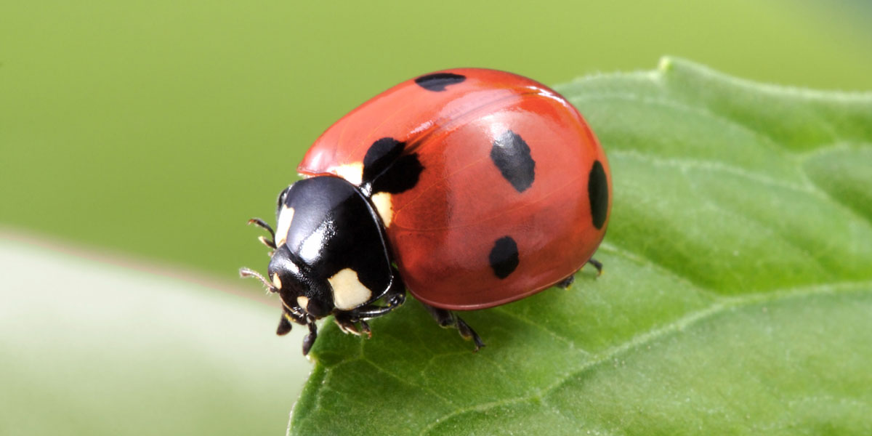
Notes:
Ladybird

Slide 9
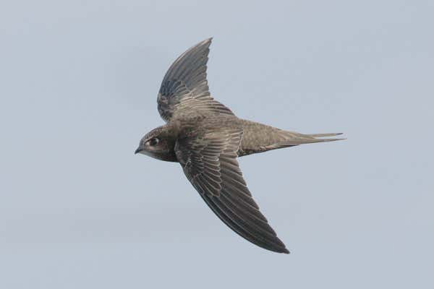
Notes:
Swift

Slide 10
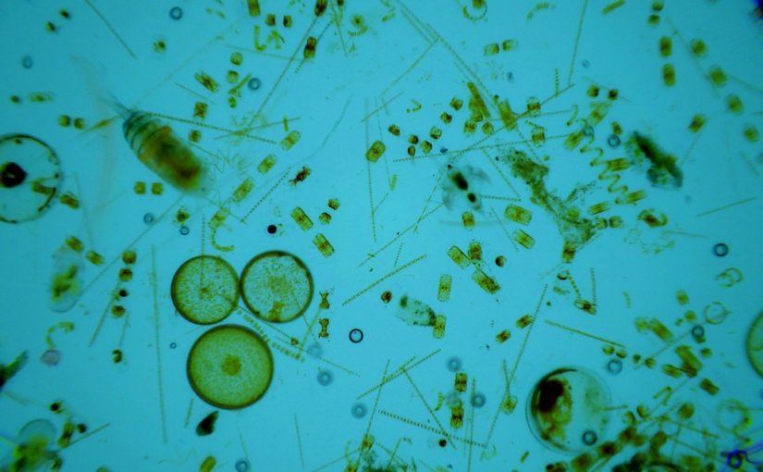
Notes:
“Plant” plankton (phytoplankton)

Slide 11
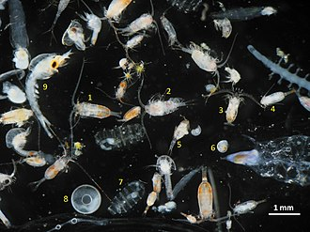
Notes:
“Animal” plankton (zooplankton)

Slide 12
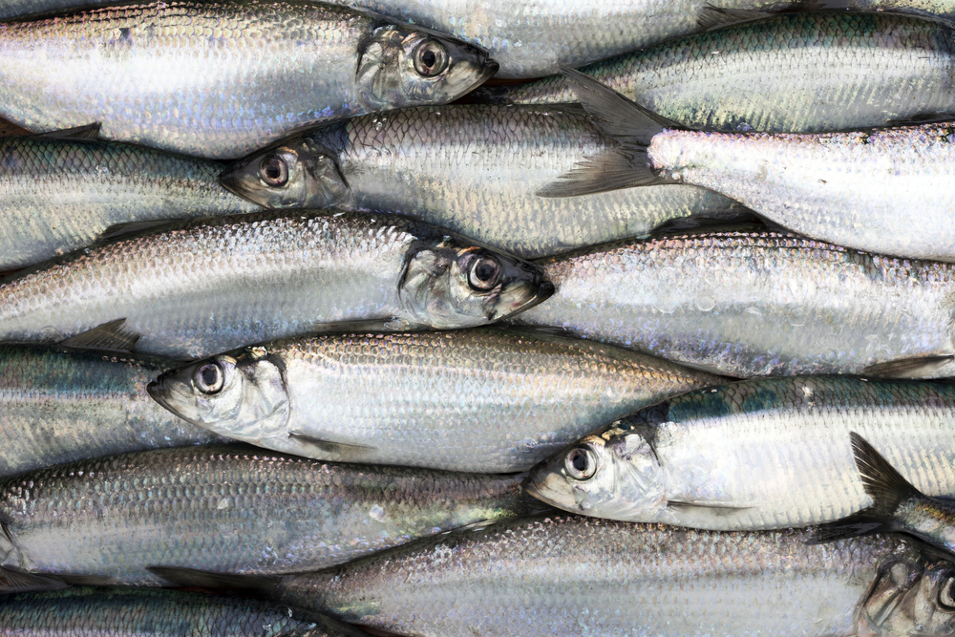
Notes:
Herring

Slide 13
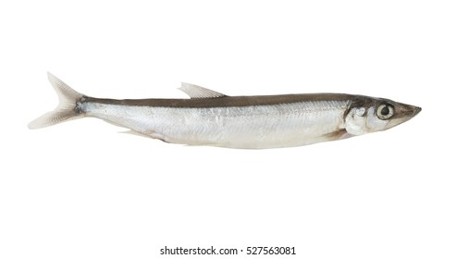
Notes:
Capelin

Slide 14
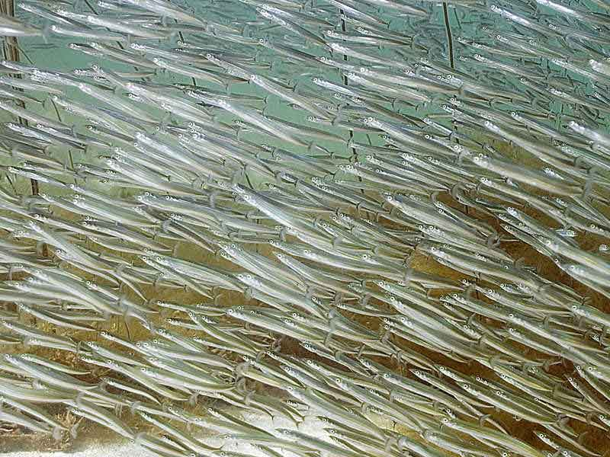
Notes:
Sand eels

Slide 15
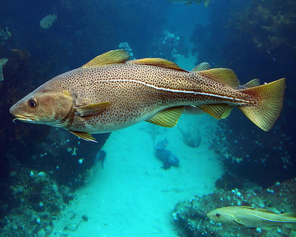
Notes:
Cod

Slide 16
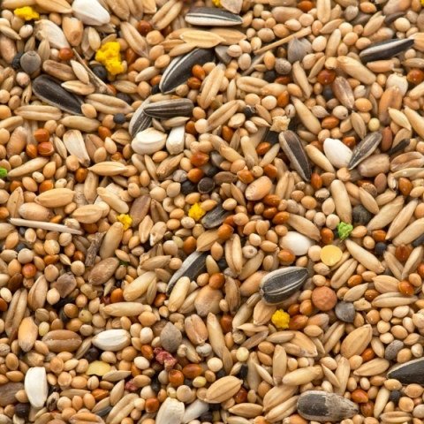
Notes:
Seeds

Slide 17
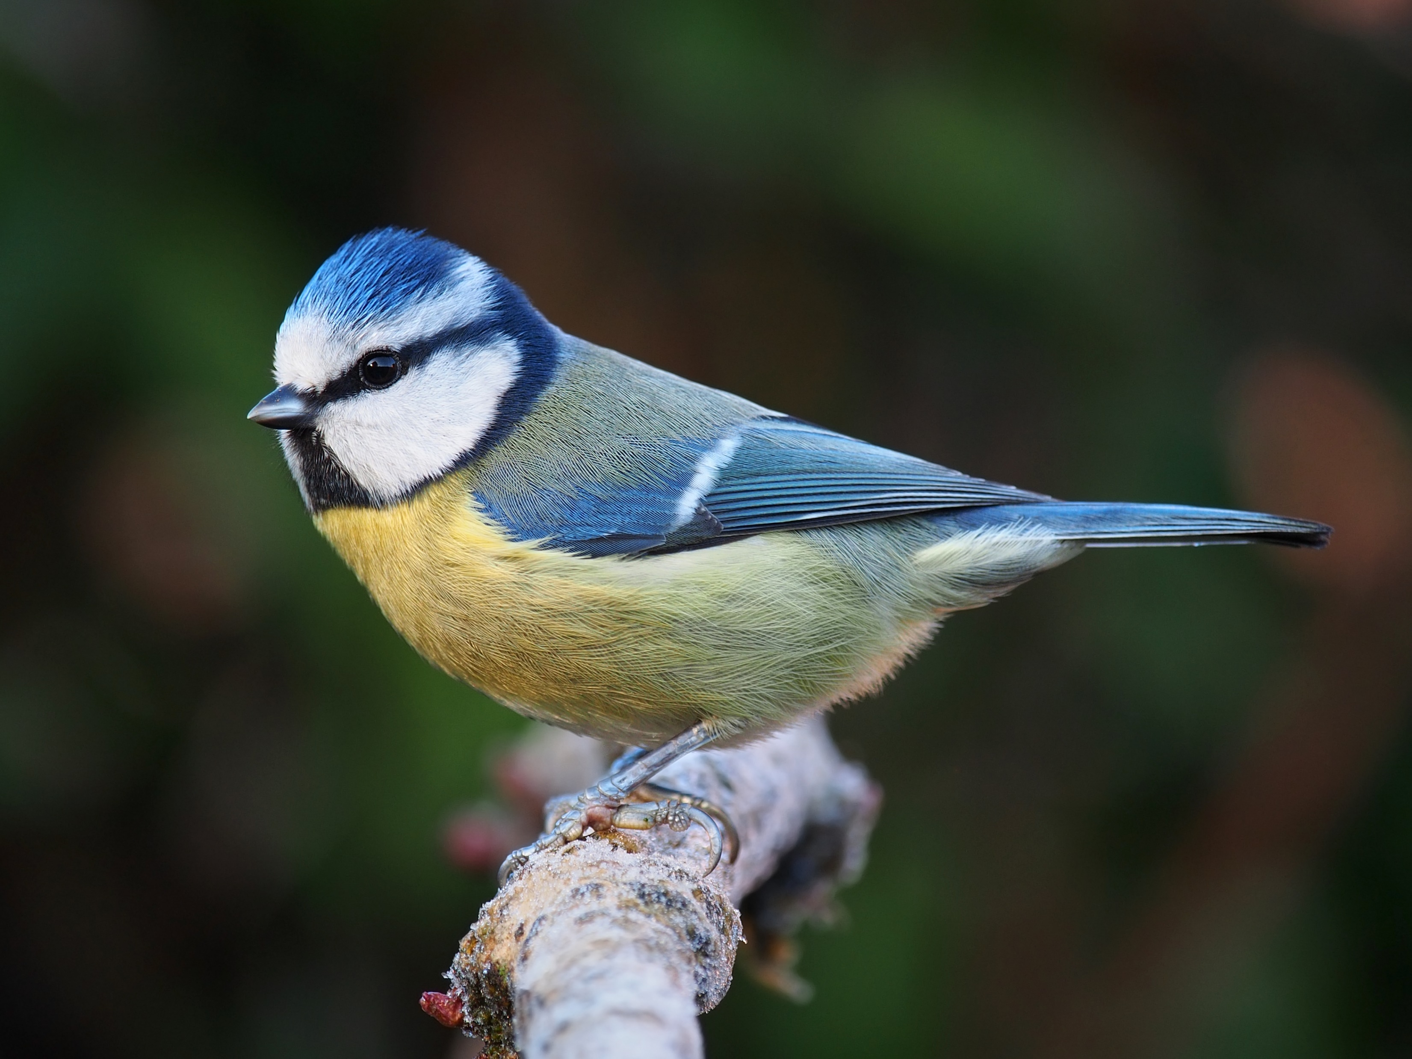
Notes:
Blue tits

Slide 18
Notes:
‘Plants’

Slide 19
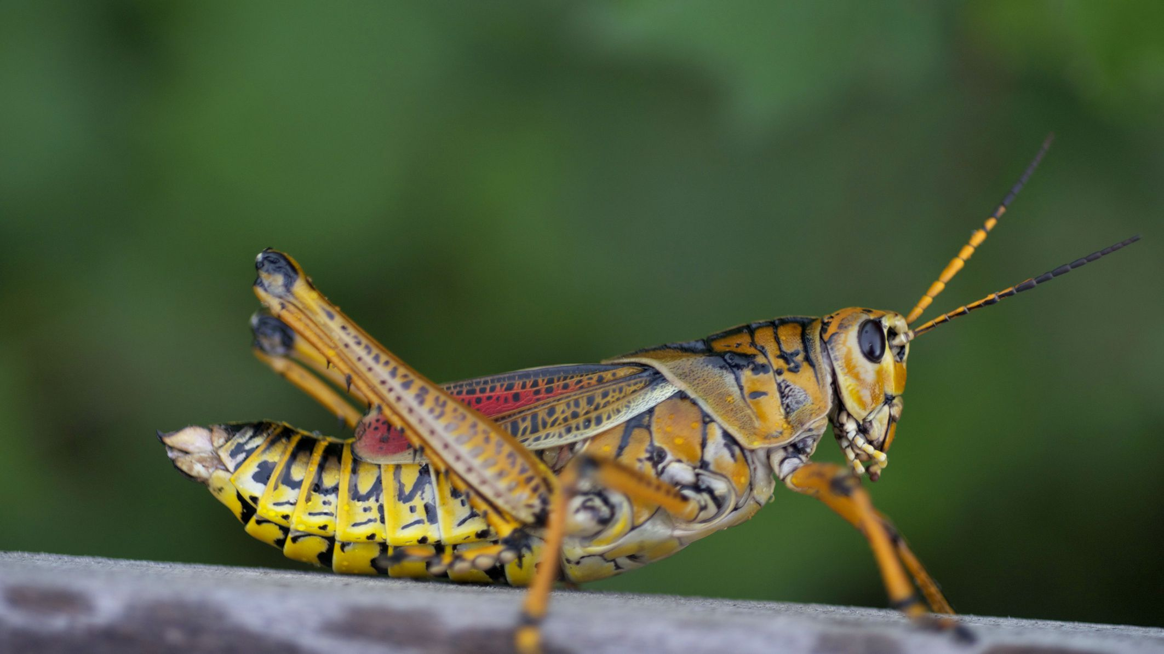
Notes:
Grasshoppers

Slide 20
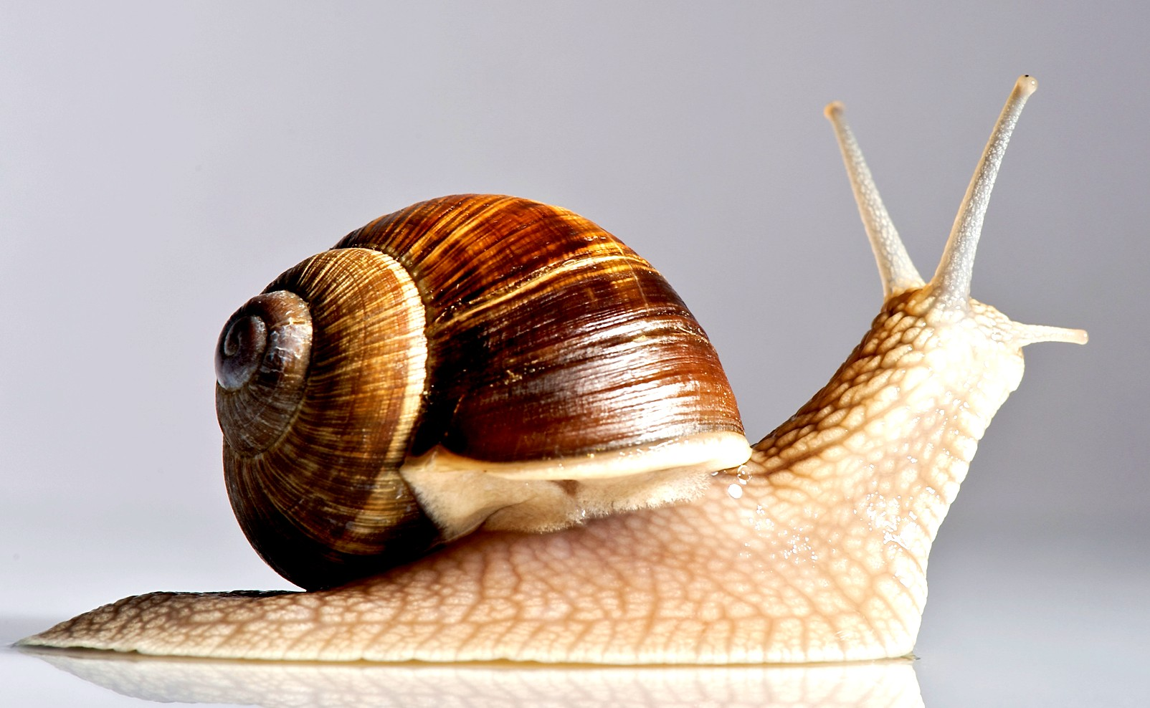
Notes:
Snail

Slide 21
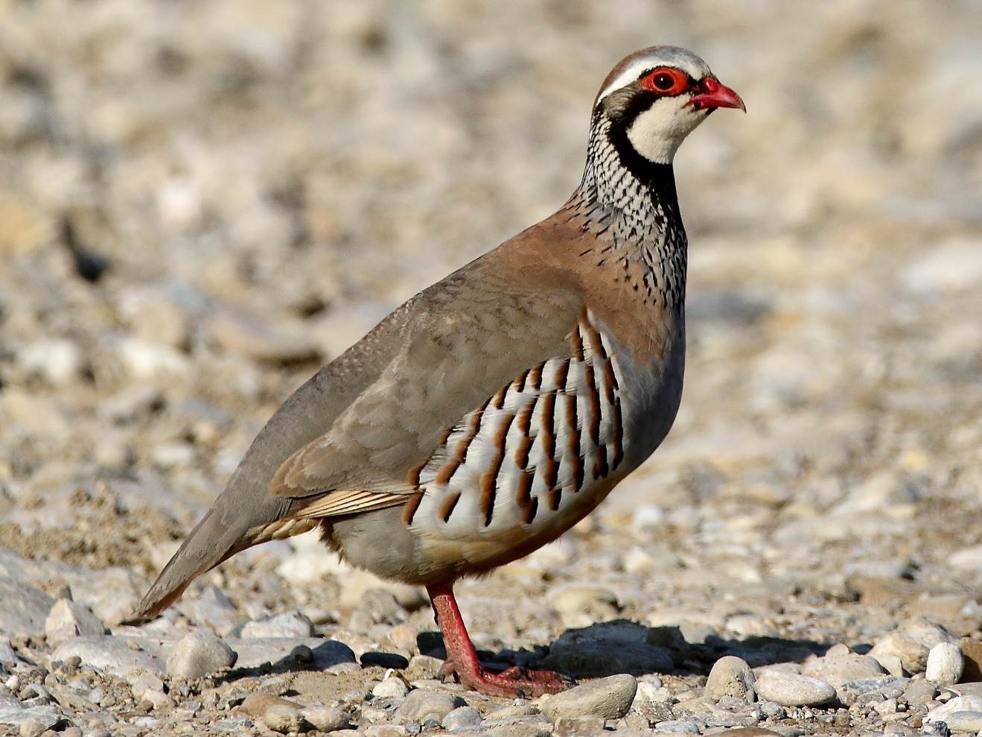
Notes:
Partridge

Slide 22
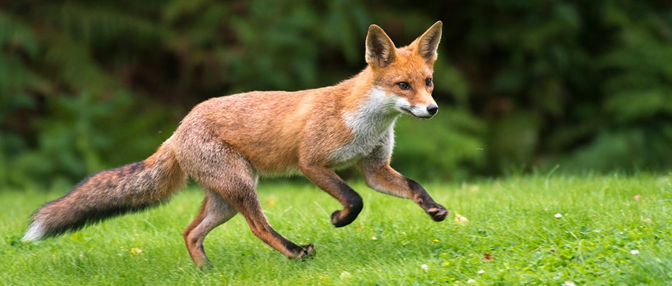
Notes:
Fox

Slide 23
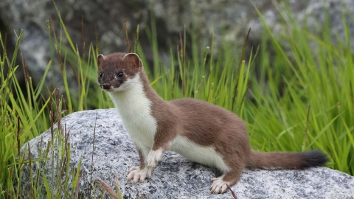
Notes:
Stoat

Slide 24
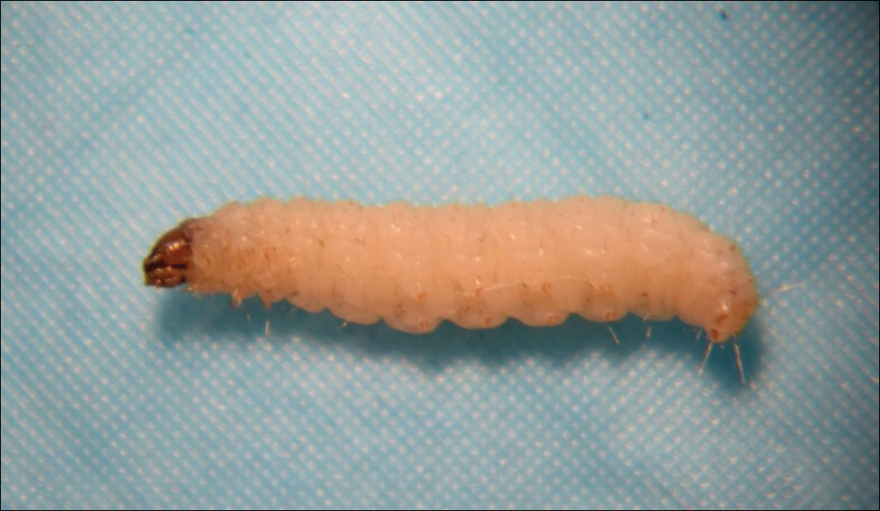
Notes:
Moth larvae

Slide 25
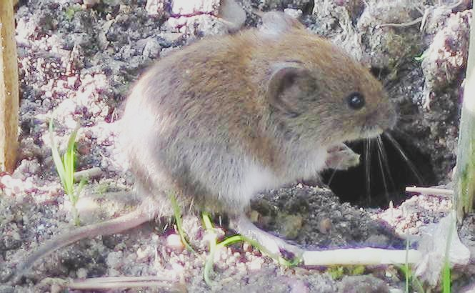
Notes:
Vole

Slide 26
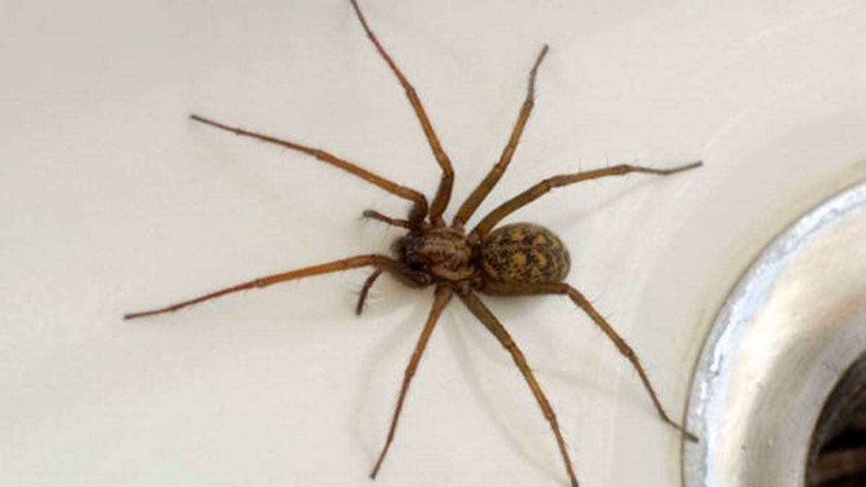
Notes:
Spider

Slide 27
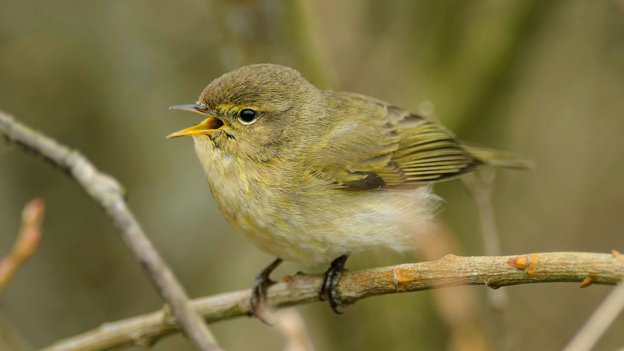
Notes:
Chiffchaff

Slide 28
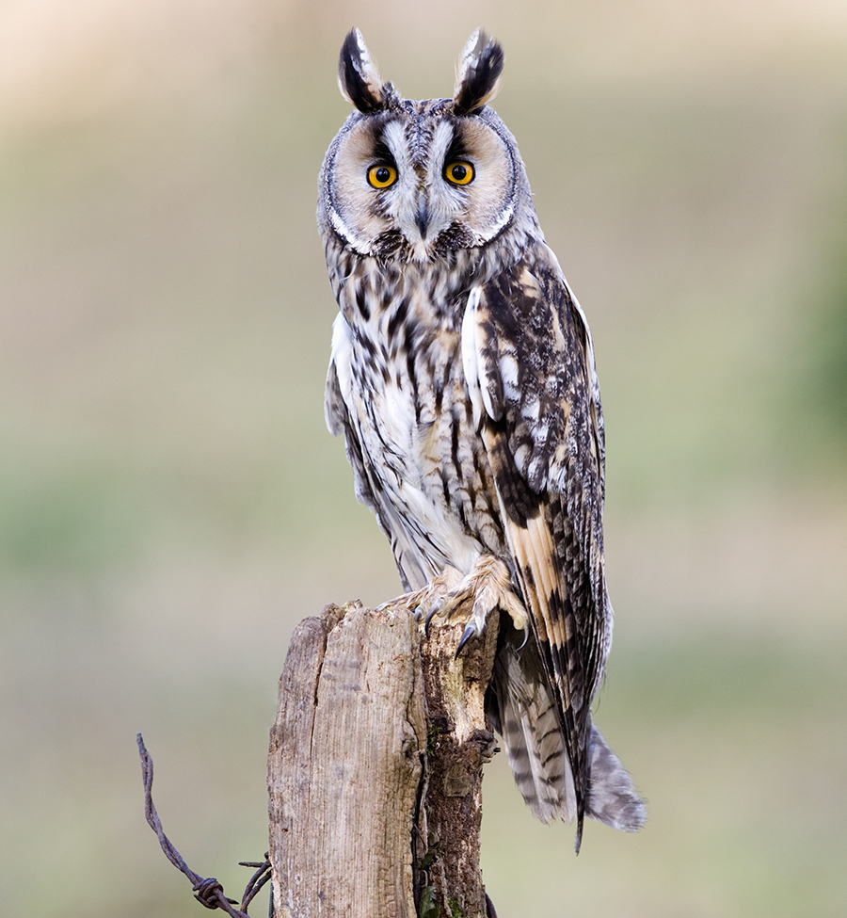
Notes:
Owl

Slide 29
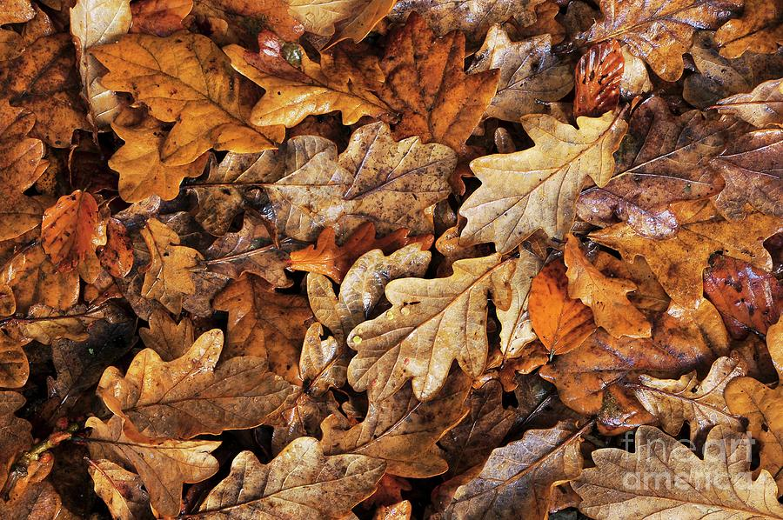
Notes:
Dead leaves

Slide 30
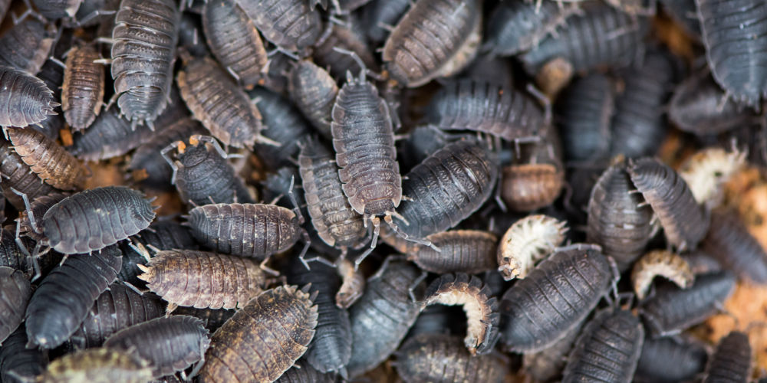
Notes:
Woodlice

Slide 31
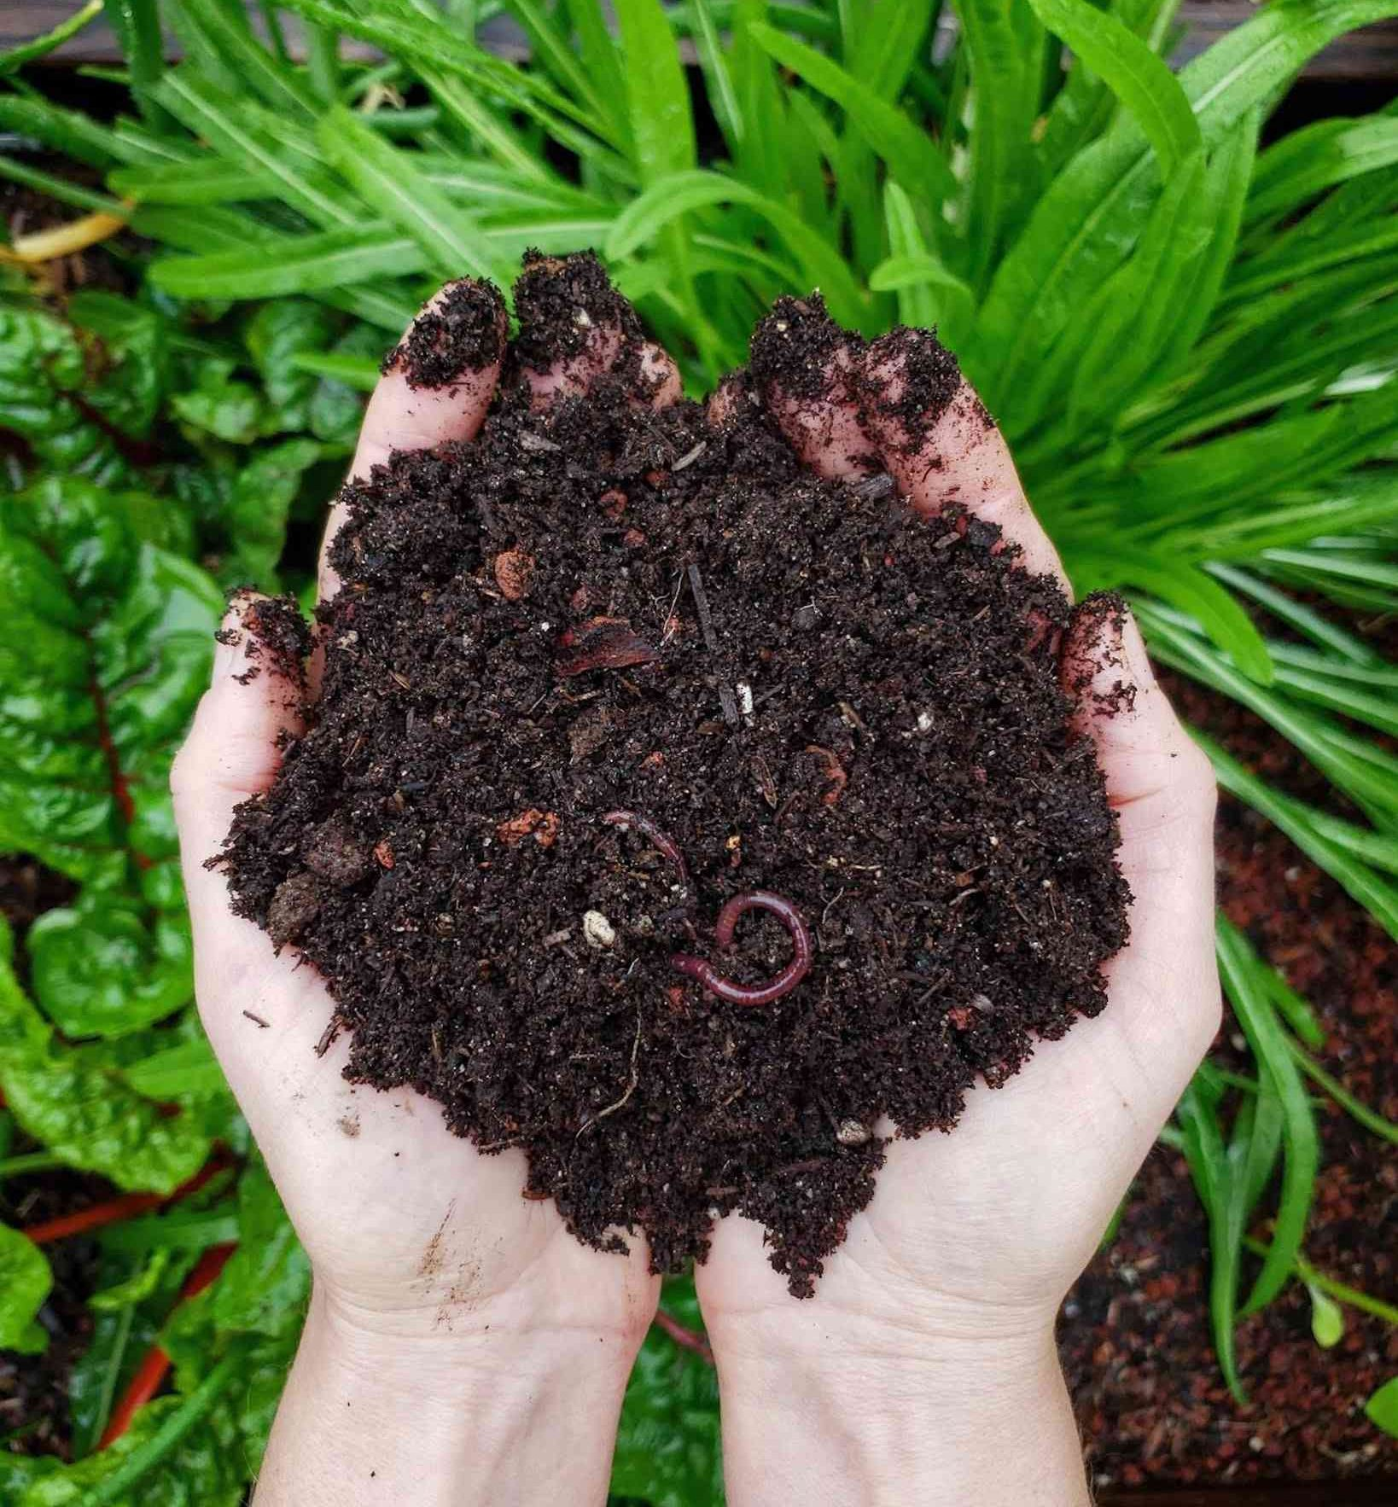
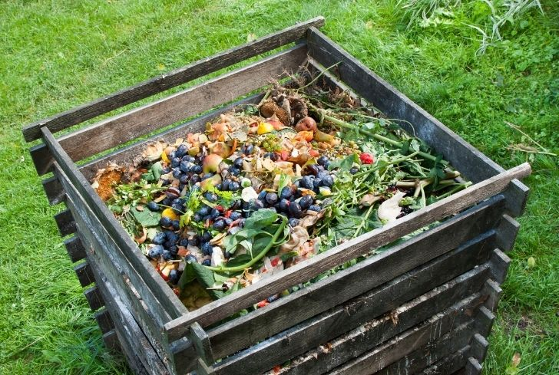

Slide 32
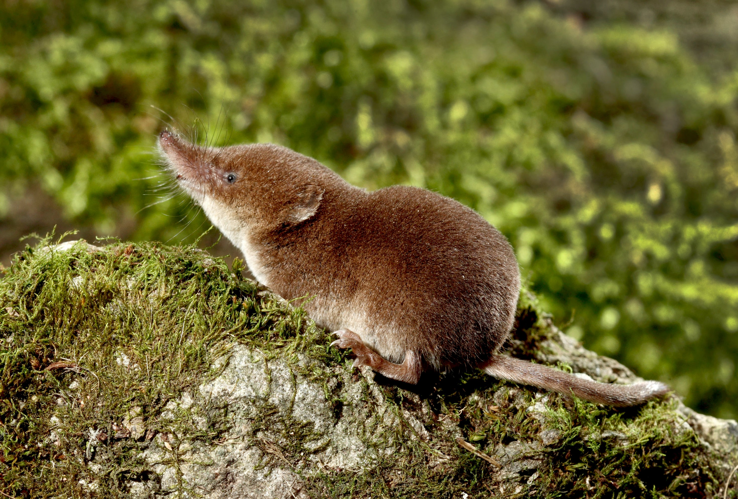
Notes:
Shrew

Slide 33
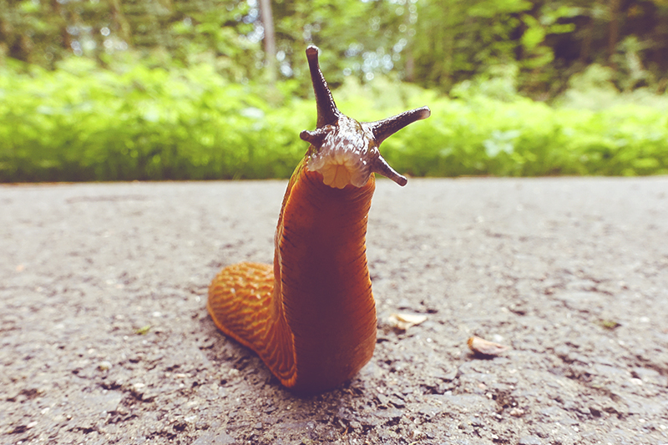
Notes:
Slug

Slide 34
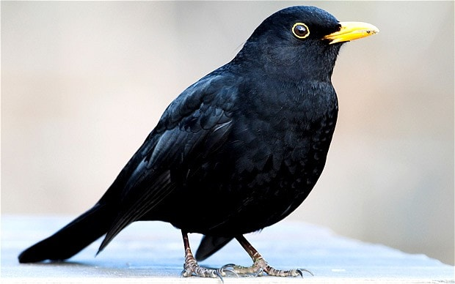
Notes:
Blackbird

Slide 35
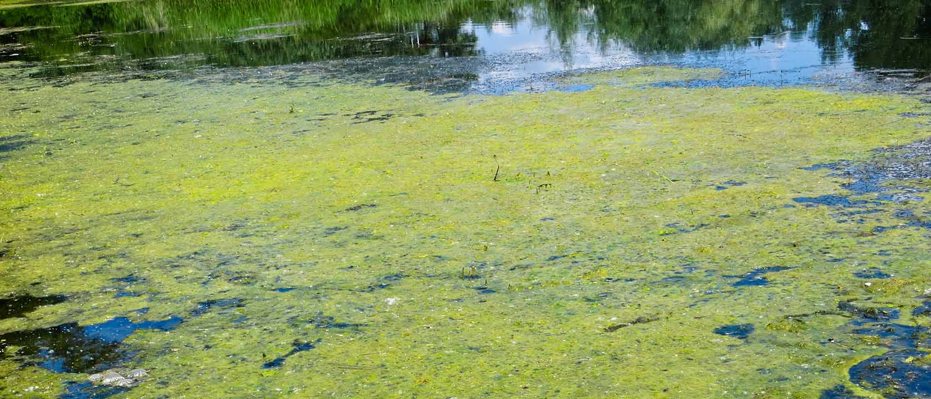
Notes:
Algae

Slide 36
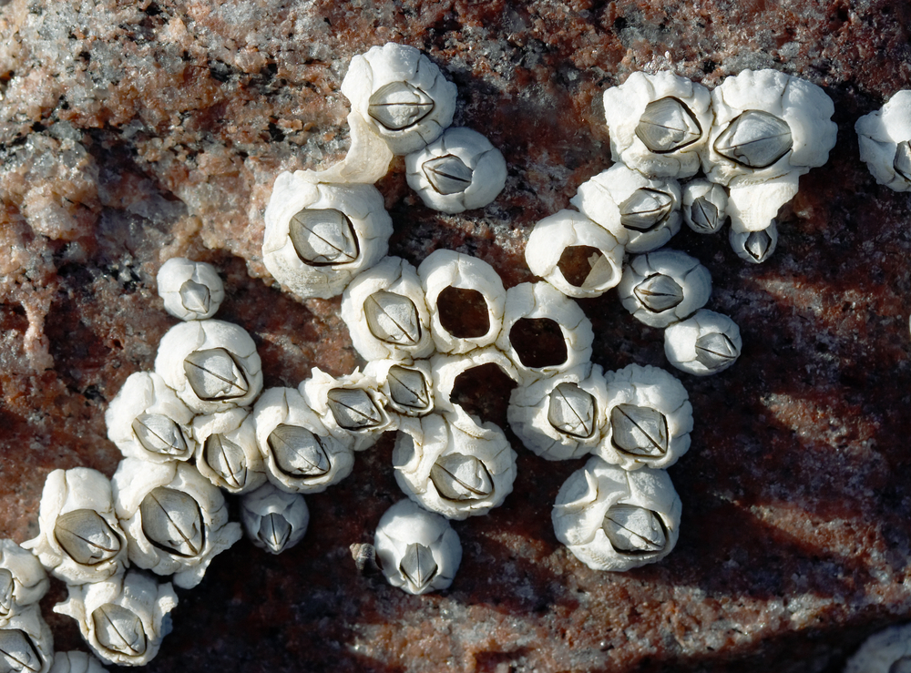
Notes:
barnacles

Slide 37
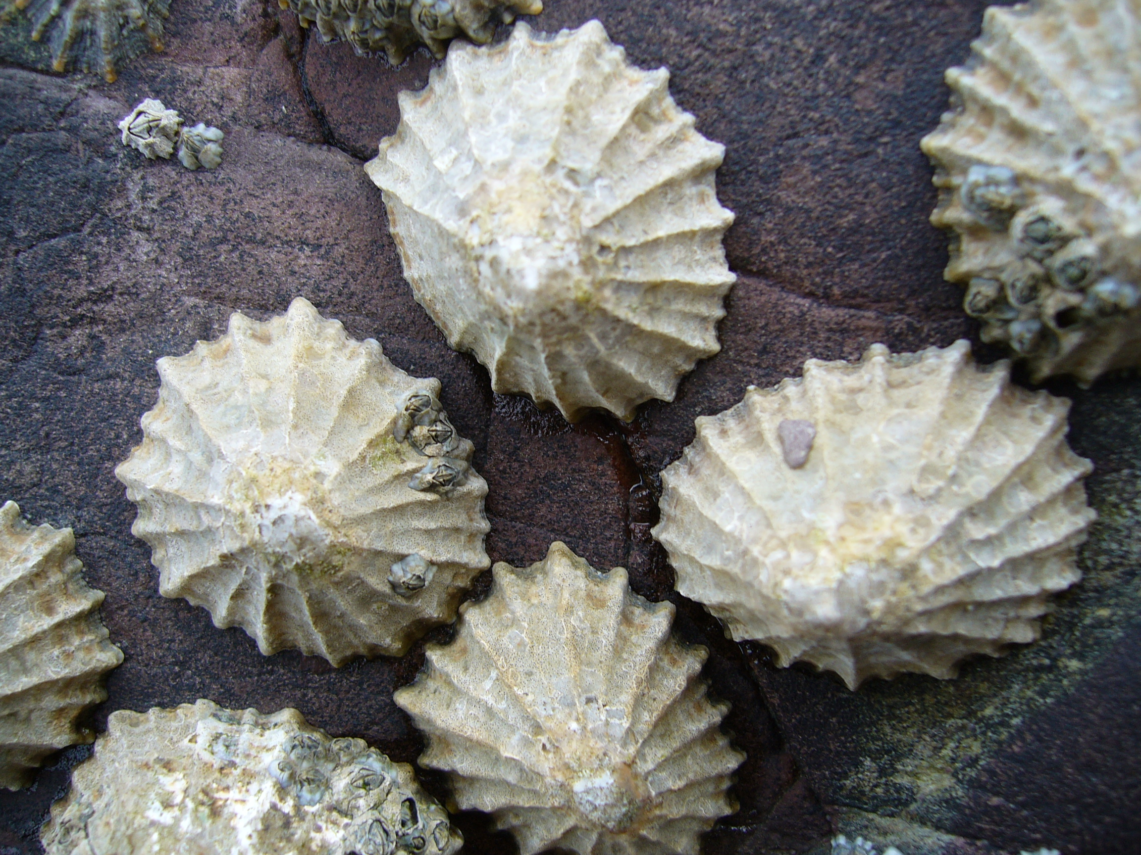
Notes:
Limpets

Slide 38
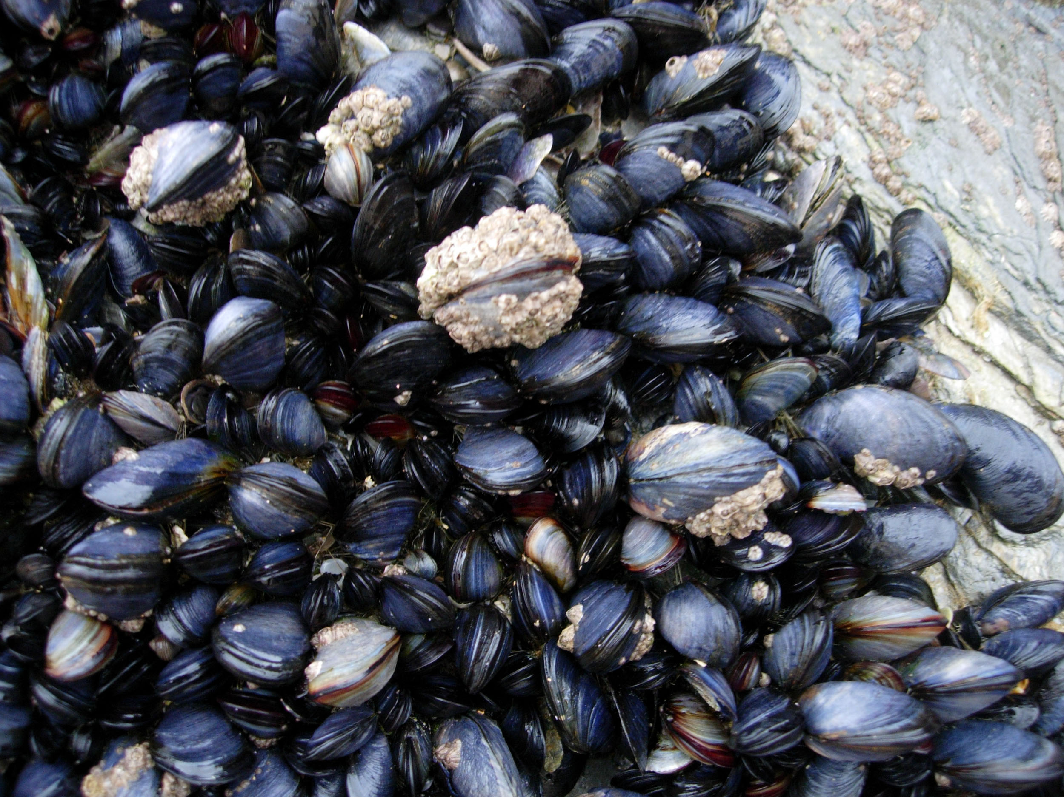
Notes:
Mussels

Slide 39
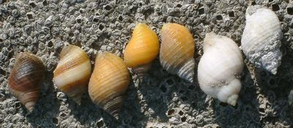
Notes:
Dog whelk

Slide 40
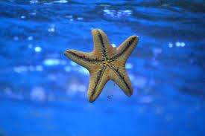
Notes:
Starfish

Slide 41
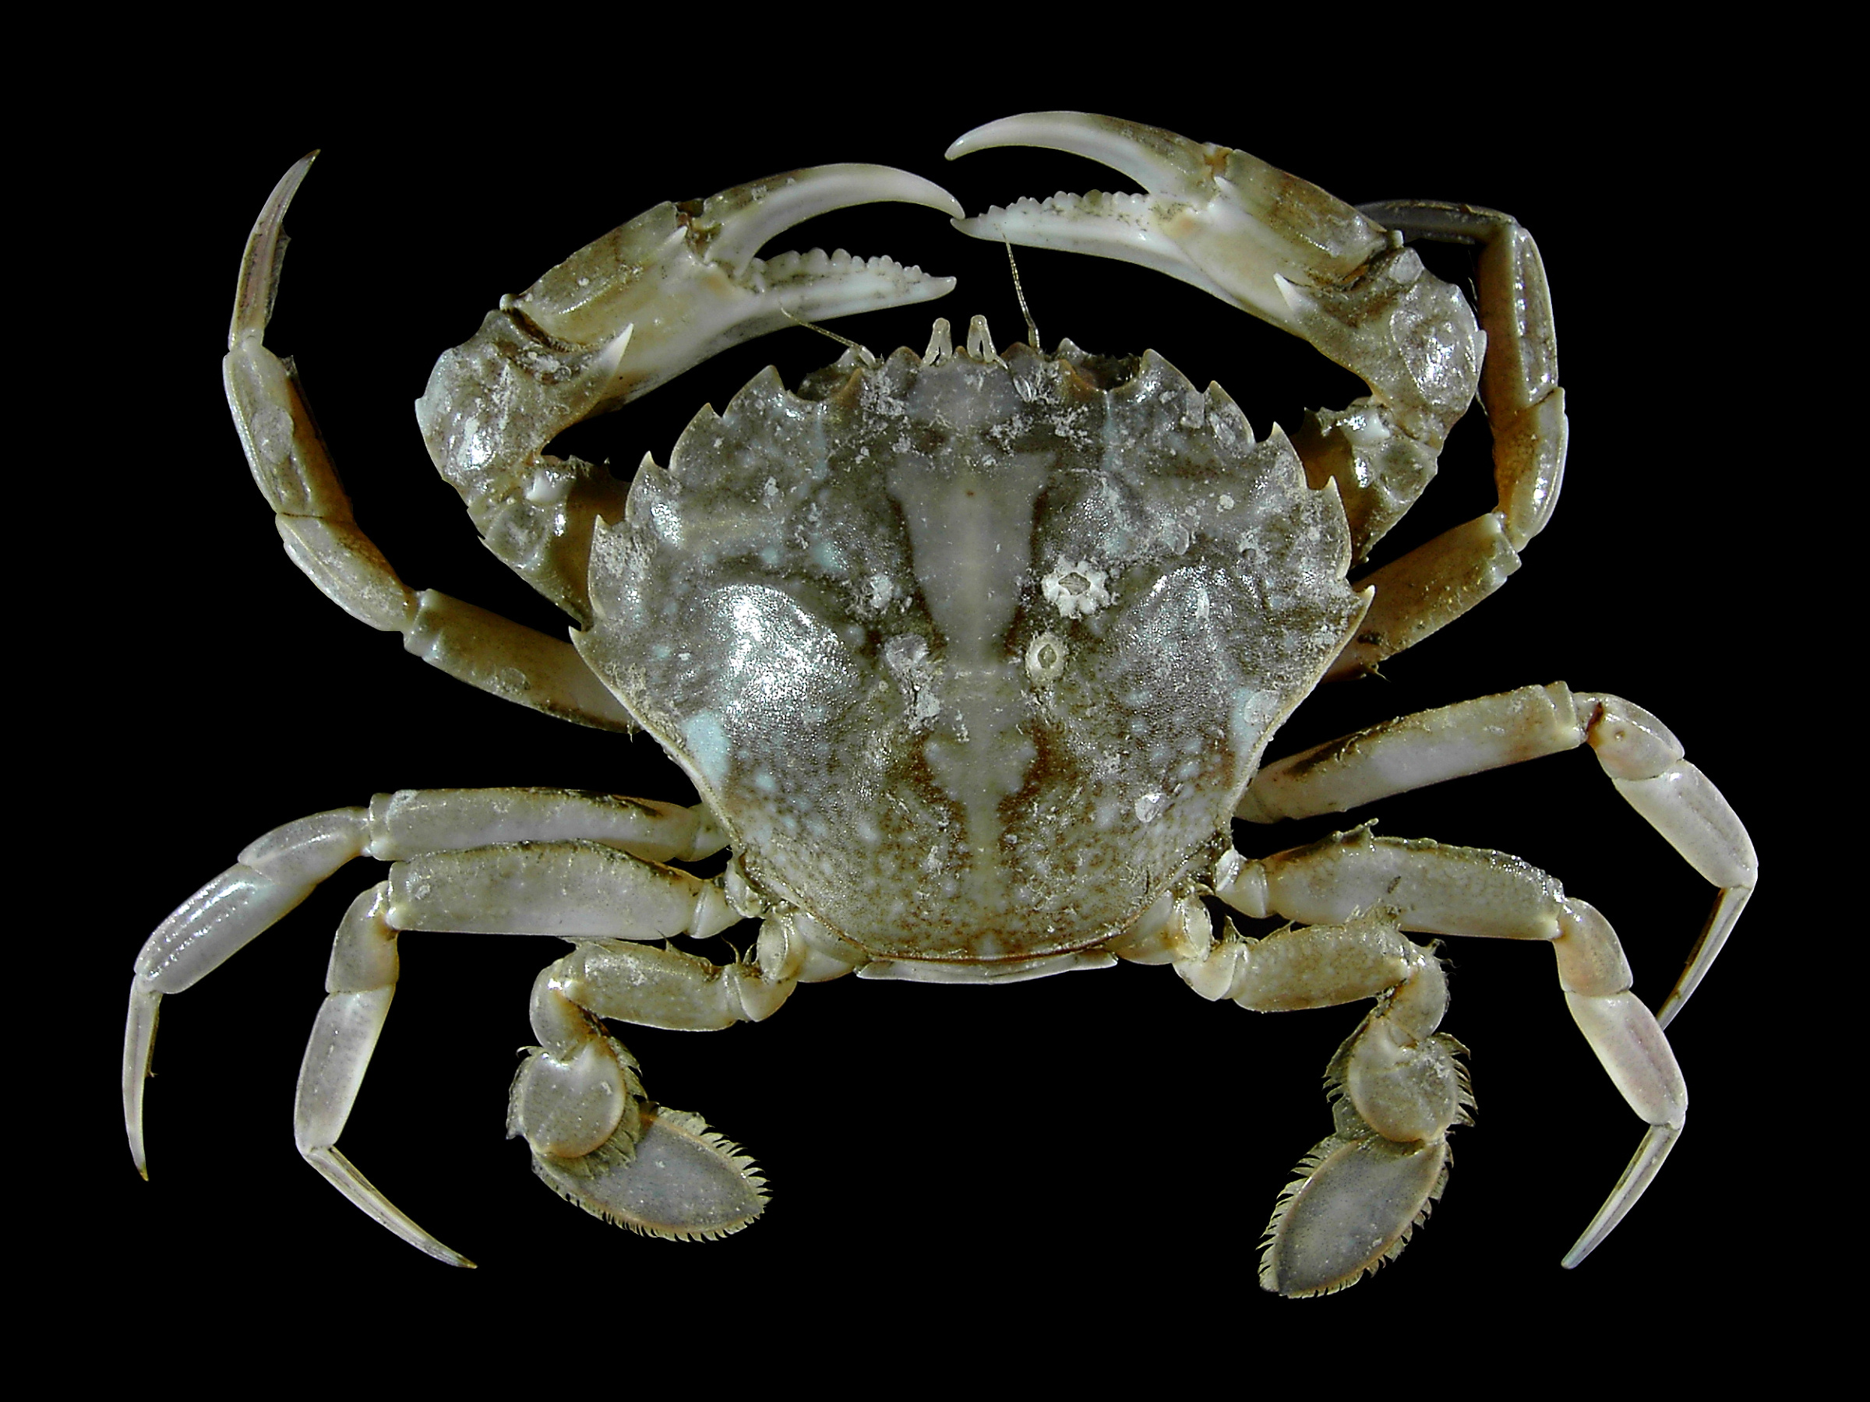
Notes:
Crabs

Slide 42
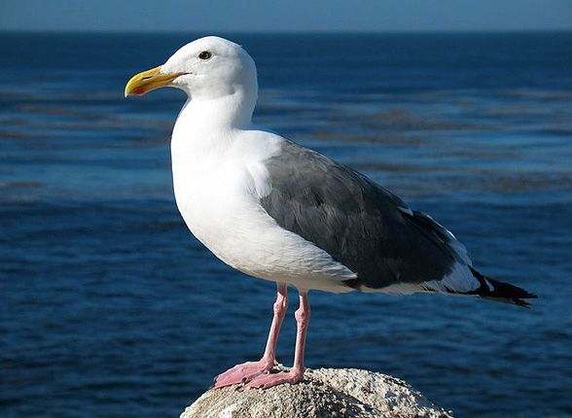
Notes:
Seabird

Slide 43
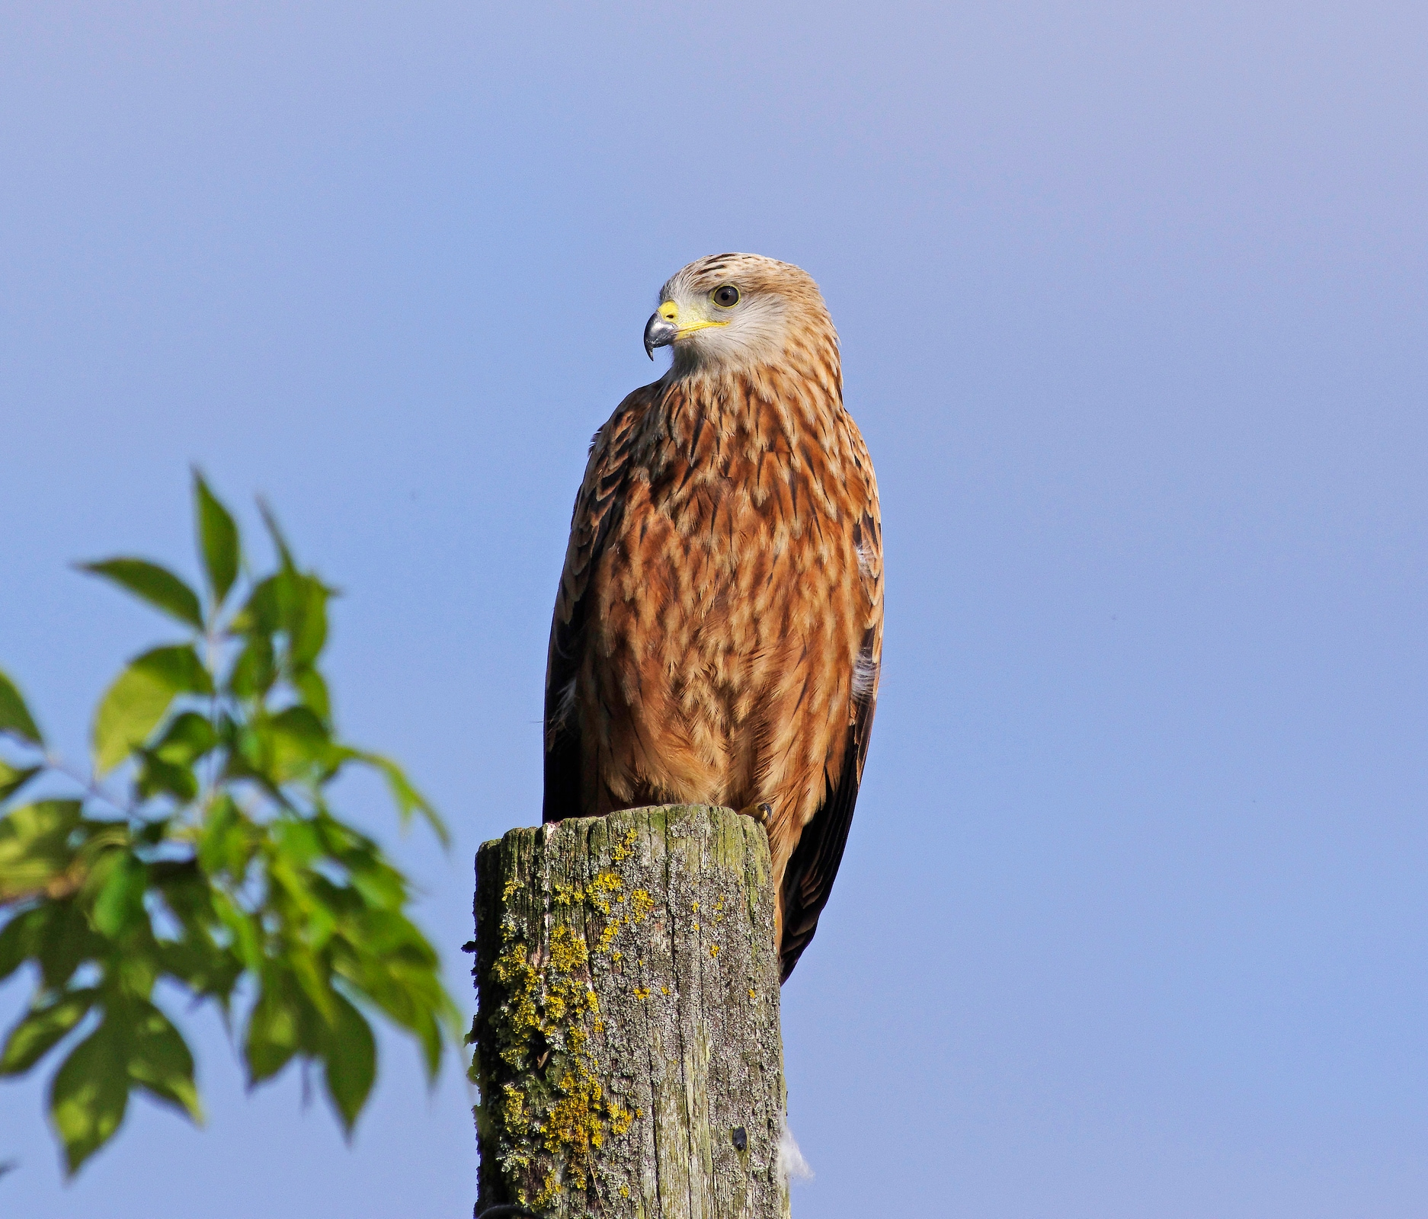
Notes:
Red kite

Slide 44
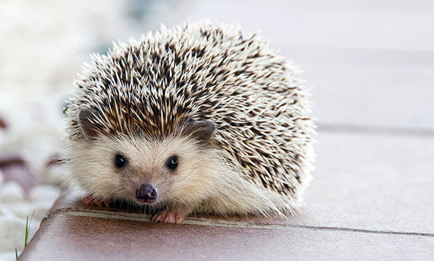
Notes:
Hedgehog

Slide 45
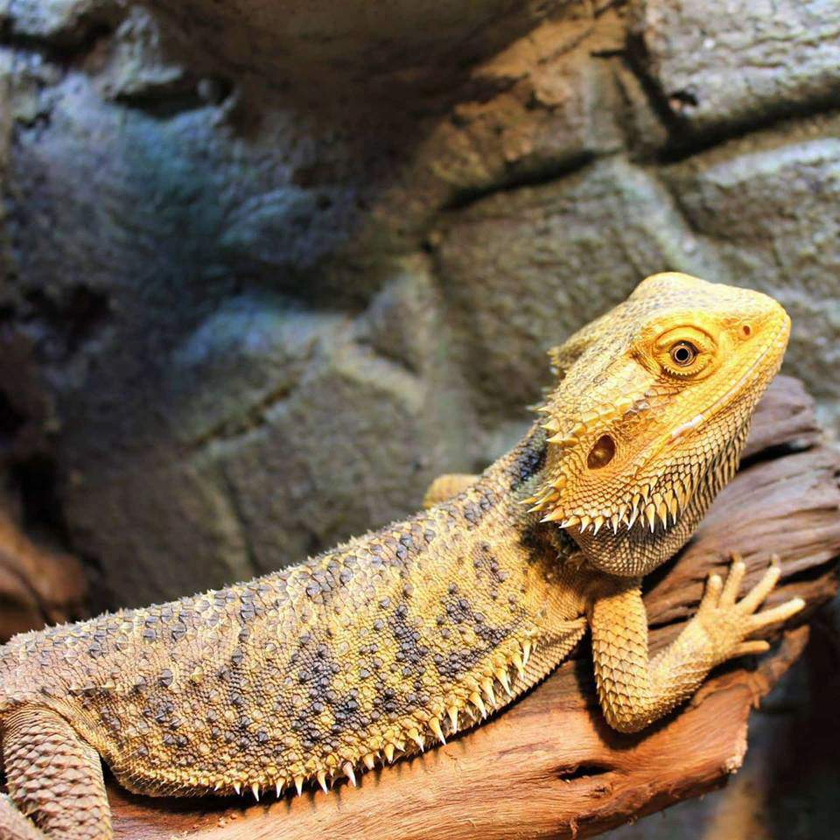
Notes:
Bearded dragons

Slide 46
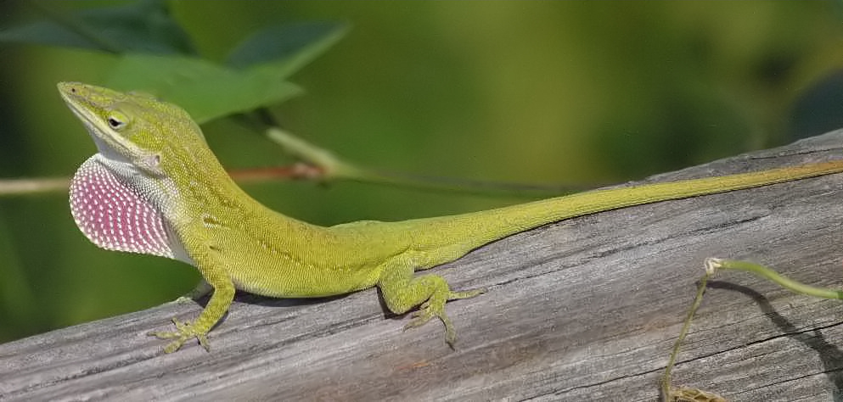
Notes:
Anolis lizard

Slide 47
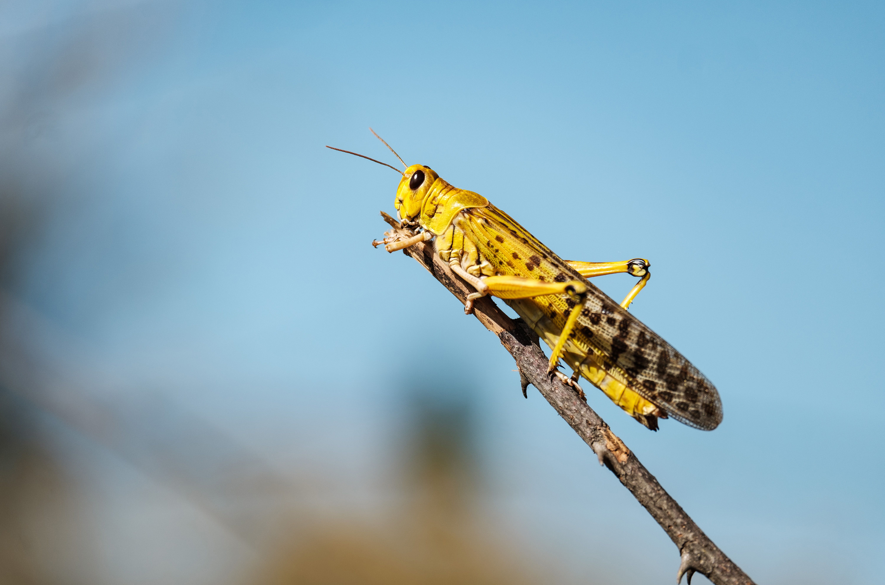
Notes:
Locust

Slide 48
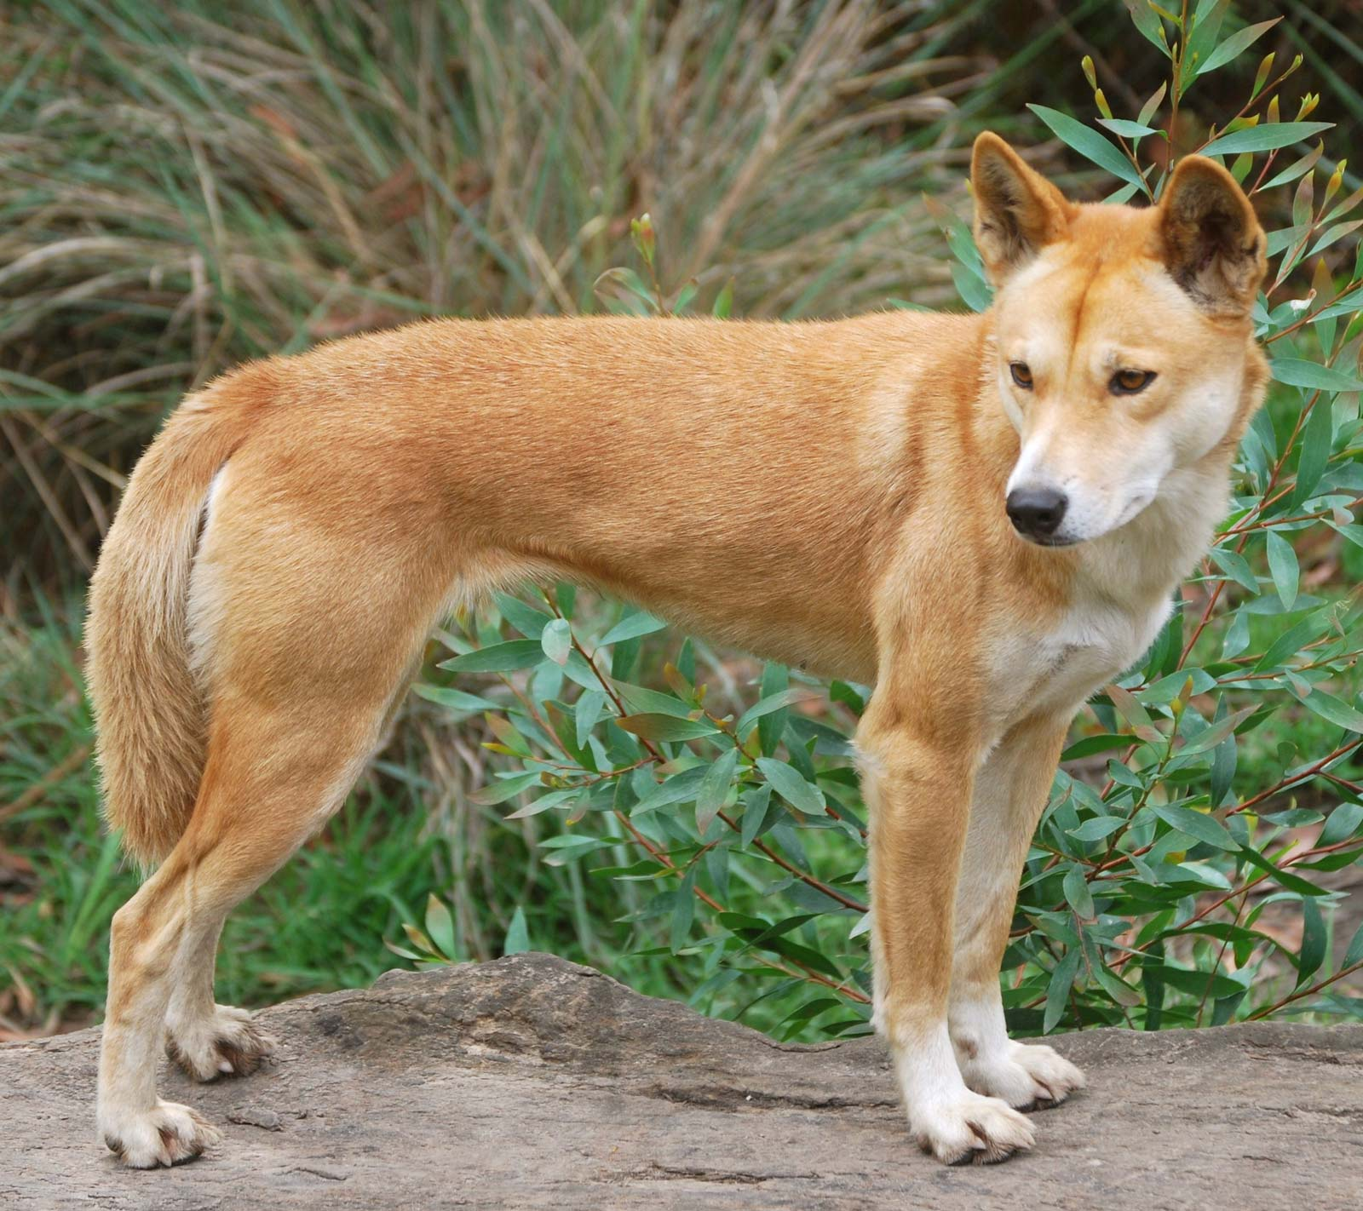
Notes:
Dingo

Slide 49
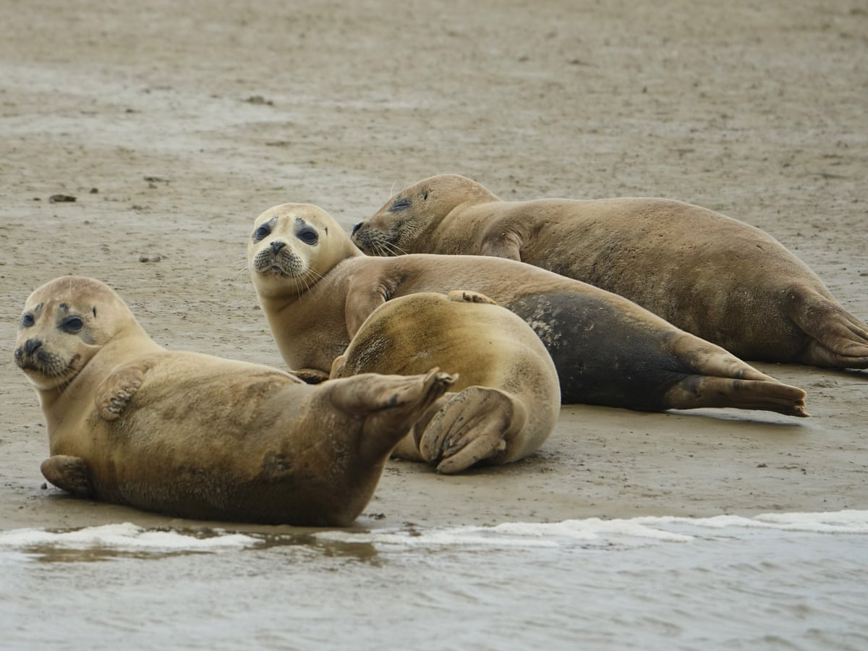
Notes:
Seals

Slide 50
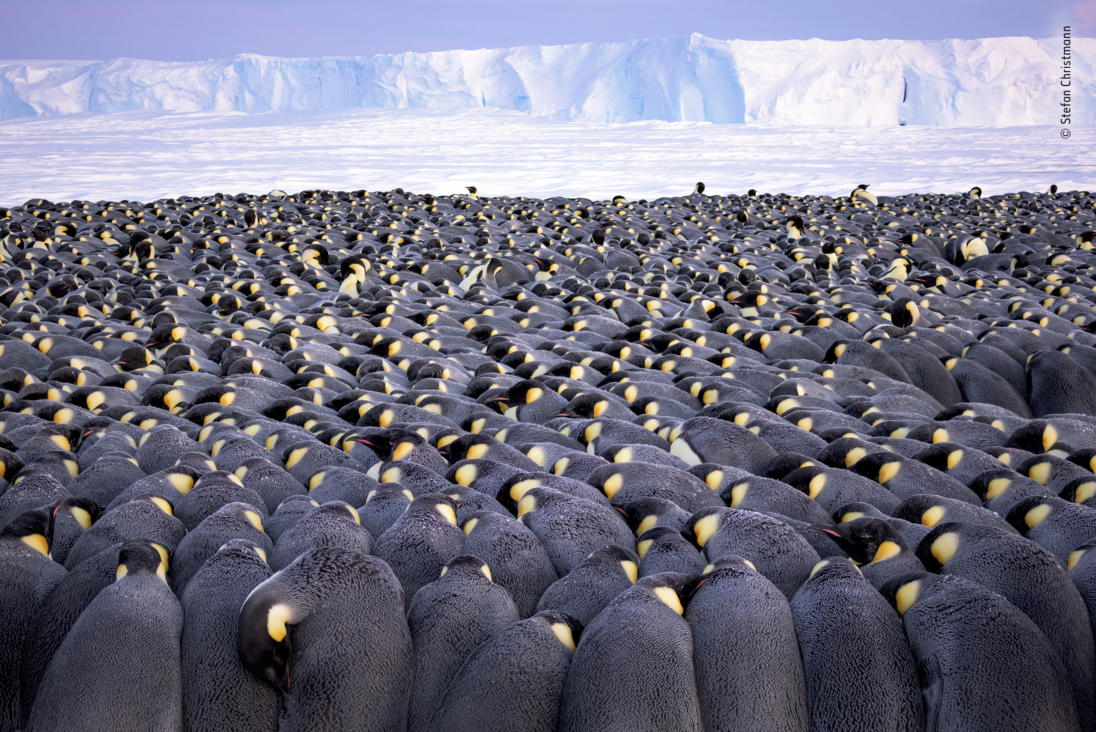
Notes:
Penguins huddling

Slide 51

Notes:
Walrus fight

Slide 52

Notes:
Male bowerbird

Slide 53

Notes:
Male kangaroos fighting

Slide 54

Notes:
Trees growing high to get to the light

Slide 55

Notes:
Wild horses

Slide 56

Notes:
Red squirrel

Slide 57

Notes:
Acorns

Slide 58

Notes:
Grey squirrel

Slide 59

Notes:
Pine marten

Slide 60

Notes:
Hyracotherium

Slide 61

Notes:
Oysters

Slide 62

Notes:
Polar bear (Ursus maritimus)

Slide 63

Notes:
Cactus

Slide 64

Notes:
Kakapo

Slide 65

Notes:
Galapagos giant tortoise

Slide 66

Notes:
Ash tree infected with dieback

Slide 67

Notes:
Axolotl

